Slide 1


Time Series Analysis From the Ground Up
Bruno Gonçalves www.data4sci.com/newsletter
https://github.com/DataForScience/Timeseries_long

Slide 2



Slide 4






Slide 5
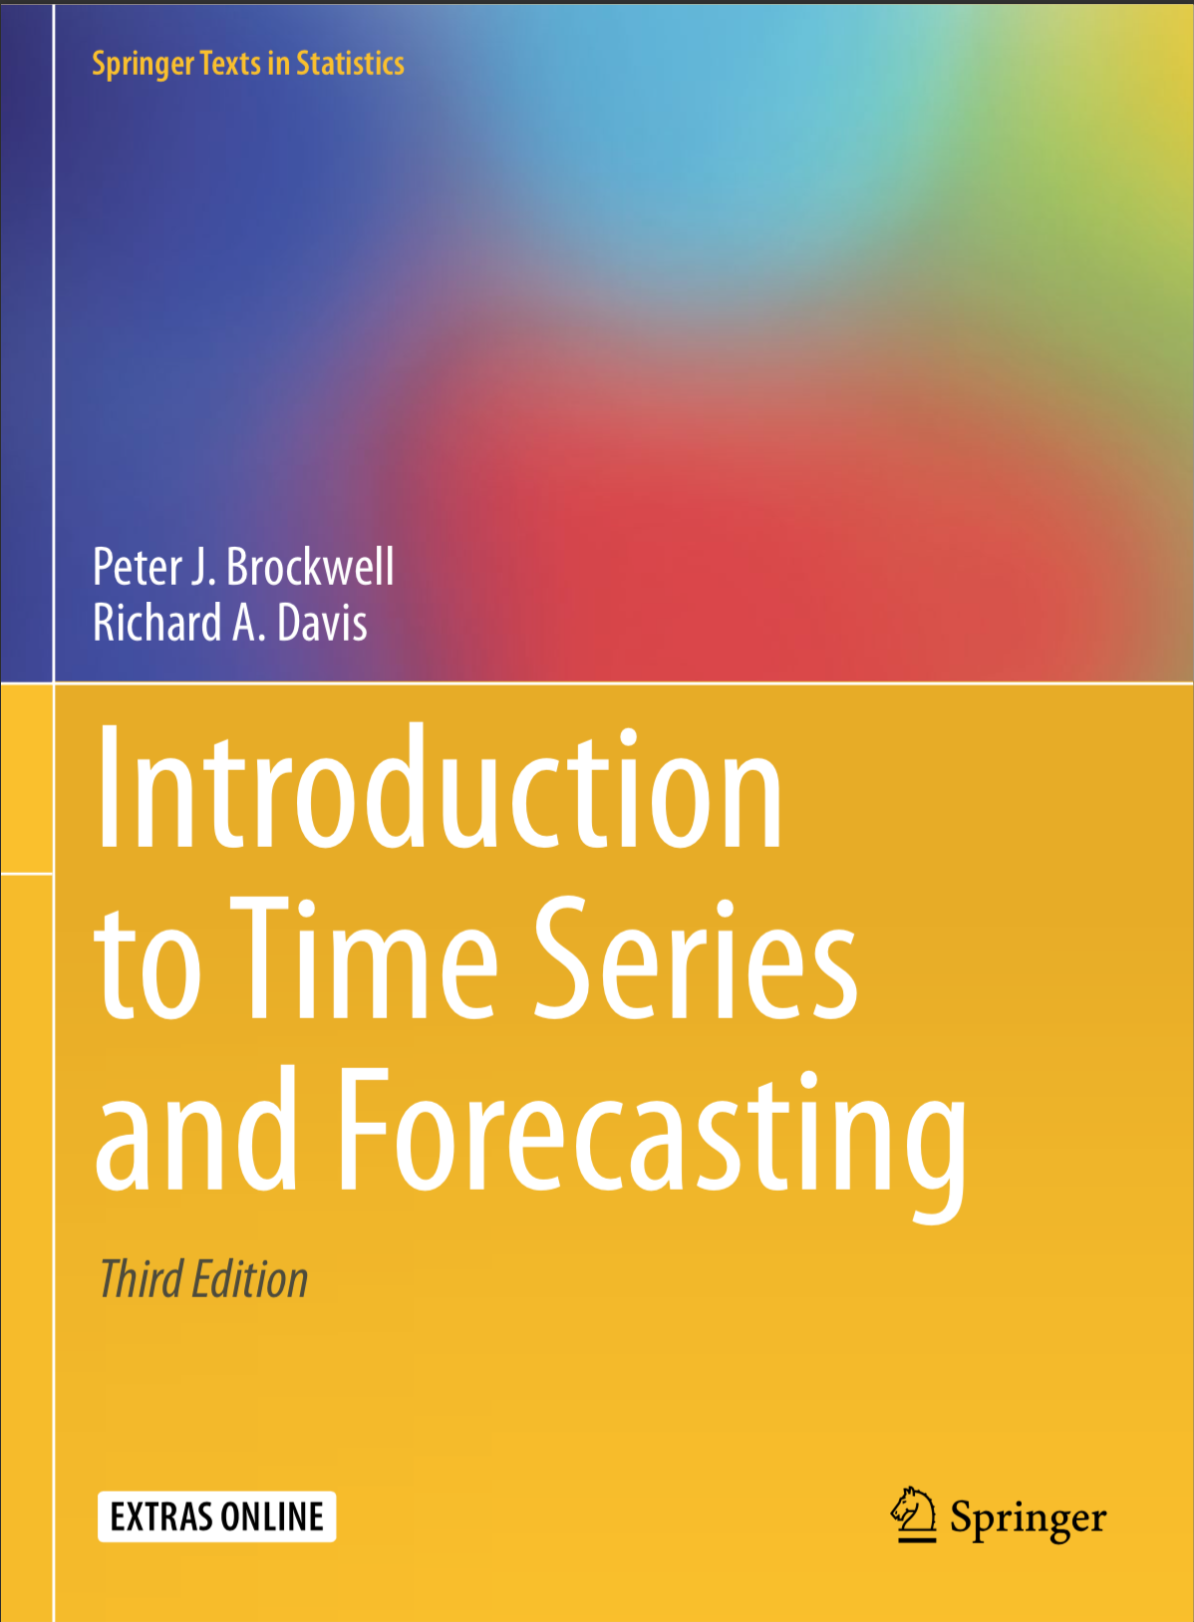
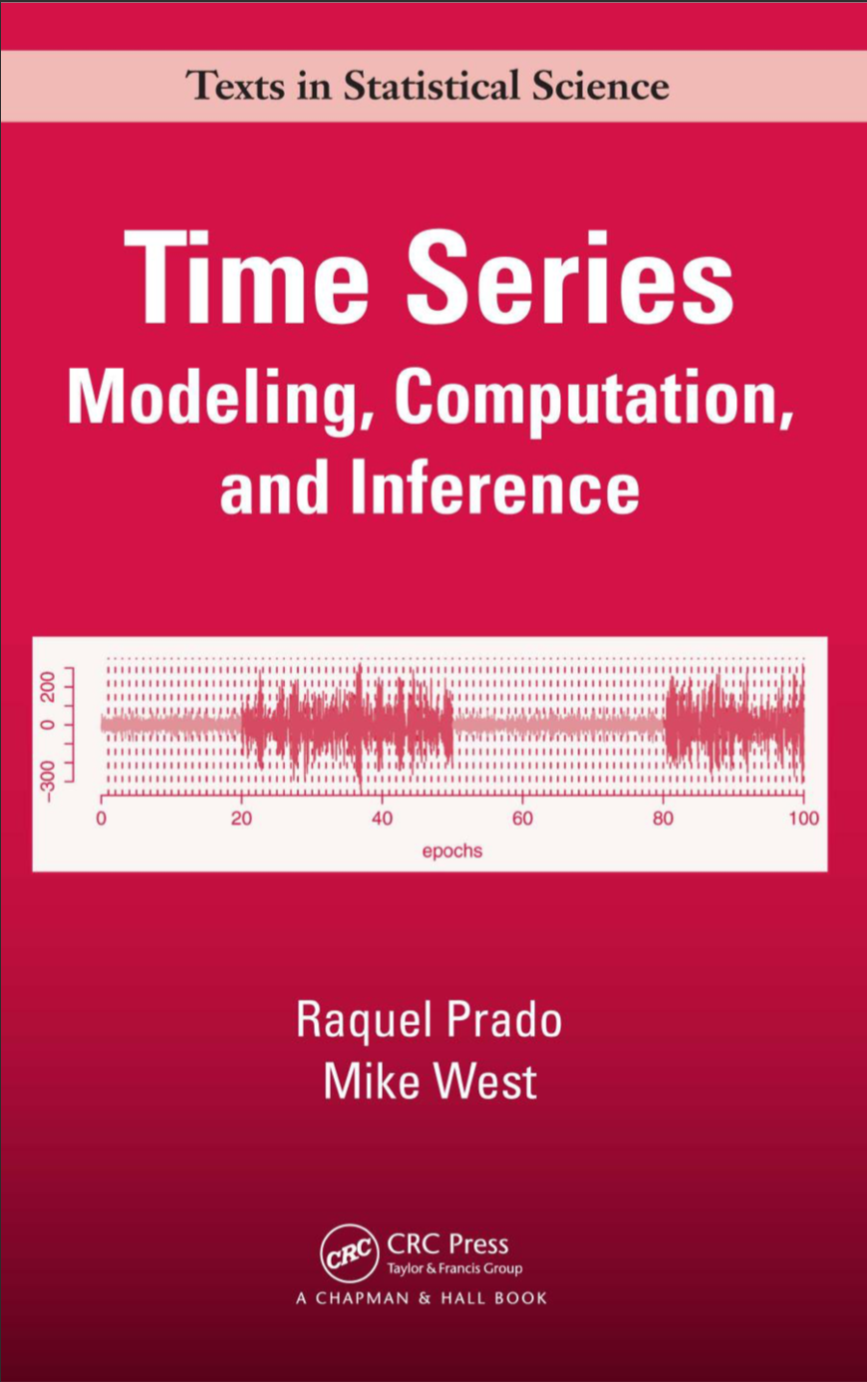
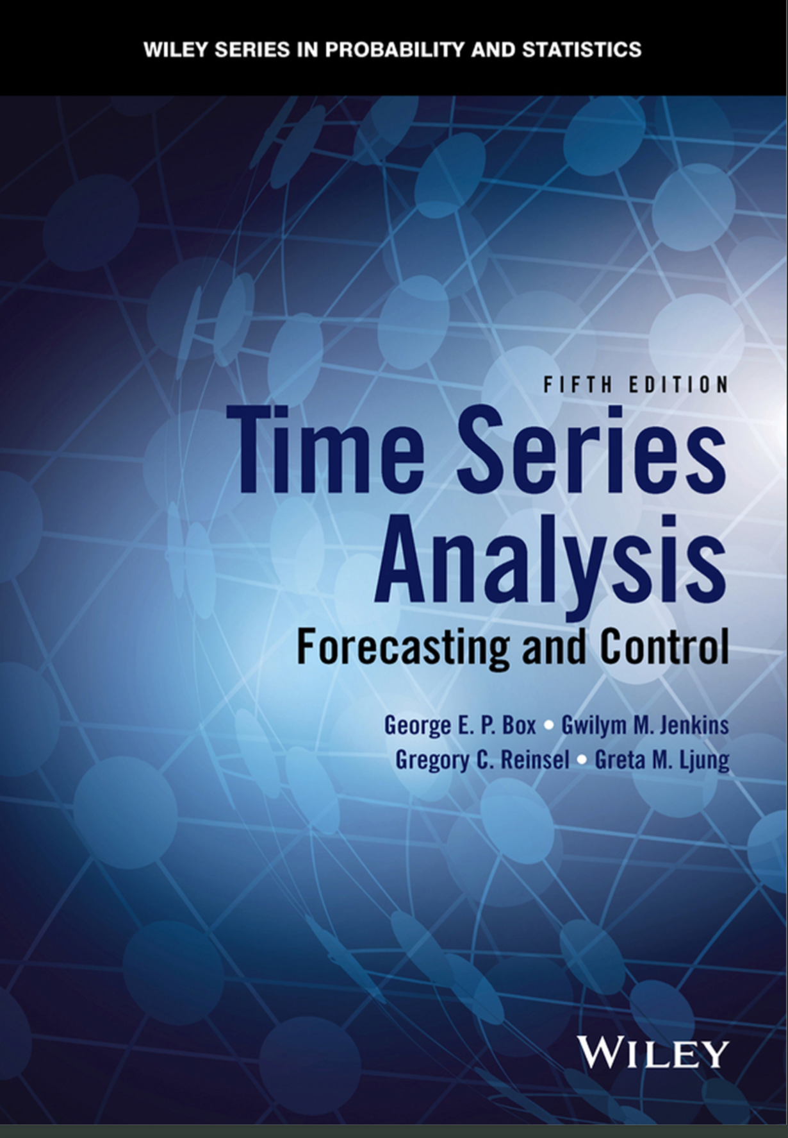
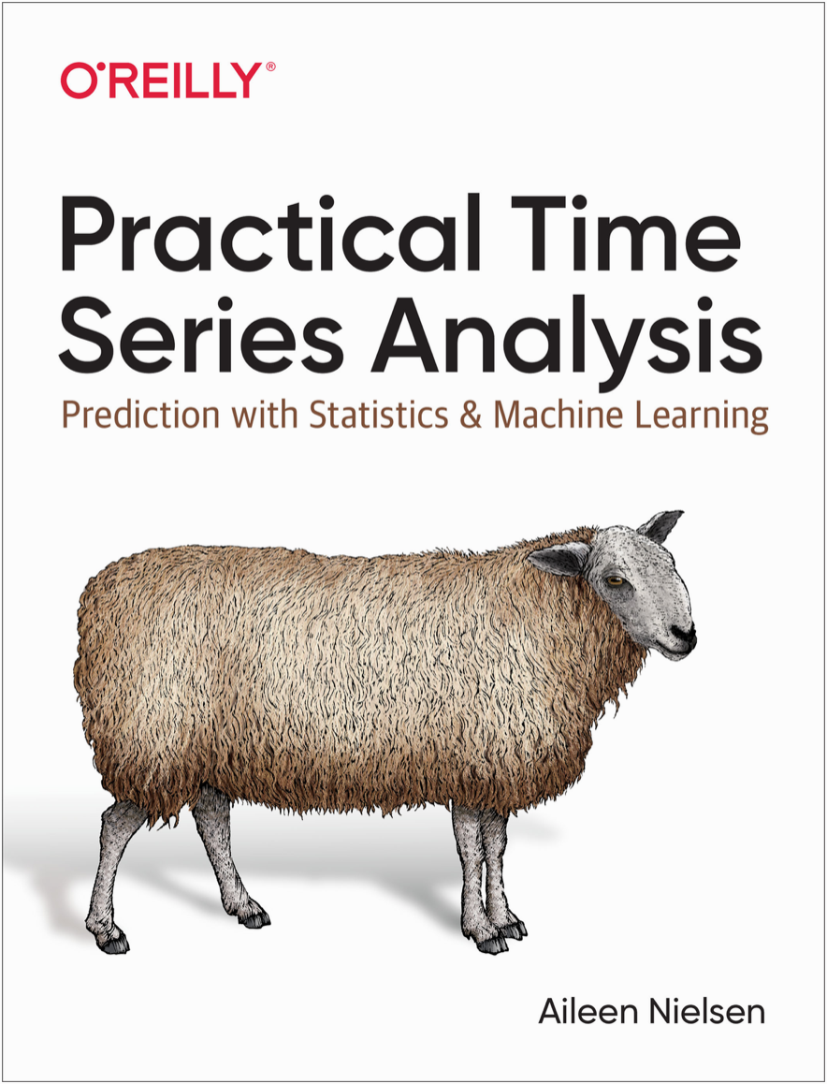
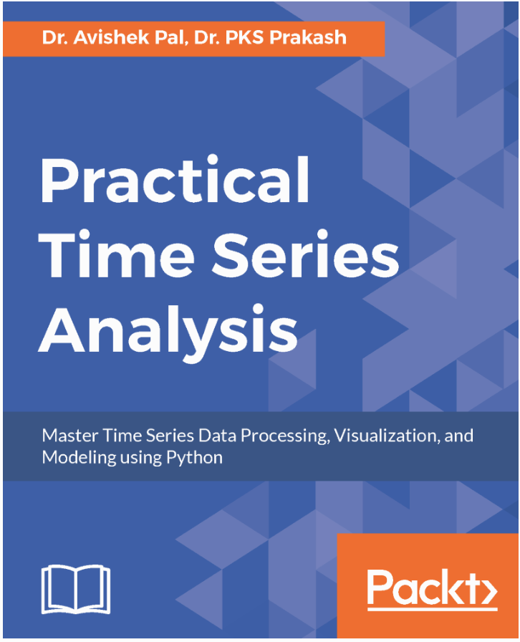
References

Slide 6
Time series examples

Slide 7
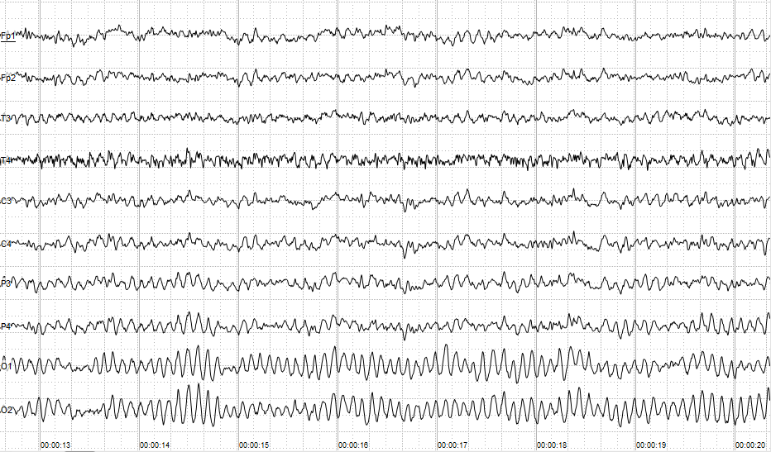
Medicine - EEG
https://en.wikipedia.org/wiki/Electroencephalography

Slide 8
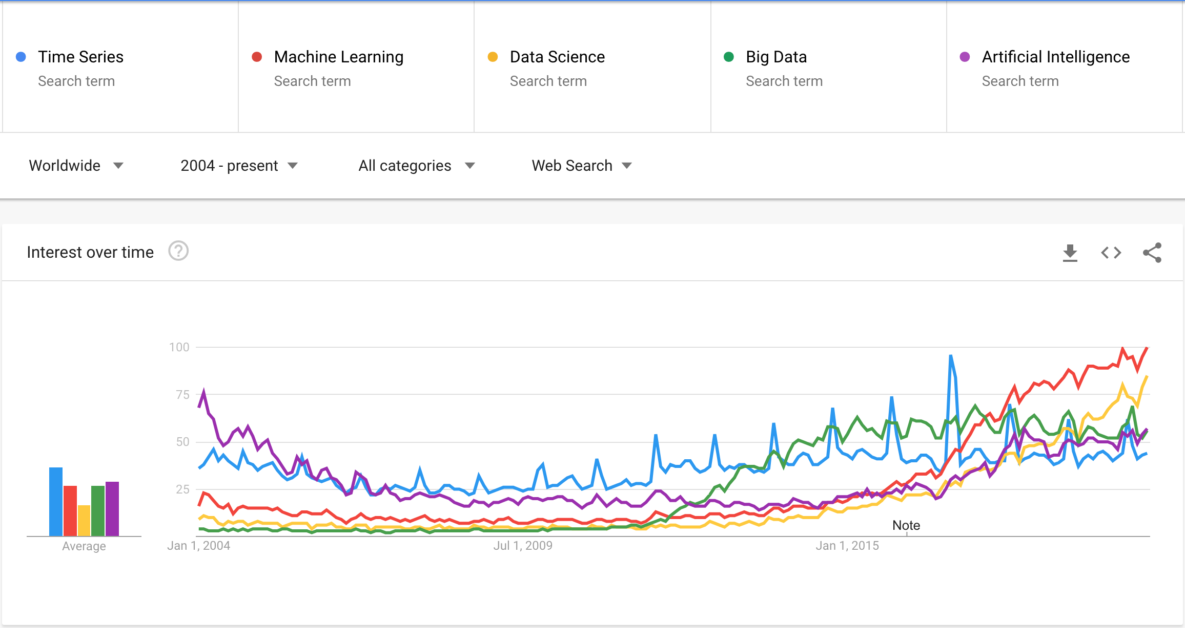
Public Interest - Search Trends

Slide 9
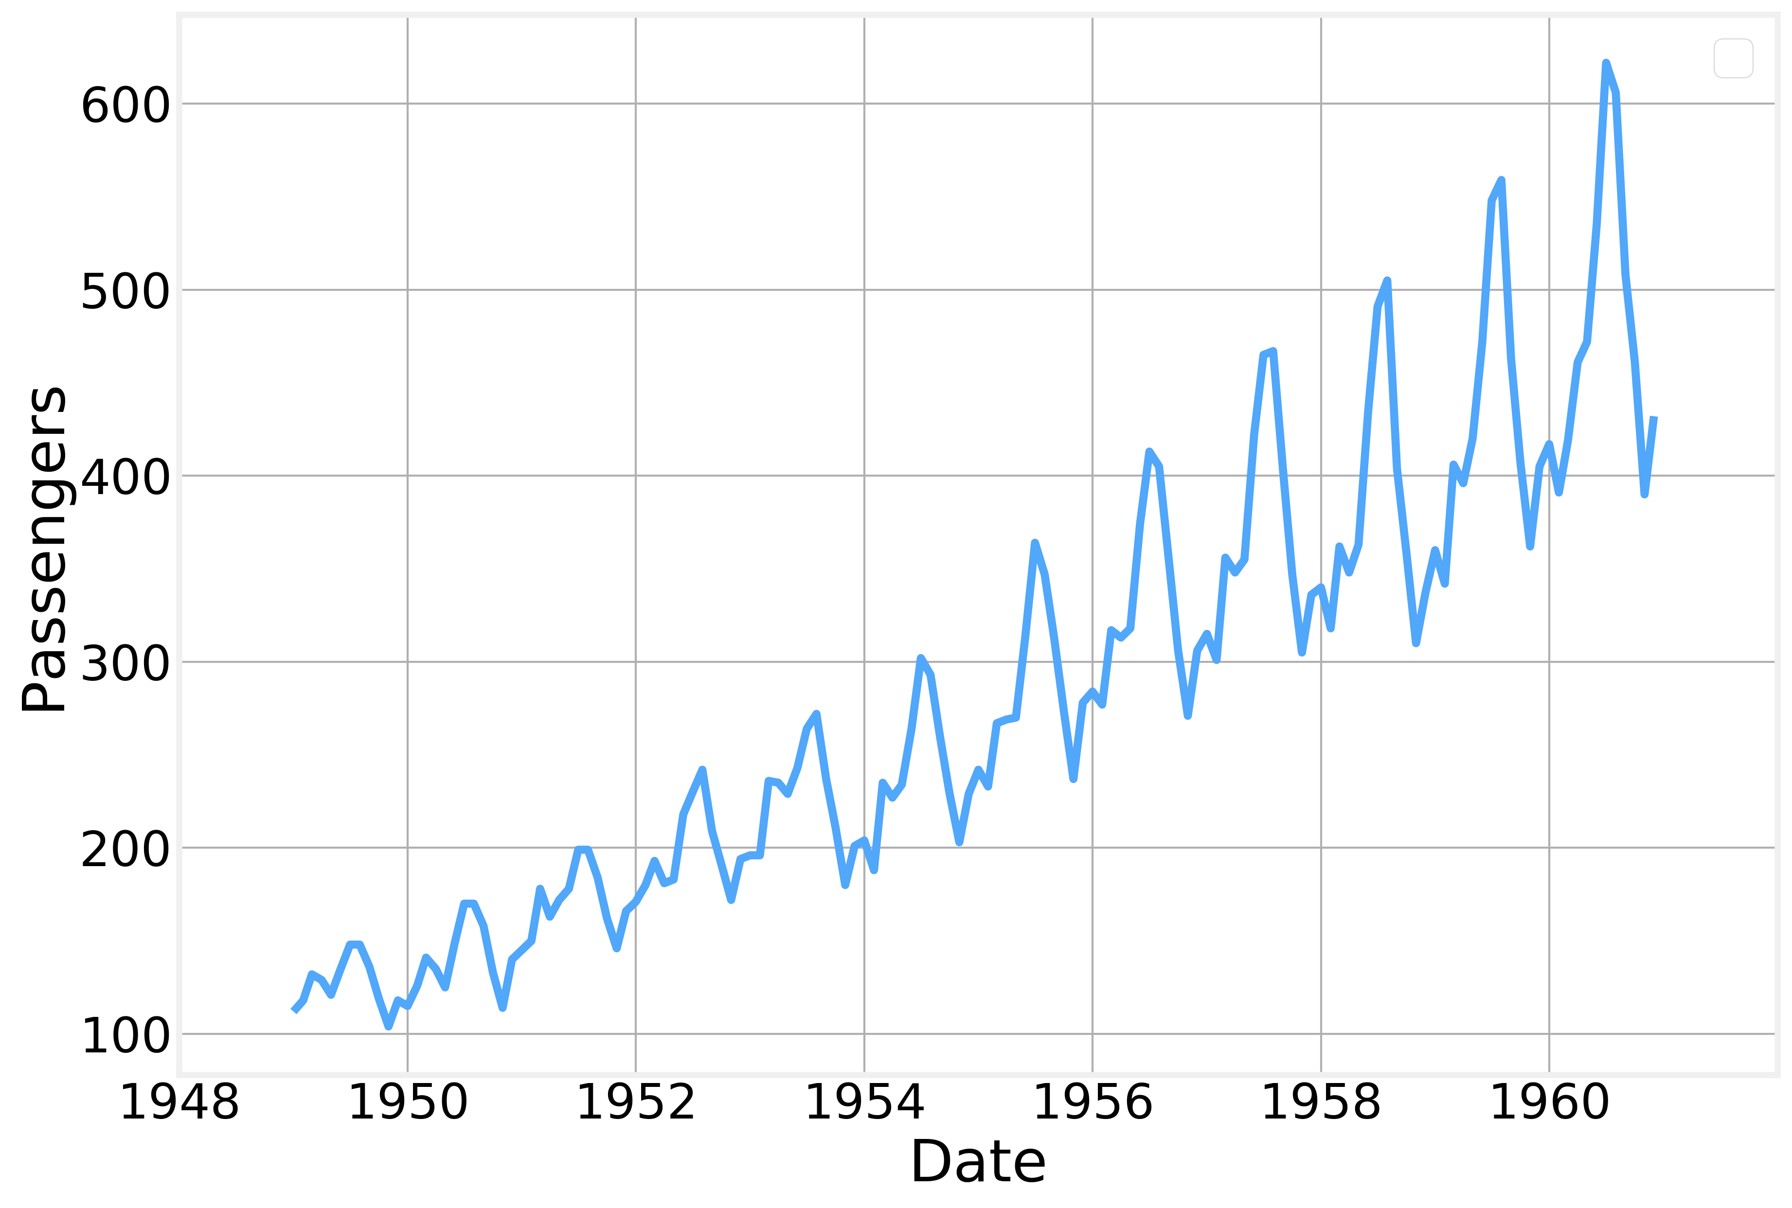
Logistics - Airline Passengers
https://www.kaggle.com/chirag19/air-passengers

Slide 10
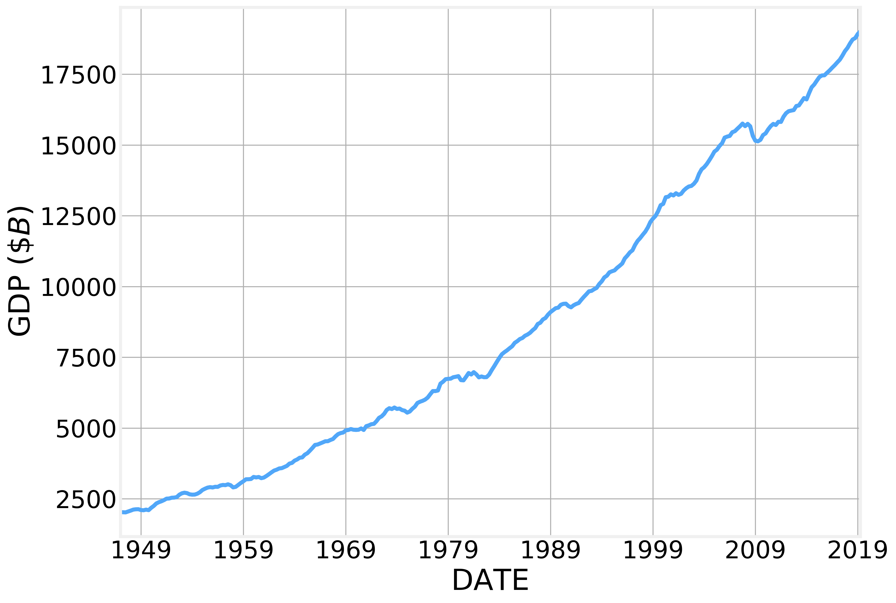
Economics - GDP
https://fred.stlouisfed.org/series/GDPC1

Slide 11
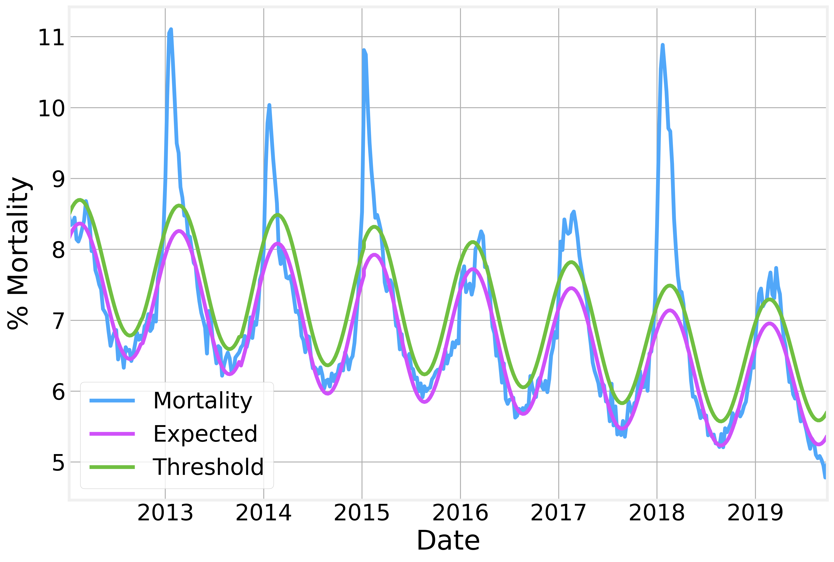
Epidemiology - Influenza
www.cdc.gov/flu/weekly/

Slide 12
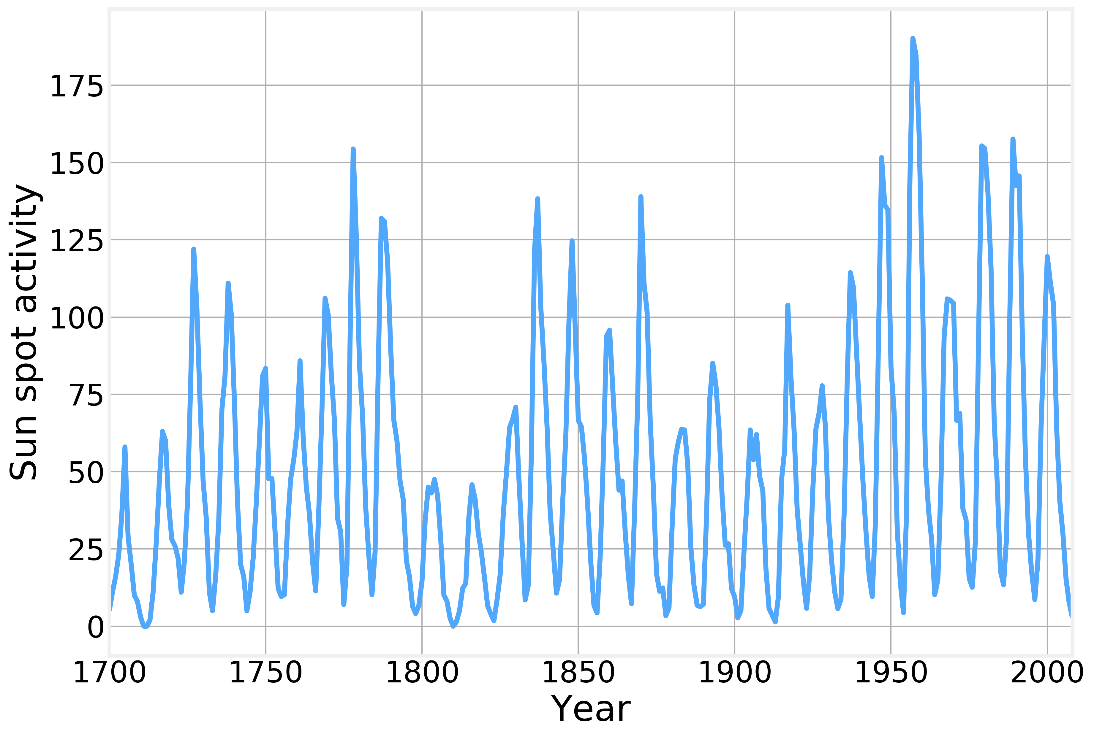
Astronomy - Sunspot activity
http://www.sidc.be/silso/datafiles

Slide 13
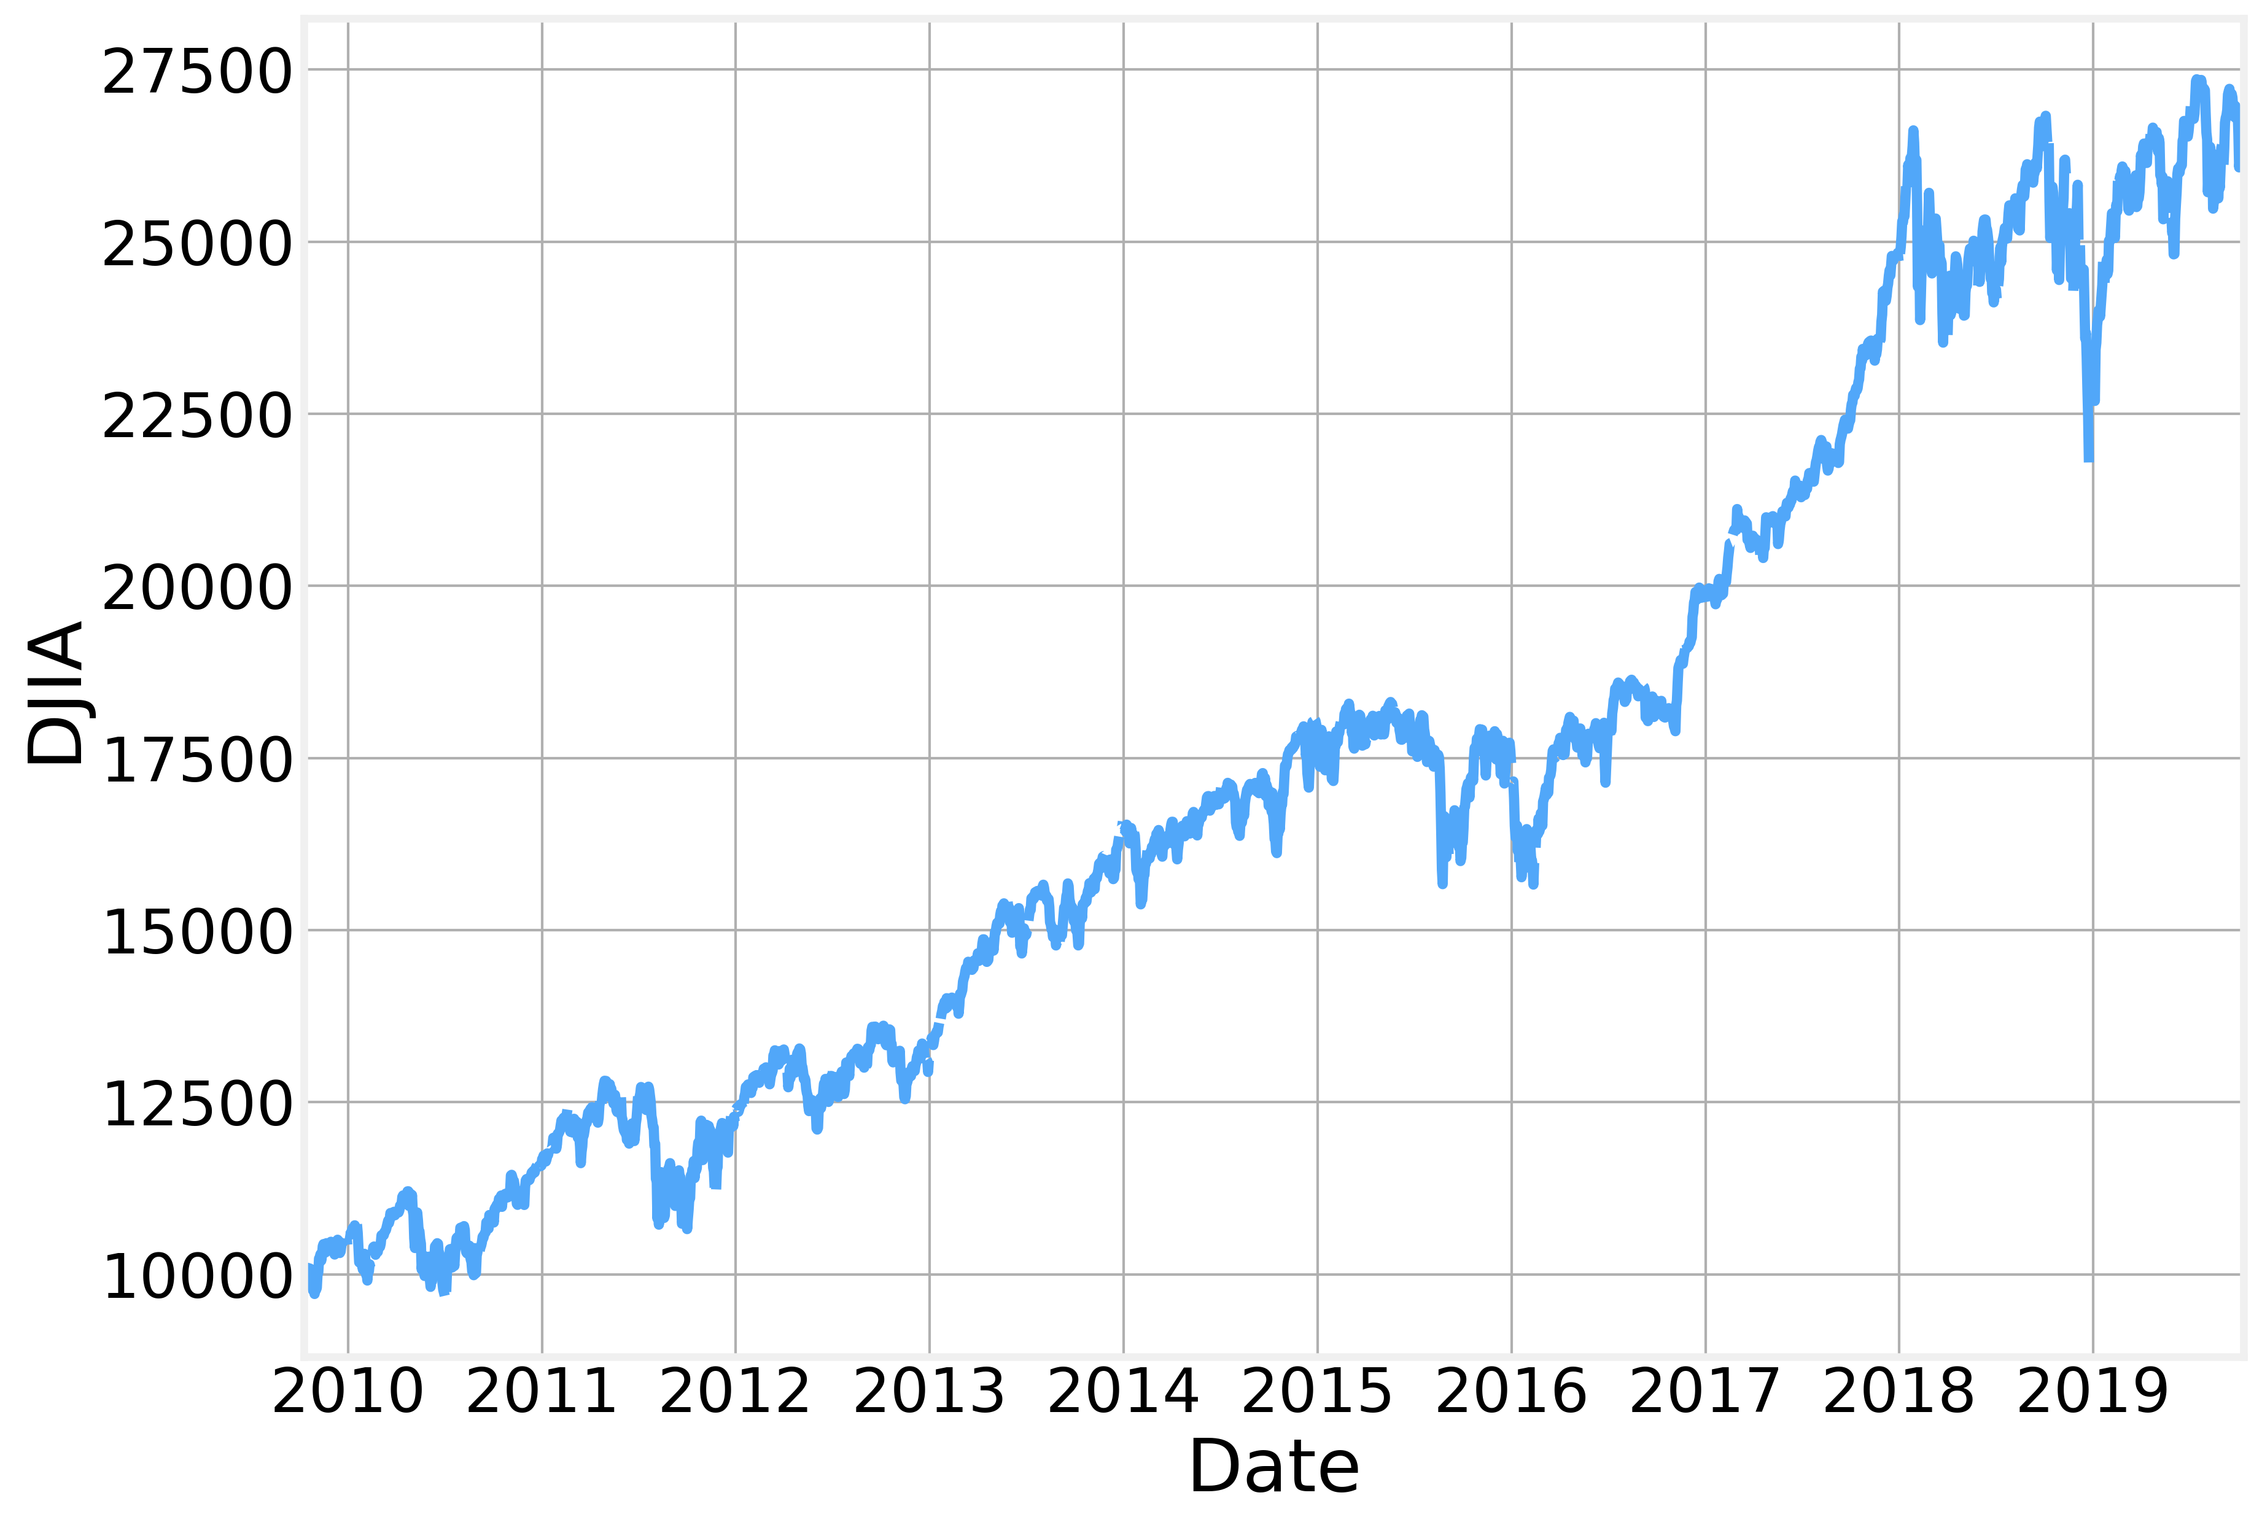
Stock Market - DJIA
https://fred.stlouisfed.org/series/DJIA

Slide 14
Pandas Review

Slide 15
pandas
pandas.pydata.org
Created by Wes McKinney in 2008 while working for AQR Capital Management, currently working at Two Sigma and Ursa Labs
Pandas is specifically designed to handle time series and data frames
High performance, flexible tool for quantitative analysis on financial data
The functionality is built on top numpy and matplotlib (see next lecture)
The fundamental data structures are Series (1-dimensional) and DataFrame (2-dimensional).
Each column of a DataFrame can have a different dtype but all the elements in a column (or Series) must be of the same dtype
Conventionally imported as

Slide 16
Series and Data Frames
A Series is conceptually equivalent to a numpy array with some extra information (column and row names, etc)
A DataFrame can be thought of as the union of several Series, with names associated.
Similarly, you can think of a DataFrame as an Excel sheet and of a Series as an individual column
A minimal DataFrame implementation would be a dict where each element is a list
Series
Series
DataFrame
 | id
0 | 23
1 | 42
2 | 12
3 | 86
 | Name
0 | “Bob”
1 | “Karen”
2 | “Kate”
3 | “Bill”
A | id | Name
0 | 23 | “Bob”
1 | 42 | “Karen”
2 | 12 | “Kate”
3 | 86 | “Bill”
+
=

Slide 17
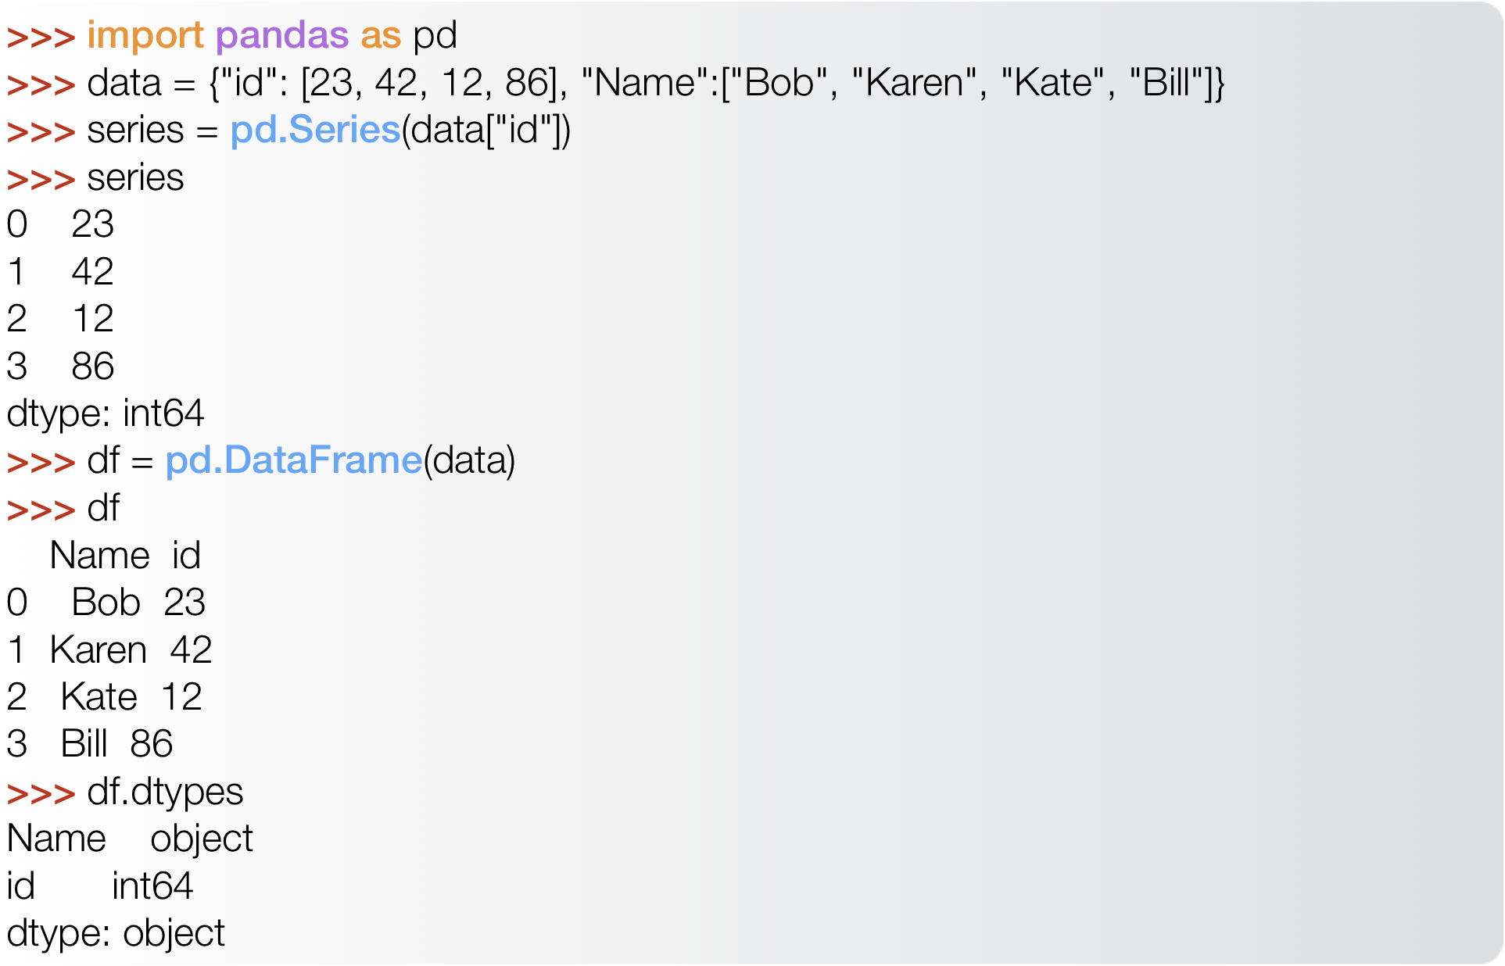
Series and Data Frames

Slide 18
DataFrame Fields
DataFrames contain a great deal of extra information in addition to just the data values. In particular, they include:
columns - column names
index - row names
dtypes - dtype associated with each column
shape - number of rows and columns
ndim - the number of dimensions
DataFrames make it easy to add new columns.
DataFrame elements can be accessed and modified in various ways

Slide 19
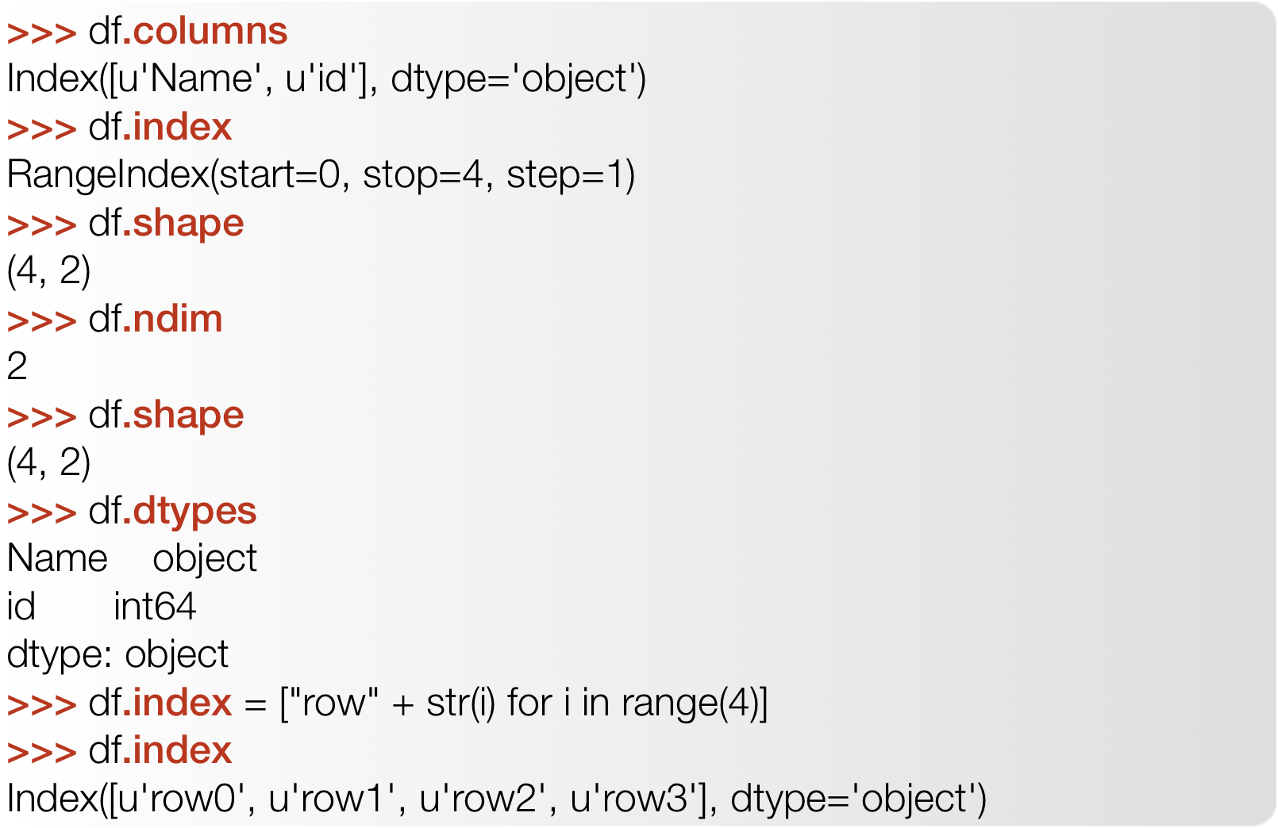
DataFrame Fields
Both index
and column
names have
an associated
dtype
By default the
index is simply
a sequential
integer number
but it can have
arbitrary values

Slide 20
DataFrame Exploration
We get information about the contents of a DataFrame using several simple methods:
head() - display the top 5 rows
tail() - display the bottom 5 rows
info() - Print a concise summary of a DataFrame
describe() - Generate descriptive statistics that summarize the data

Slide 21
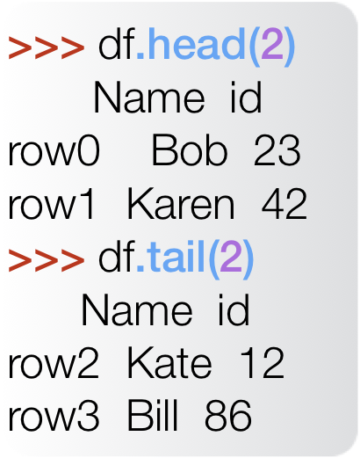
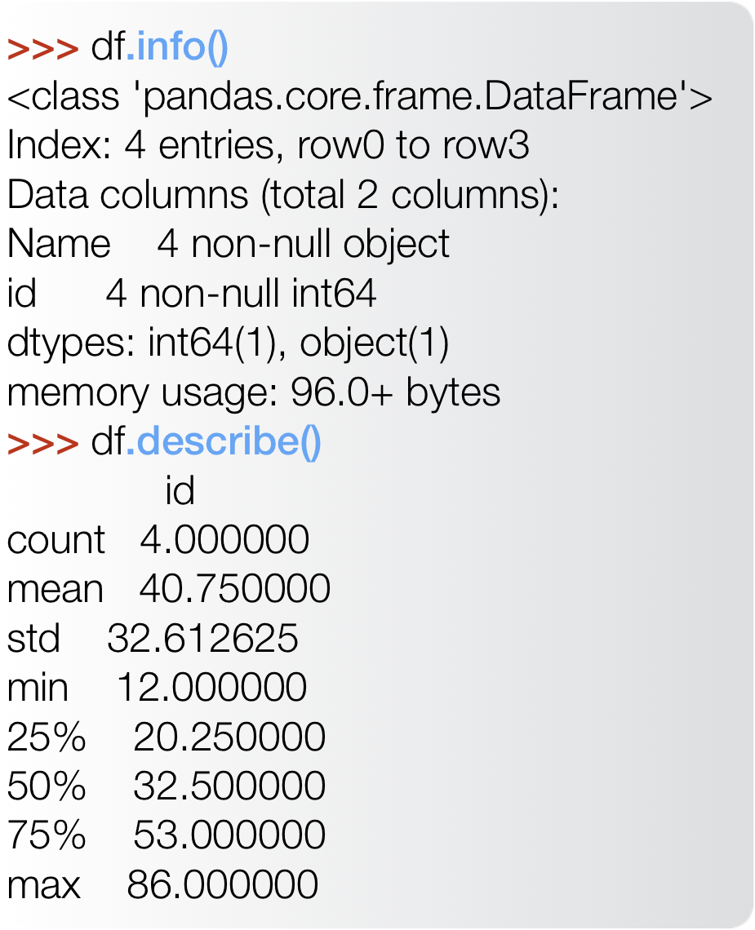
DataFrame Exploration
head and tail can take as argument the number
of rows to
display
the output of
describe only includes numerical columns

Slide 22
Indexing and Slicing
pandas supports various ways of indexing the contents of a DataFrame
[<column name>] - select a given column by it's name. column names can also be used as field names
.loc[<row name>] - select a given row by it’s (Index) name
.iloc[<position>] - select a given row by it’s position in the Index, starting at 0
.loc[<row name>, <column name>] - select an individual element by row and column name
.iloc[<row position>, <row position>] - select an individual element by row and column position (starting at 0)
.iloc also supports ranges and slices similarly to python lists or numpy arrays

Slide 23
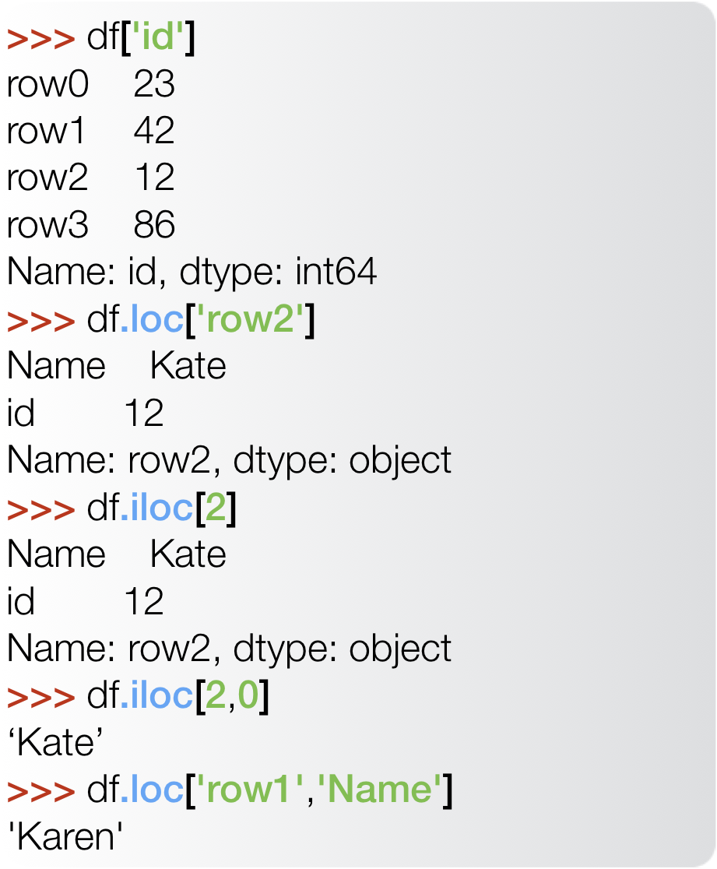
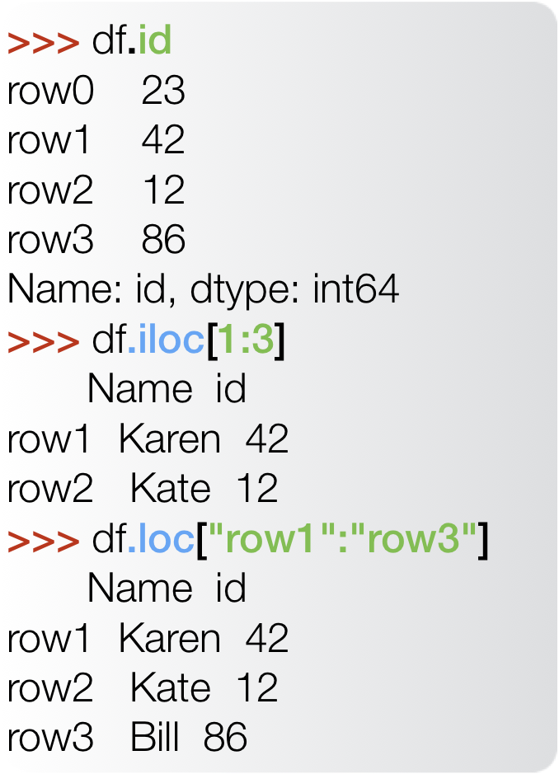
Indexing and Slicing
.loc slices include the last element while .iloc slides don’t !!!

Slide 24
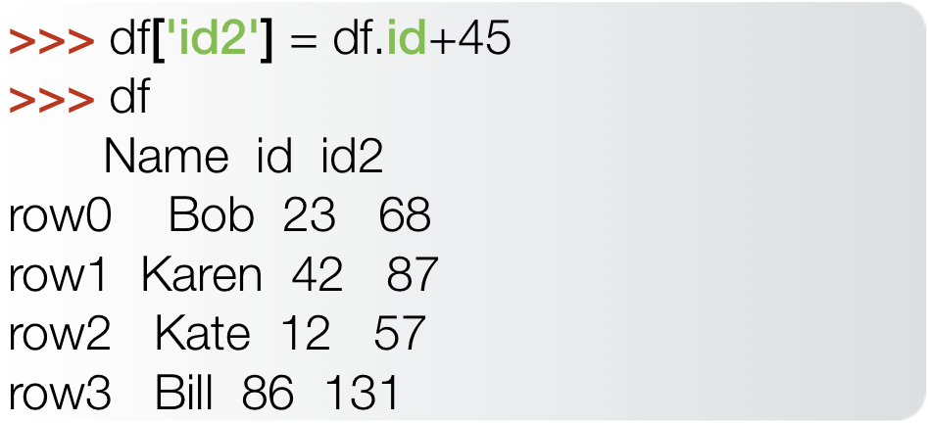
Adding columns and rows
New columns can be added (in place) by simply assigning to them
columns behave like numpy arrays and support mathematical operations
New rows can be added in two ways:
append() - Append rows to the end of a DataFrame, returning a new object
pd.concat() - Concatenate two or more DataFrame objects, adding new rows (axis=0) or columns (axis=1). A new object is returned

Slide 25
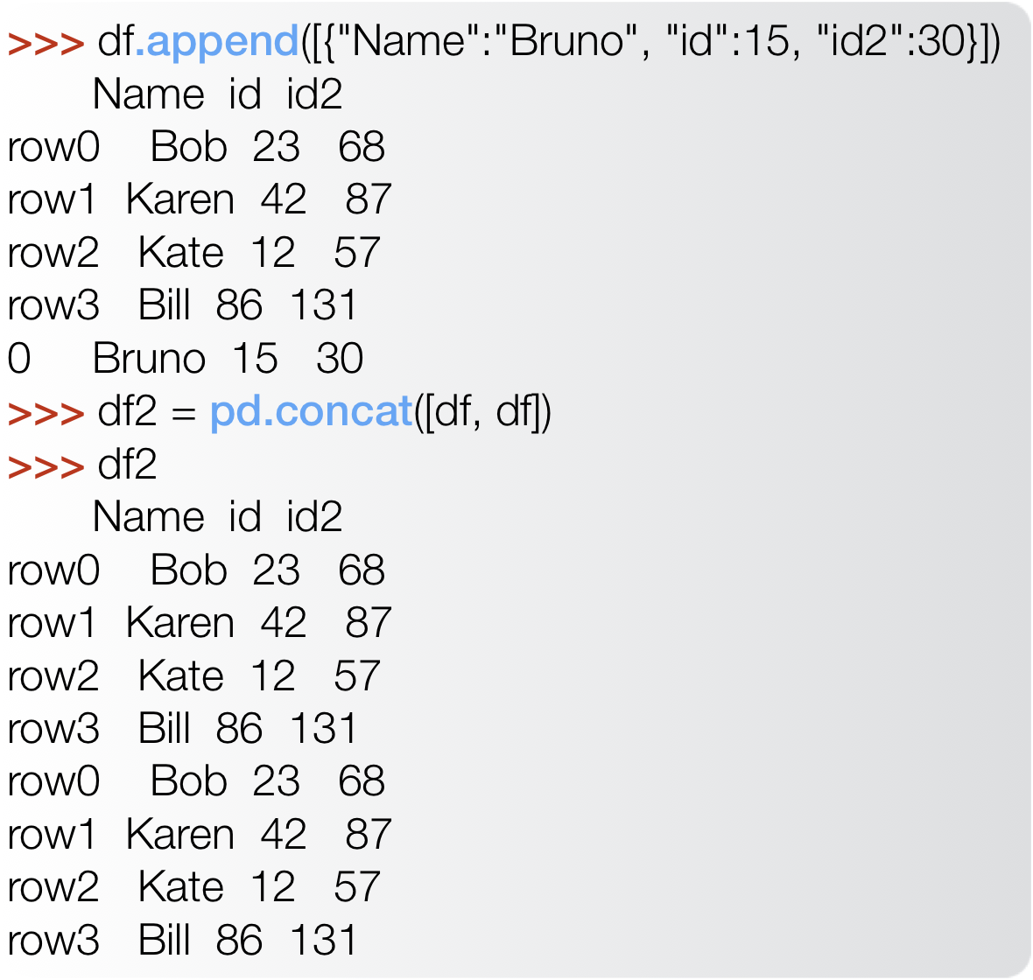
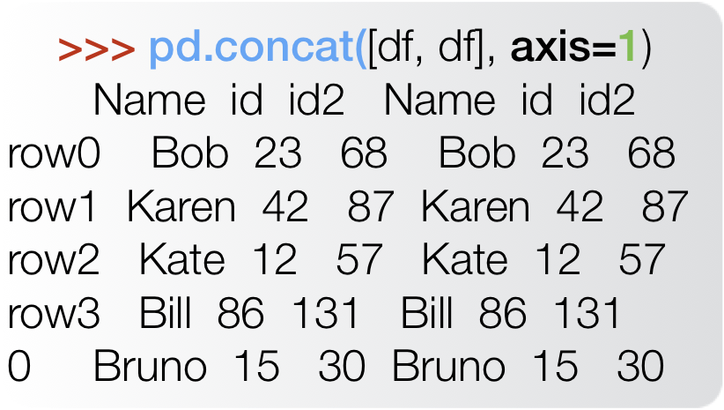
Adding columns and rows

Slide 26
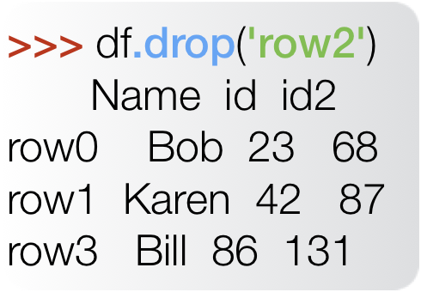
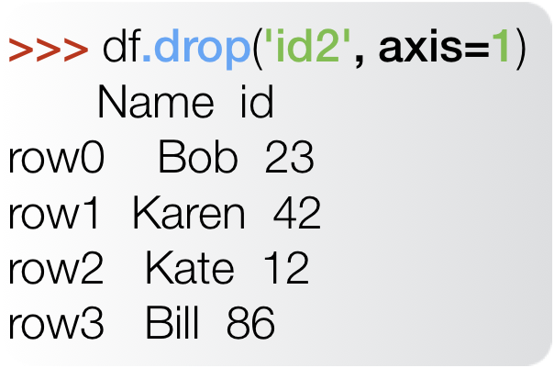
Deleting columns and rows
Rows and columns can be deleted using the drop() function.
The drop() function takes the row/column name as an argument
The axis argument indicates wether we mean rows or columns:
axis=0 - rows (the default)
axis=1 - columns
In both cases, a new object is returned

Slide 27
Importing and Exporting Data
pandas has powerful methods to read and write data from multiple sources
pd.read_csv() - Read a comma-separated values file
sep=‘ ’ - Define the separator to use. ‘,’ is the default
header=0 - Row number to use as column names
pd.read_excel() - Read an Excel file
sheet_name - The sheet name to load
pd.read_html() - Read tabular data from a URL (or local html file)
pd.read_pickle() - Read a Pickle file
Each of these functions accepts a large number of options and parameters controlling its behavior. Use help(<function name>) to explore further.
Each read_*() function has a complementary to_*() function to write out a DataFrame to disk. The to_*() functions are members of the DataFrame object

Slide 28
Time series
pandas was originally developed to handle financial data
Temporal sequences (time series) are a common type of data encountered in financial applications, so, naturally, pandas has good support for the most common time series operations.
pd.to_datetime - converts a Series or value into a date time timestamp.
Format is inferred by looking at the entire Series data
Format can also be manually specified using specific arguments:
format - detailed string specifying the full format
dayfirst=True - parse 10/11/12 as Nov 10, 2012
yearfirst=True - parse 10/11/12 as Nov 12, 2010
pd.to_timedelta - converts a Series into an absolute difference in time
Dates can also be parse automatically at read time by passing a list of the columns containing dates to the parse_dates argument of pd.read_csv

Slide 29
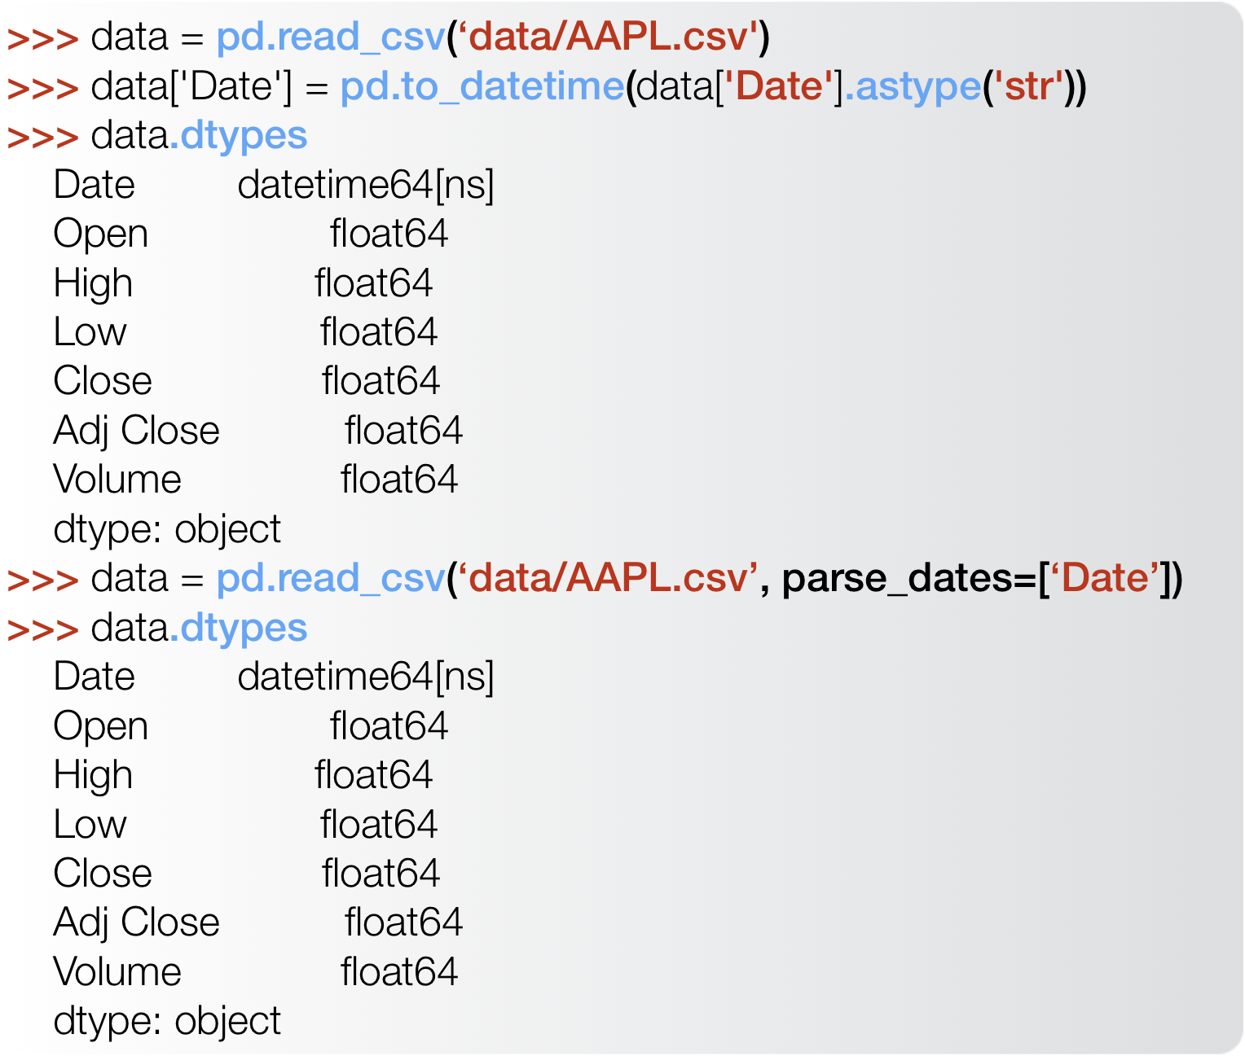
Time series

Slide 30
Time series
Sequences of dates/times can be created using pd.date_range(), similar to np.arange()
start/end - specify the limits
freq - specify frequency (step)
B - business day frequency
D - calendar day frequency
W - weekly frequency
M - month end frequency
Q - quarter end frequency
A - year end frequency
H - hourly frequency
T - minutely frequency
S - secondly frequency
By setting the index to be a date time, we turn the DataFrame into a Timeseries.
Pandas has several methods that are specialized to this case
index.day/index.month/index.year - return the day, month and year of the time series index value

Slide 31
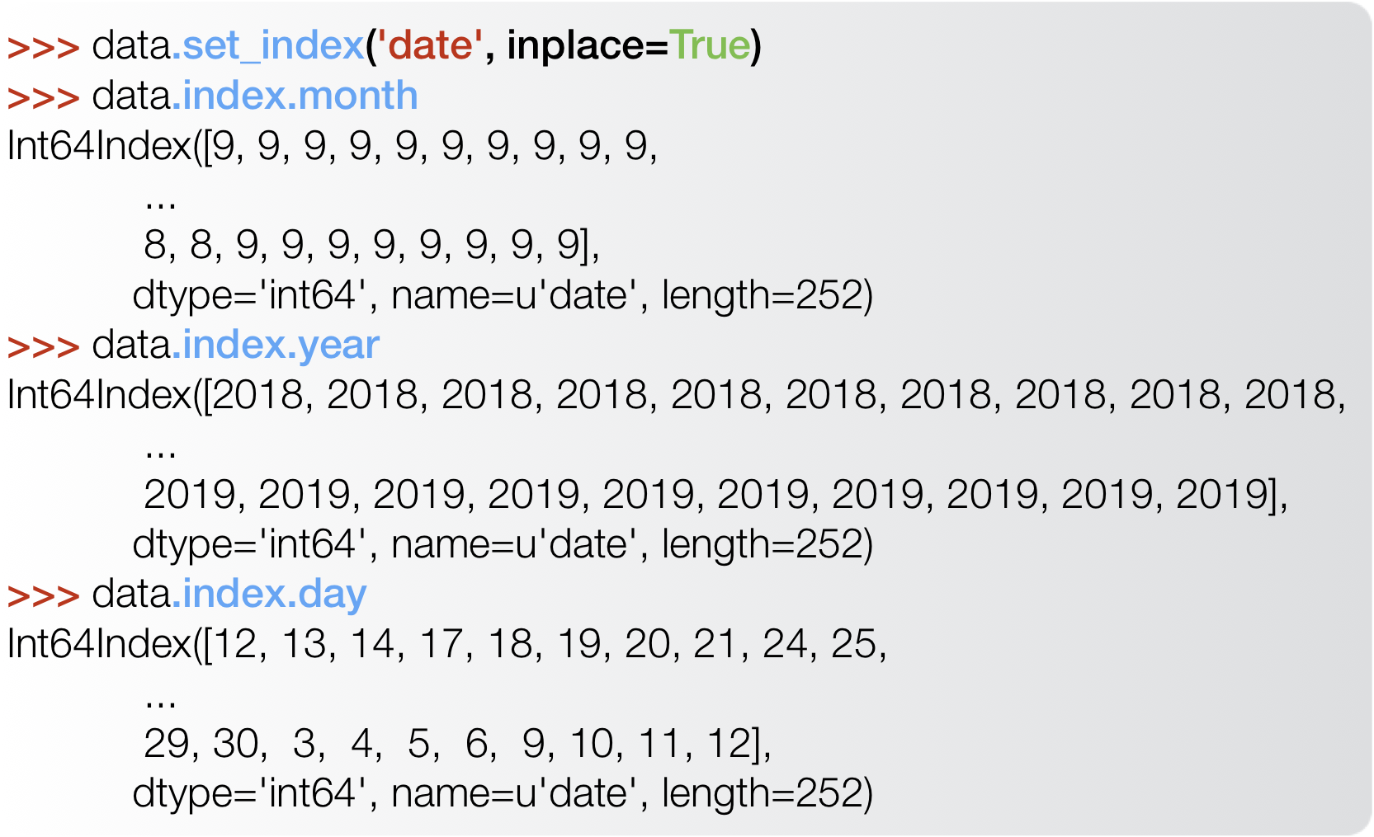
Time series

Slide 32
DataFrame manipulations
pd.to_datetime() is just one of several methods that allow us to manipulate and transform the format and contents of Series and DataFrames.
other methods include:
map() - Map values of Series according to input correspondence.
func - function, dict or Series to use for mapping
transform() - Transform each column/row of the DataFrame using a function. Output must have the same shape as the original
axis = 0 - apply function to columns
axis = 1 - apply function to rows
apply() - Apply a function along an axis of the DataFrame
Similar to transform but without the limitation of preserving the shape

Slide 33
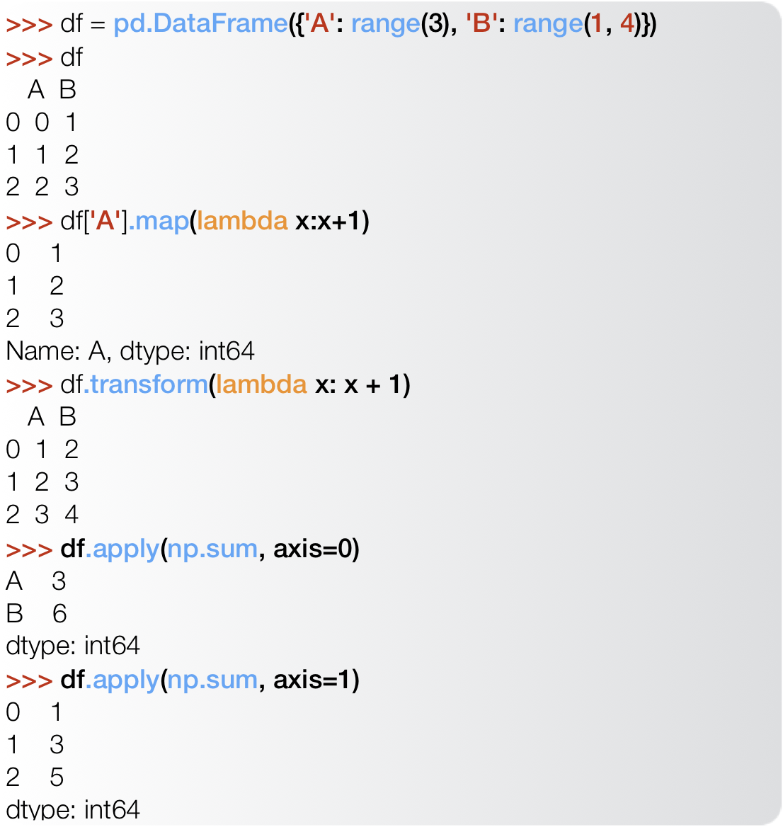
DataFrame manipulations

Slide 34
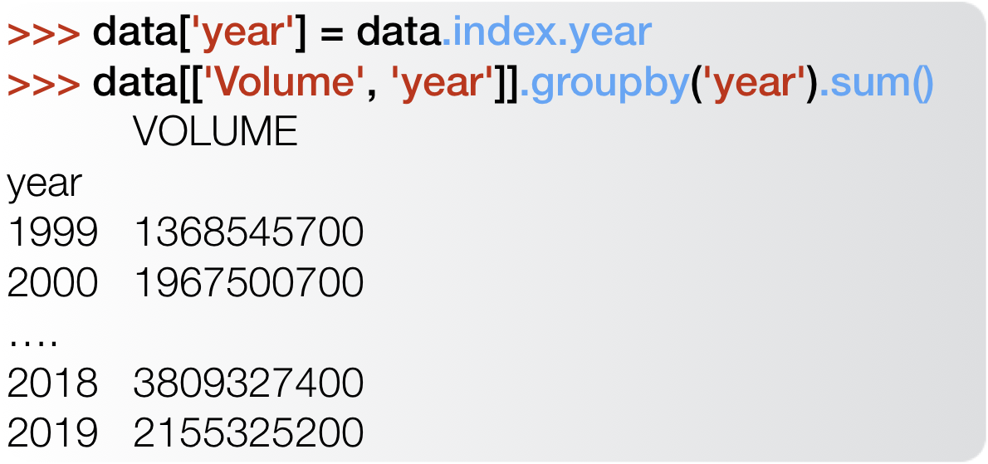
groupby
Sometimes we need to calculate statistics for subsets of our data
groupby() allows us to group data based on a dict or function
groupby() returns a GroupBy object that supports several aggregations functions, including:
max()/min()/mean()/median()
transform()/apply()
sum()/cumsum()
prod()/cumprod()
quantile()
Each of these functions is applied to the contents of each group

Slide 35
Pivot Tables
Pandas provides an extremely flexible pivot table implementation
pd.pivot_table() - Creates a spreadsheet-style pivot table as a DataFrame.
Three important arguments:
values - column to aggregate
index - Keys to group by on the pivot table index. If an array is passed, it is being used as the same manner as column values.
columns - Keys to group by on the pivot table column.
aggfunc - Function to use for aggregation. Defaults to np.mean()
index, columns and aggfunc can also be lists of keys or functions to use.

Slide 36
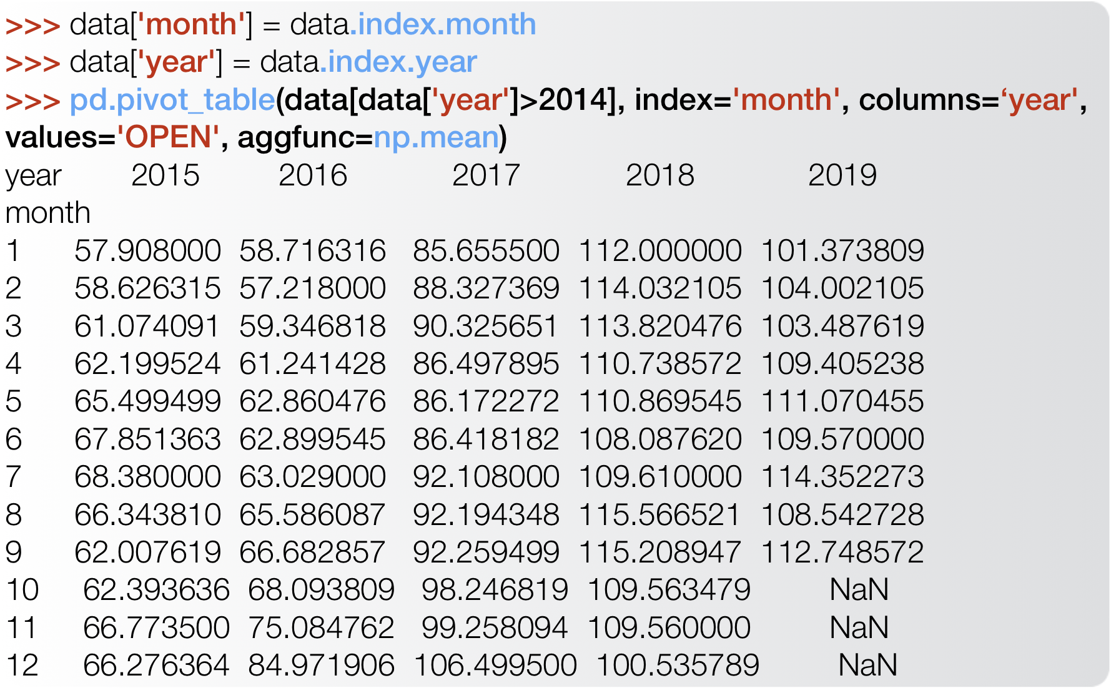
Pivot Tables

Slide 37
merge/join
merge() and join() allows us to perform database-style join operation by columns or indexes (rows)
Some of the most important arguments are common to both methods:
on - Column(s) to use for joining, otherwise join on index. Can pass an array as the join key if not already contained in the calling DataFrame. Like an Excel VLOOKUP operation
how - Type of join to perform: {‘left’, ‘right’, ‘outer’, ‘inner’}
merge() is more sophisticated and flexible. It also allows us to specify:
left_on/right_on - Field names to join on for each DataFrame
left_index/right_index - Whether or not to use the left/right index as join key(s)

Slide 38
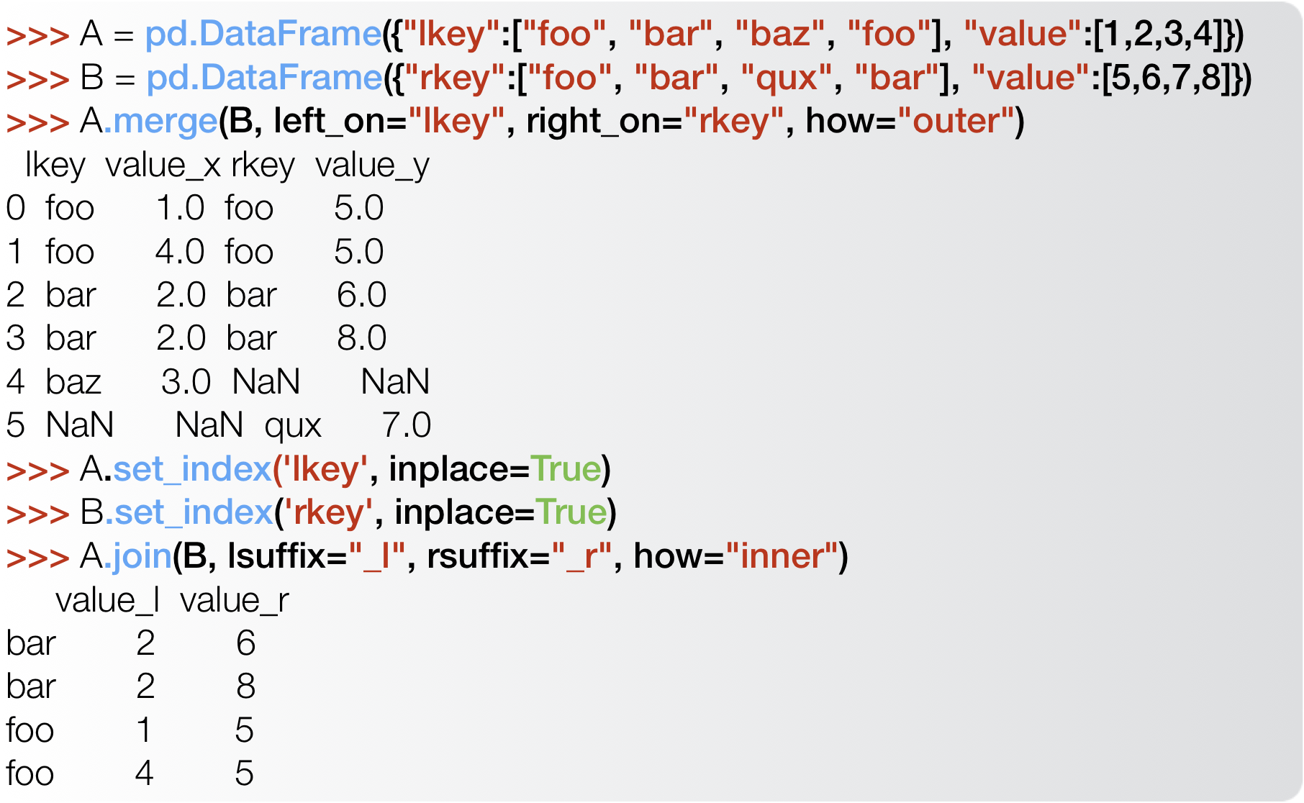
merge/join

Slide 39
plotting
Finally, pandas also provides a simple interface for basic plotting through the plot() function
By specifying some basic parameters the variables plotted and even the kind of plot can be easily modified:
x/y -column name to use for the x/y axis
kind - type of plot
‘line’ - line plot (default)
‘bar’/‘barh’ - vertical/horizontal bar plot
‘hist’ - histogram
‘box’ - boxplot
‘pie’ - pie plot
‘scatter’ - scatter plot
The plot() function returns a matplotlib Axes object

Slide 40
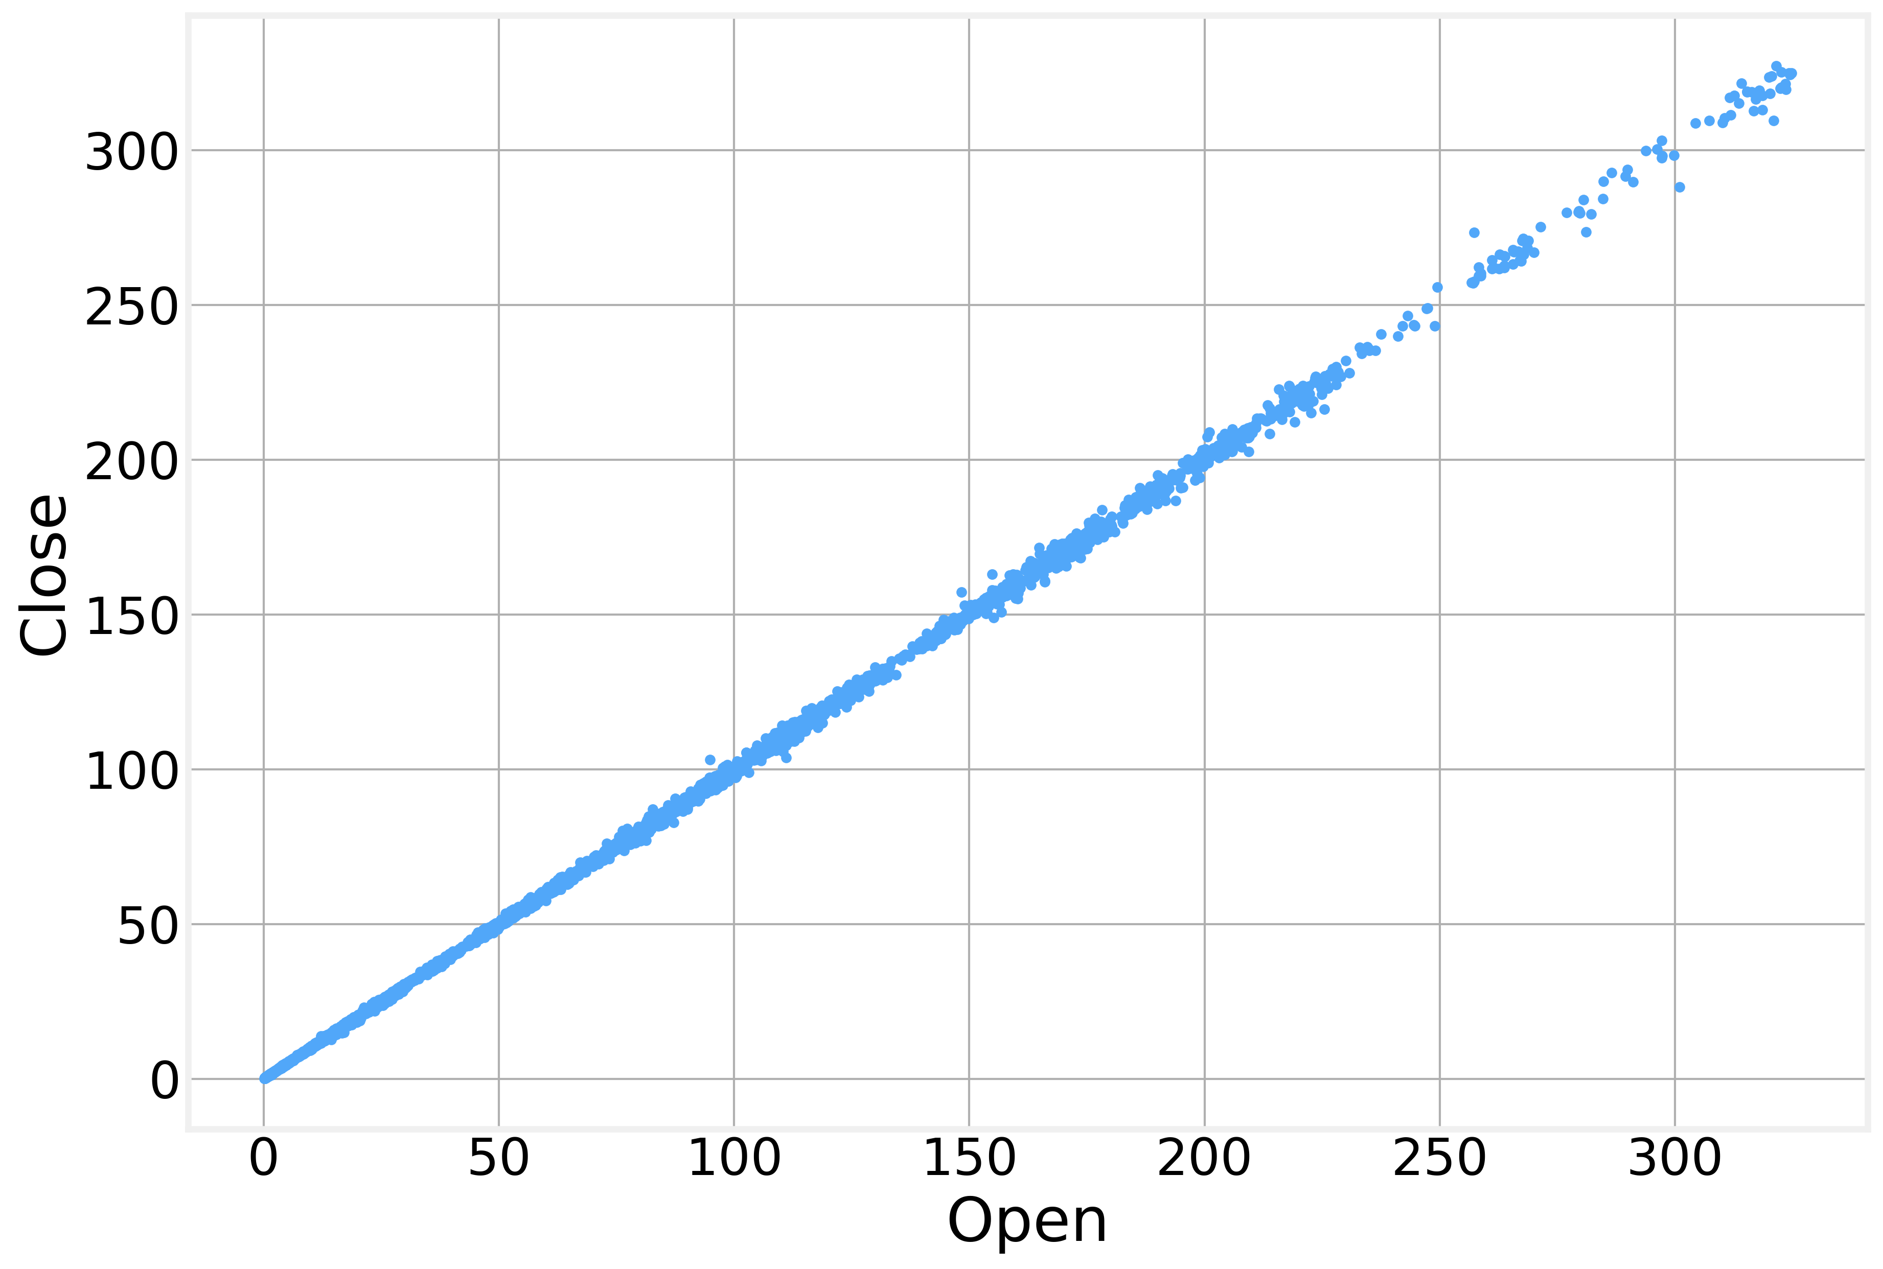
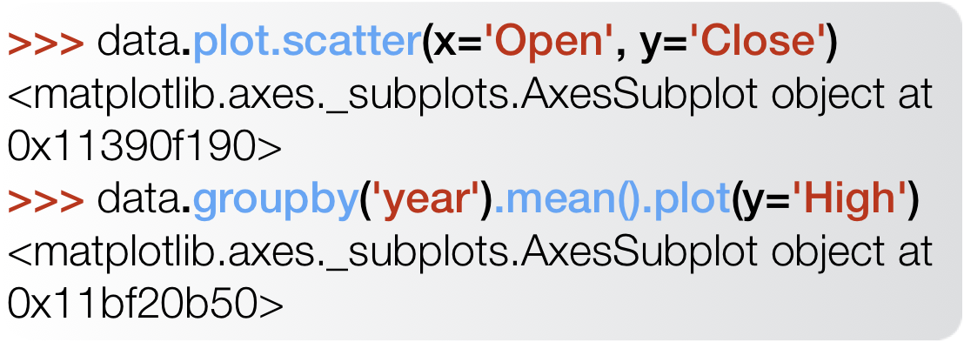
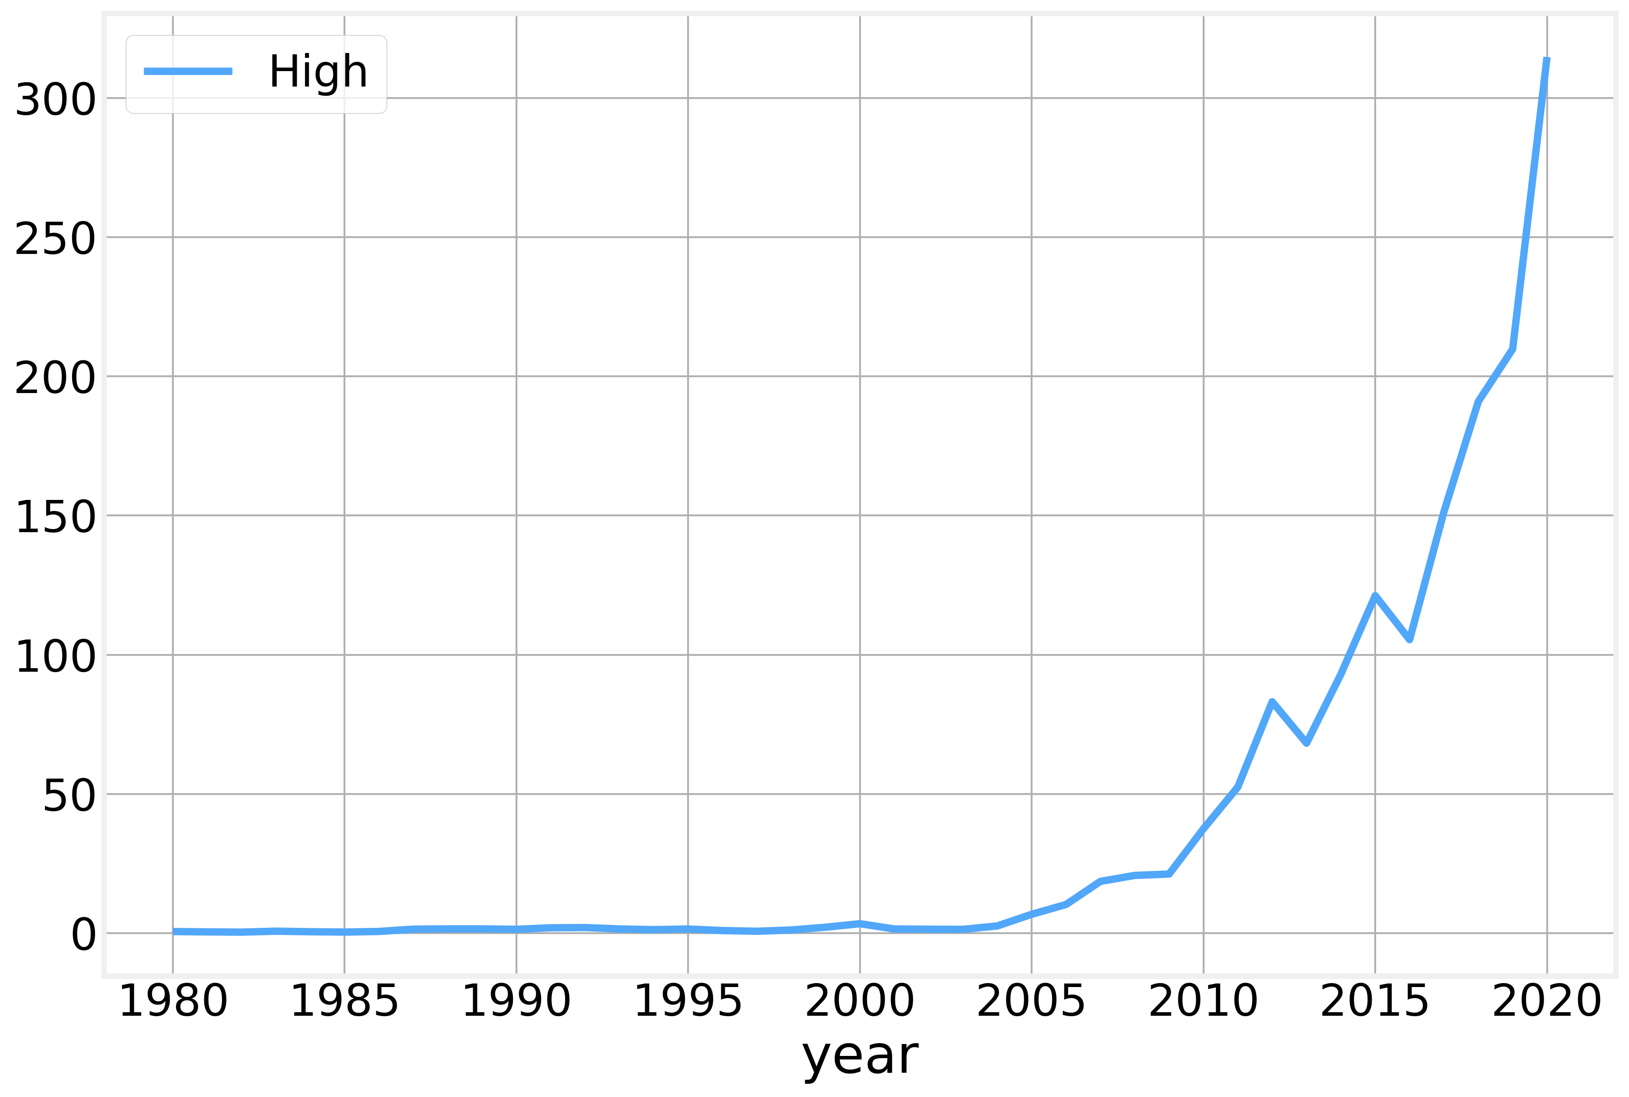
plotting

Slide 41
Code - Pandas Review
https://github.com/DataForScience/Timeseries_long

Slide 42
Data Representation

Slide 43
Time series
A set of values measured sequentially in time
Values are typically (but not always) measured at equal intervals, $x_{1}$, $x_{2}$, $x_{3}$, $x_{3}$, etc…
Values can be:
continuous
discrete or symbolic (words).
Associated with empirical observation of time varying phenomena:
Stock market prices (day, hour, minute, tick, etc…)
Temperatures (day, minute, second, etc…)
Number of patients (week, month, etc…)
GDP (quarter, year, etc…)
Forecasting requires predicting future values based on past behavior

Slide 44
Mathematical Conventions
The value of the time series at time $t$ is given by $x_{t}$
The values at a given lag $l$ are given by $x_{t-l}$
The mean of the overall signal is $μ$ and the corresponding running value is $μ_{t}^{w}$
The variance of the overall signal is $σ$ and the corresponding running value is $σ_{t}^{w}$
Running values are calculated over a window of width $w$

Slide 45
Time series analysis
The fundamental assumption is that previous values determine the current value:
$$x_{t+1}=f\left(x_{t},x_{t-1},⋯\right)$$
Then the question becomes, can we determine
$f\left(x_{t},x_{t-1},⋯\right)$?
$$x_{t-1}$$
$$x_{t}$$
$$x_{t+1}$$

Slide 46
Code - Data Exploration
https://github.com/DataForScience/Timeseries_long

Slide 47
Stationarity and Trends

Slide 48
Three fundamental behaviors

Slide 49
Three fundamental behaviors
Stationarity
$$⟨x_{t}⟩≈constant$$
Trend
$$⟨x_{t}⟩≈ct$$
Seasonality
$$x_{t+T}≈x_{t}$$

Slide 50
Stationarity
A time series is said to be stationary if its basic statistical properties are independent of time
In particular:
Mean - Average value stays constant
Variance - The width of the curve is bounded
Covariance - Correlation between points is independent of time
Stationary processes are easier to analyze
Many time series analysis algorithms assume the time series to be stationary
Several rigorous tests for stationarity have been developed such as the (Augmented) Dickey-Fuller and Hurst Exponent
Typically, the first step of any analysis is to transform the series to make it stationary

Slide 51
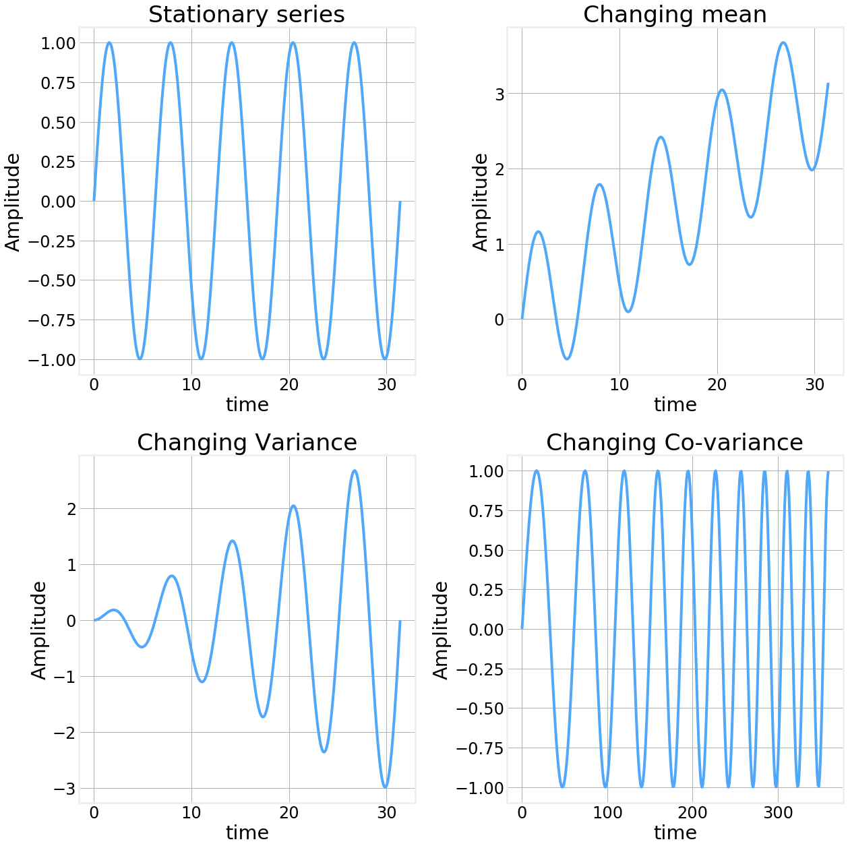
Stationarity

Slide 52
Stationarity

Slide 53
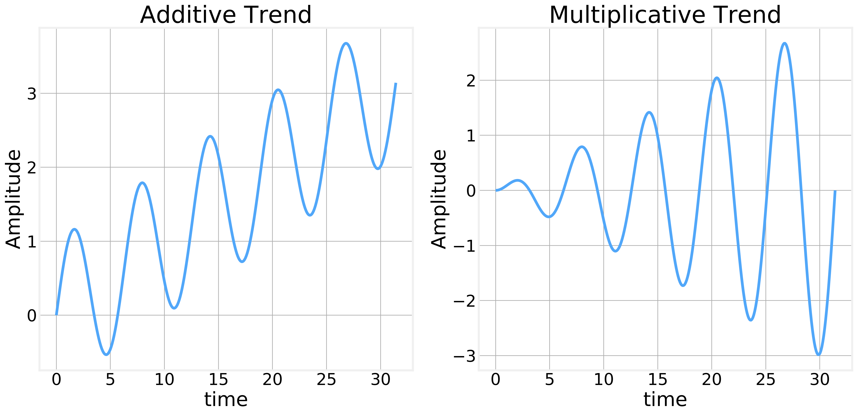
Trend
Many time series have a clear trend or tendency:
Stock market indices tend to go up over time
Number of cases of preventable diseases tends to go down over time
etc
Trends can be additive or multiplicative:
Trends can be removed by subtraction or division of the correct values
One simple way to determine the trend is to calculate a running average over the series
$$x=\frac{t}{10}+sin\left(t\right)$$
$$x=\frac{t}{10}sin\left(t\right)$$

Slide 54
Trend

Slide 55
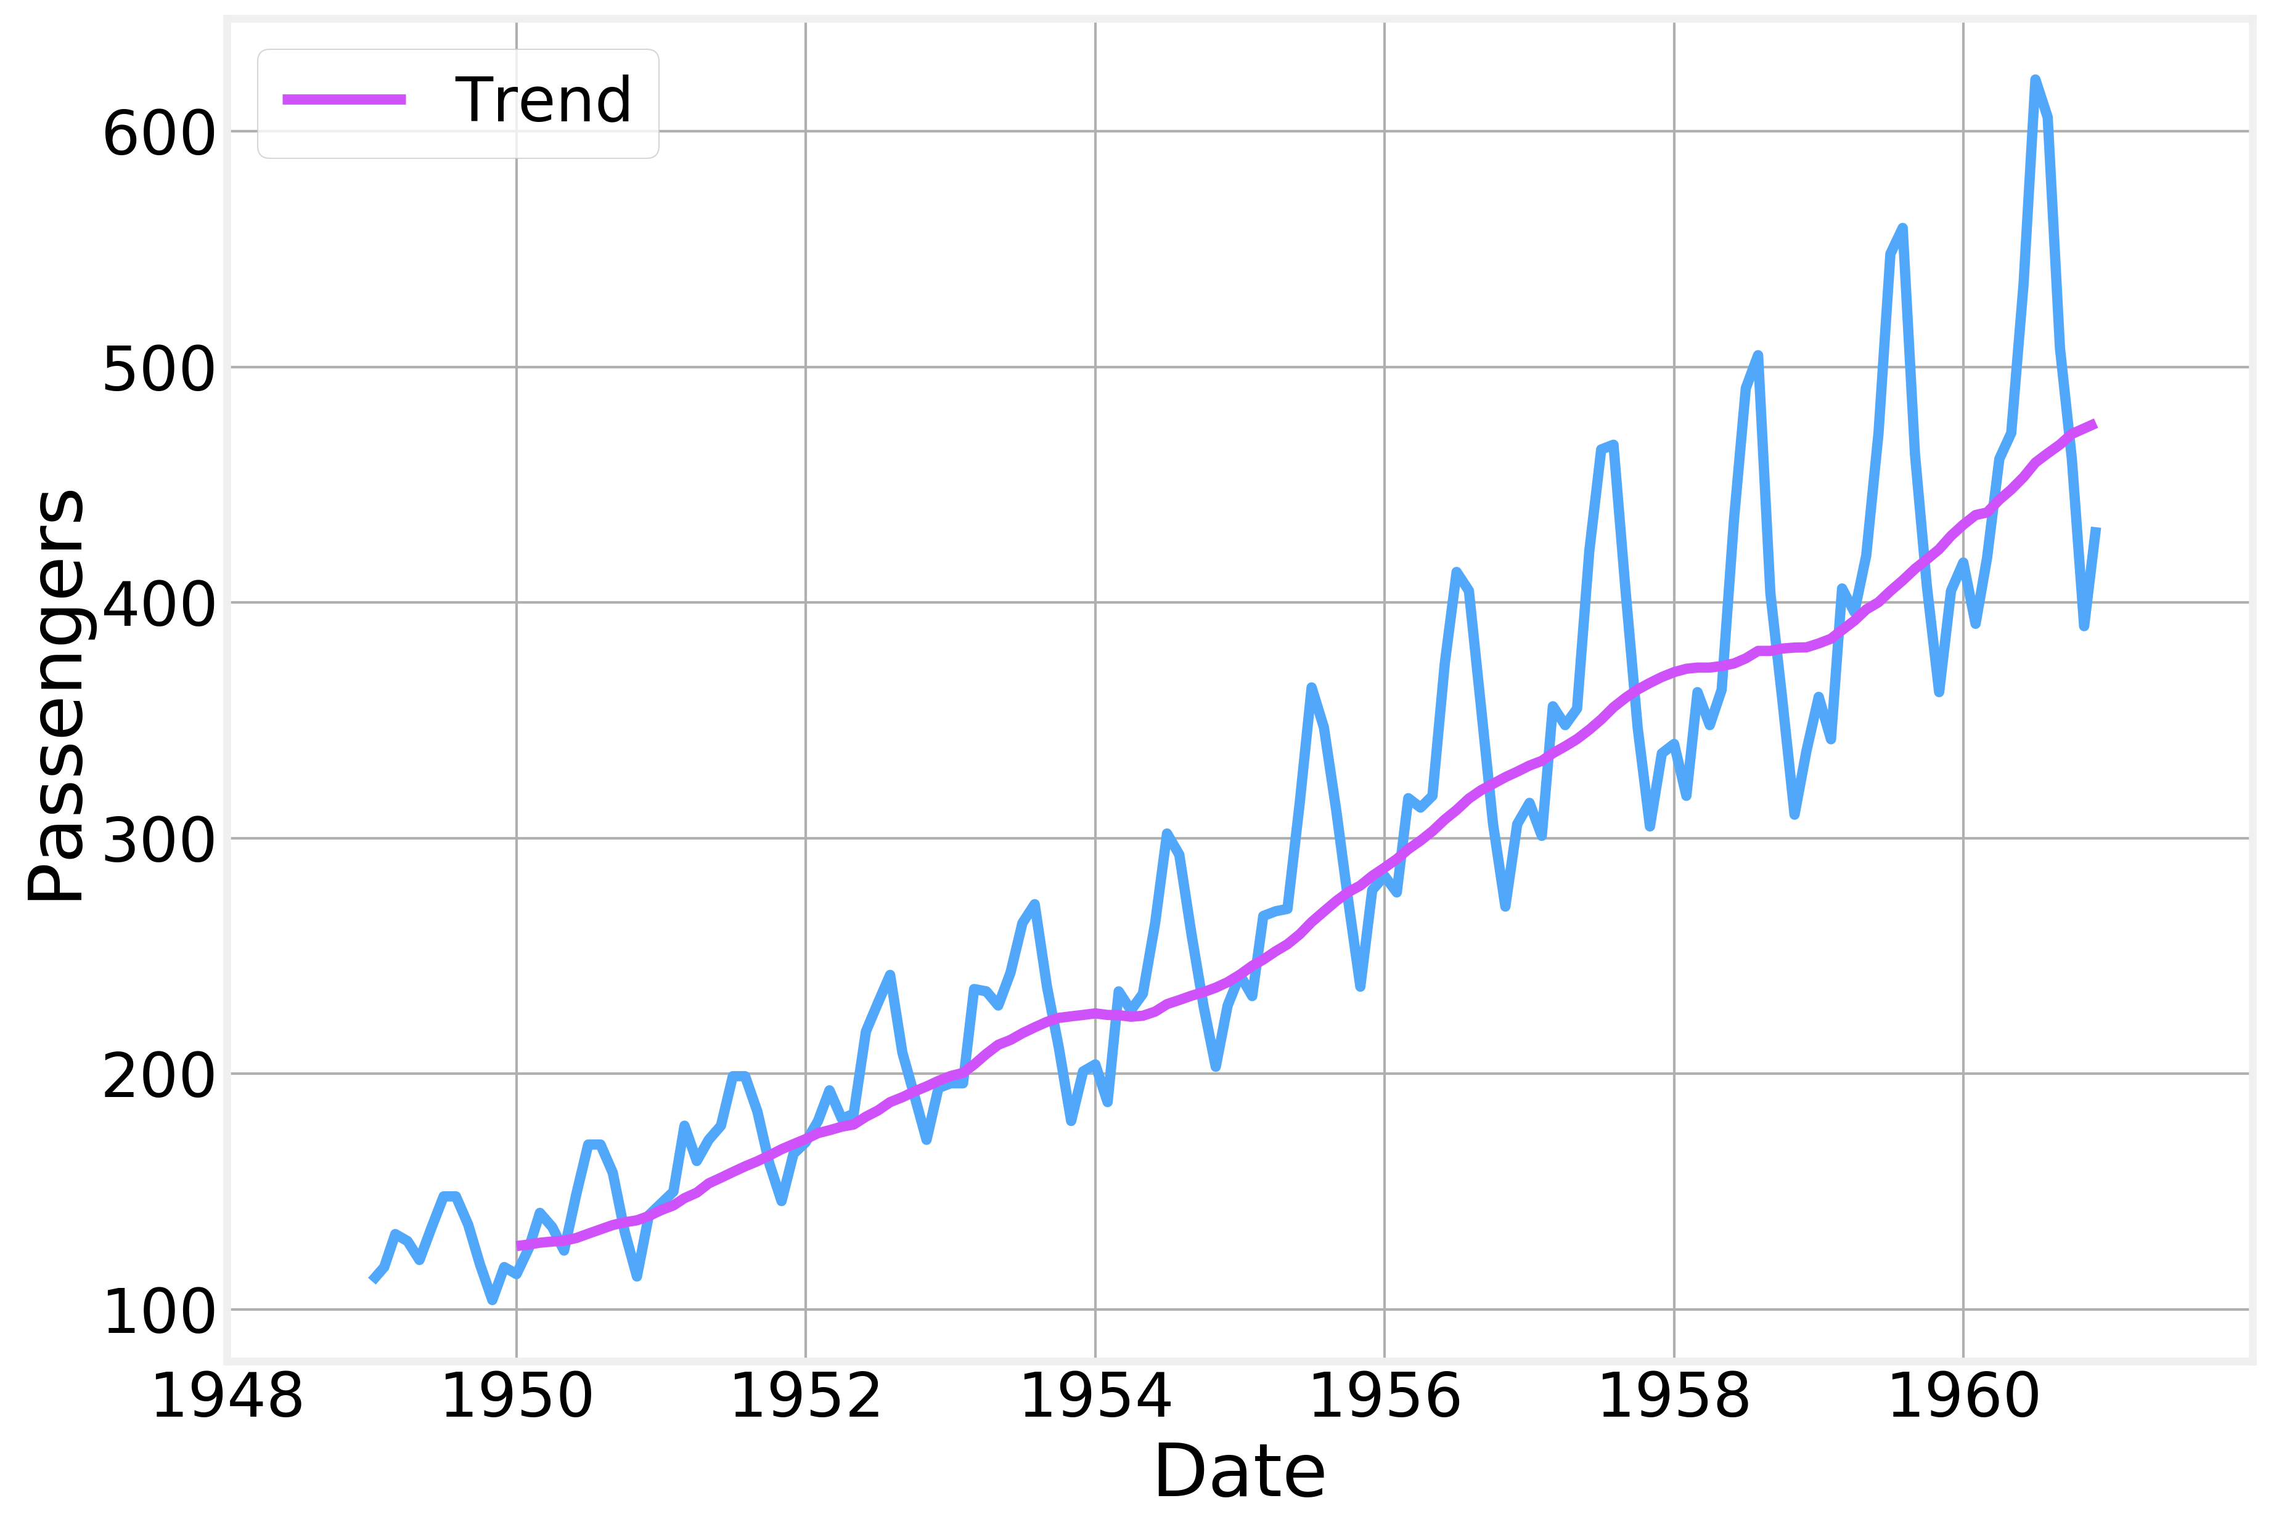
Trend

Slide 56
Code - Stationarity and Trends
https://github.com/DataForScience/Timeseries_long

Slide 57
Time Series Decomposition

Slide 58
Seasonality
Many of the phenomena we might be interested in varying in time in a cyclical or seasonal fashion
Ice-cream sales peak in the summer and drop in the winter
Number of cell phone calls made is larger during the day than at night
Many types of crime are more frequent at night than during the day
Visits to museums are more frequent in the weekend than in weekdays
The stock market grows during bull periods and shrinks during bear periods
etc
Understanding the seasonality of a time series provides important information about its long term behavior and is extremely useful in predicting future values
If the period is fixed it’s called seasonality, while if the period is irregular it's called cyclical

Slide 59
Seasonality
https://www.kaggle.com/chirag19/air-passengers
The recurring peaks are a clear indication of seasonality
In this case we expect the peaks to occur every 12 months

Slide 60
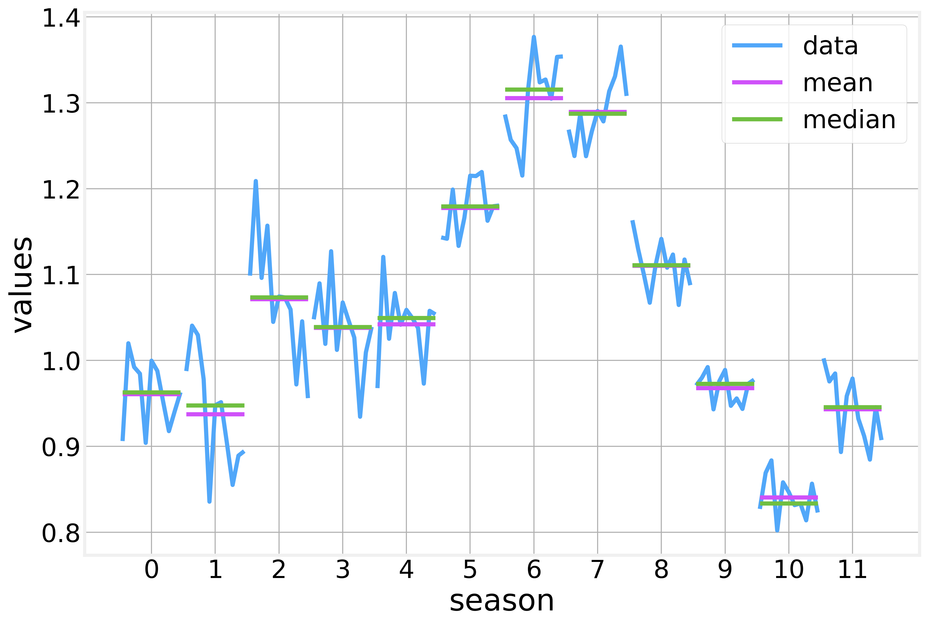
Seasonality
We can visualize the seasonal pattern by plotting all values that are 12 months apart in different subplots. One for each ‘season'

Slide 61
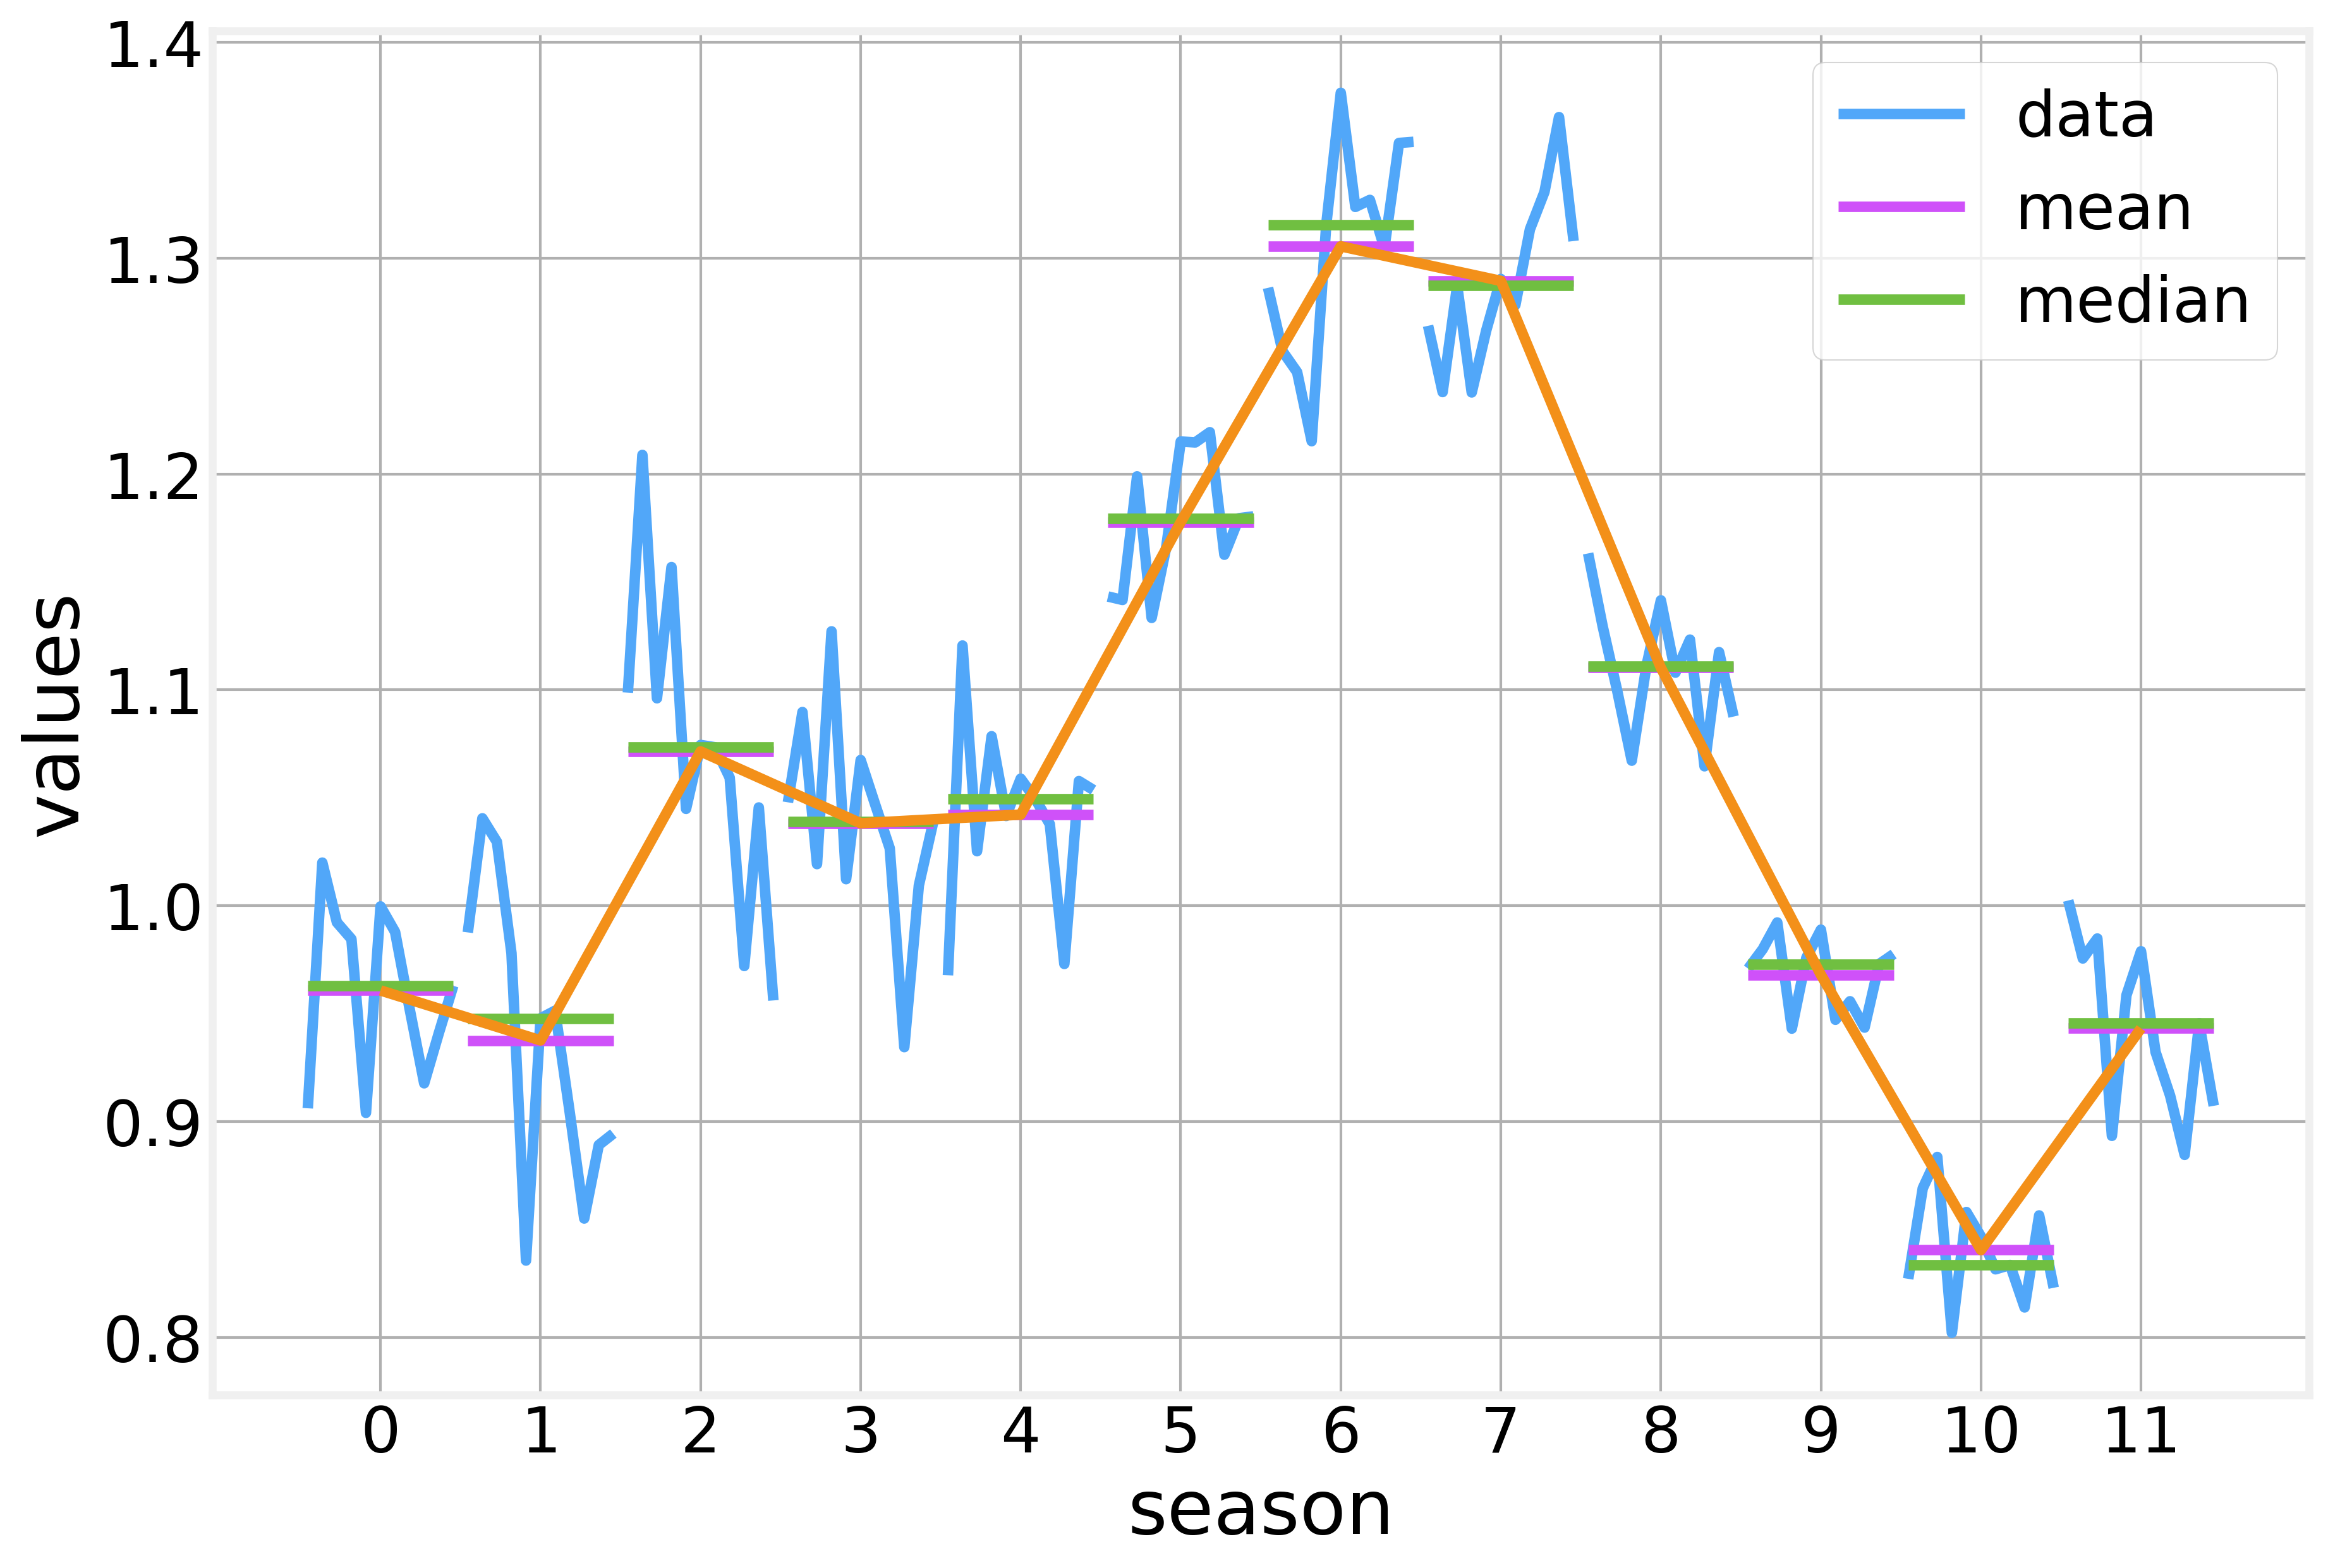
Seasonality
Seasonality can be removed by using the average values for each season in a repeating pattern

Slide 62
Time series decomposition
A time series can be decomposed into three components:
Trend, $T_{t}$
Seasonality, $S_{t}$
Residuals, $R_{t}$
Decompositions can be
additive - $x_{t}=T_{t}+S_{t}+R_{t}$
multiplicative - $x_{t}=T_{t}⋅S_{t}⋅R_{t}$
The residuals are simply what is left of the original signal after we remove the trend and the seasonality
Residuals are typically stationary

Slide 63
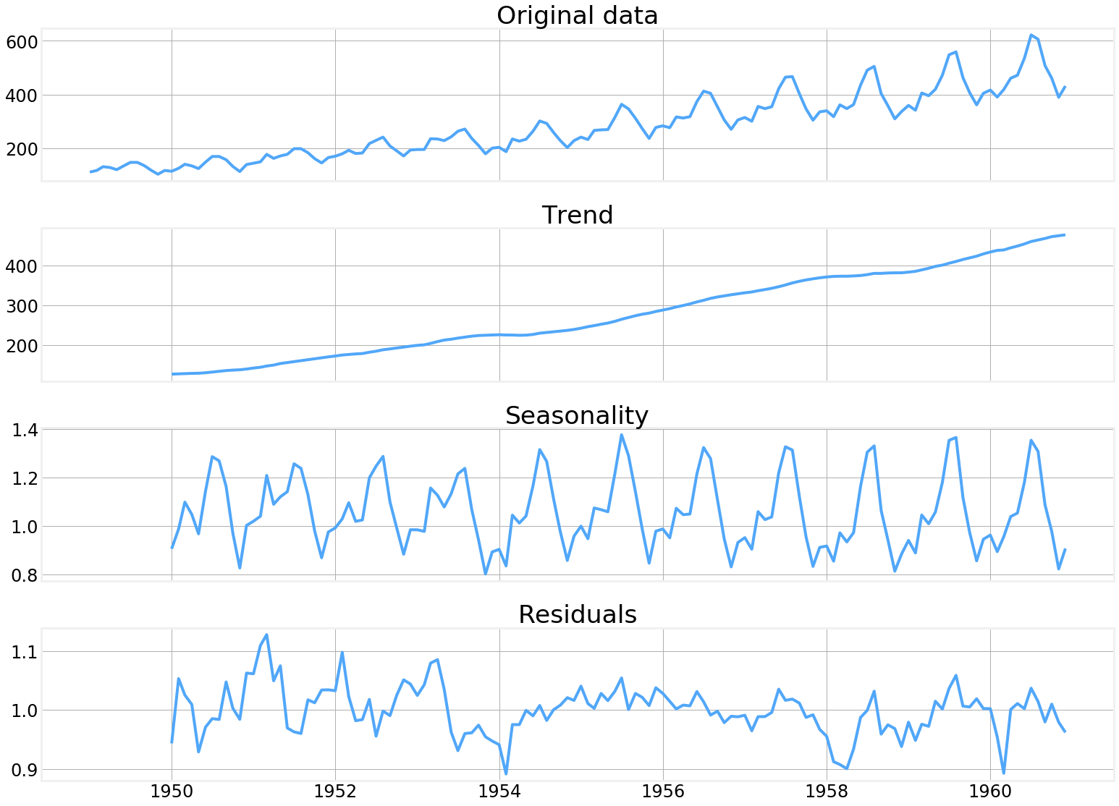
Time series decomposition

Slide 64
Code - Decomposition
https://github.com/DataForScience/Timeseries

Slide 65
Processing Timeseries data

Slide 66
Lagged values
While analyzing time series, we often refer to values that our time series took $1$, $2$, $3$, etc time steps in the past
These are known as lagged values and denoted:
where $l$ is the value of the lag we are considering.
$$x_{t-l}$$

Slide 67
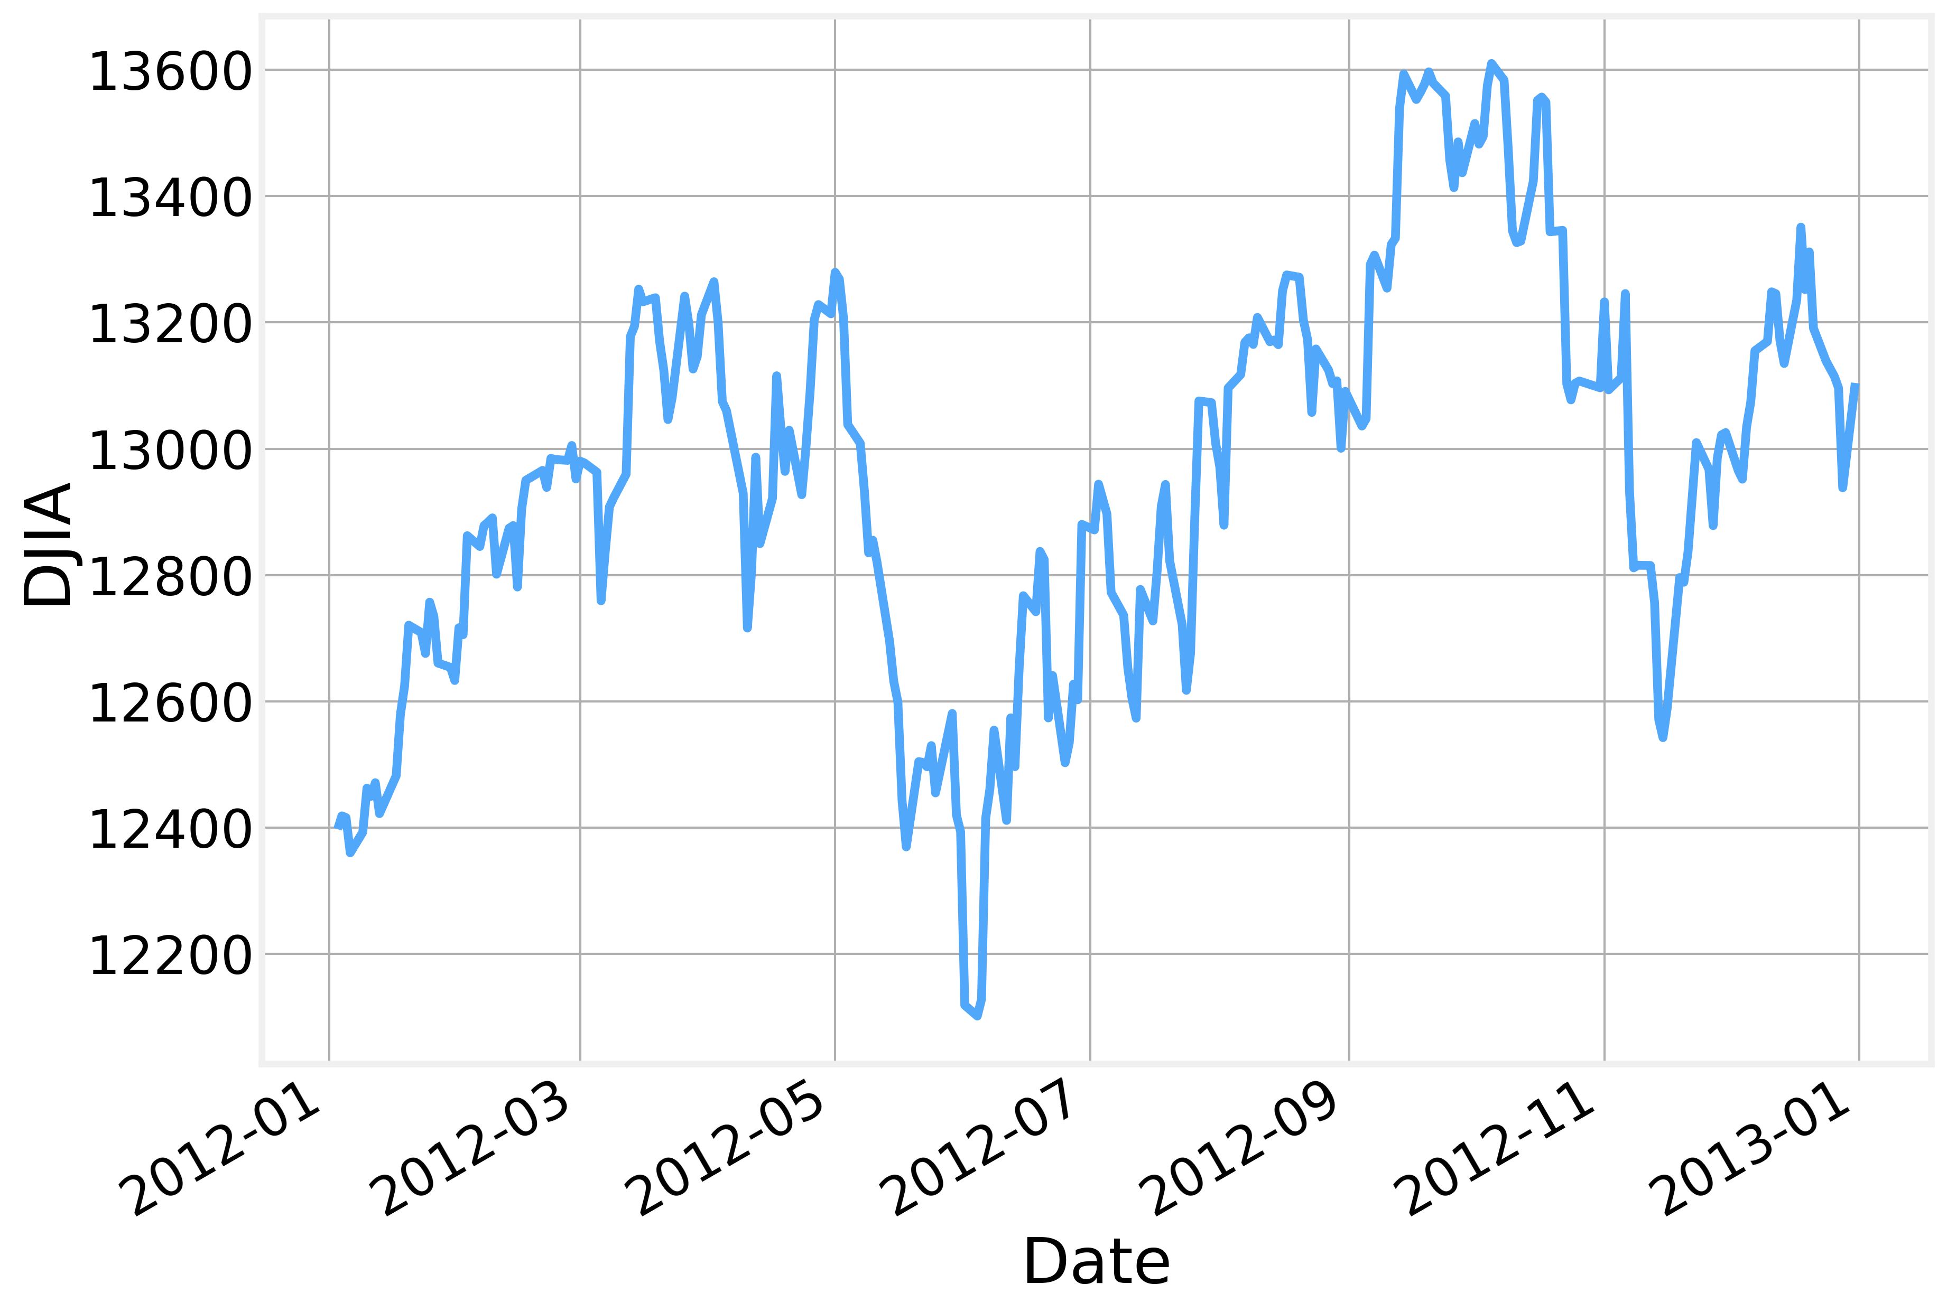
Lagged values

Slide 68
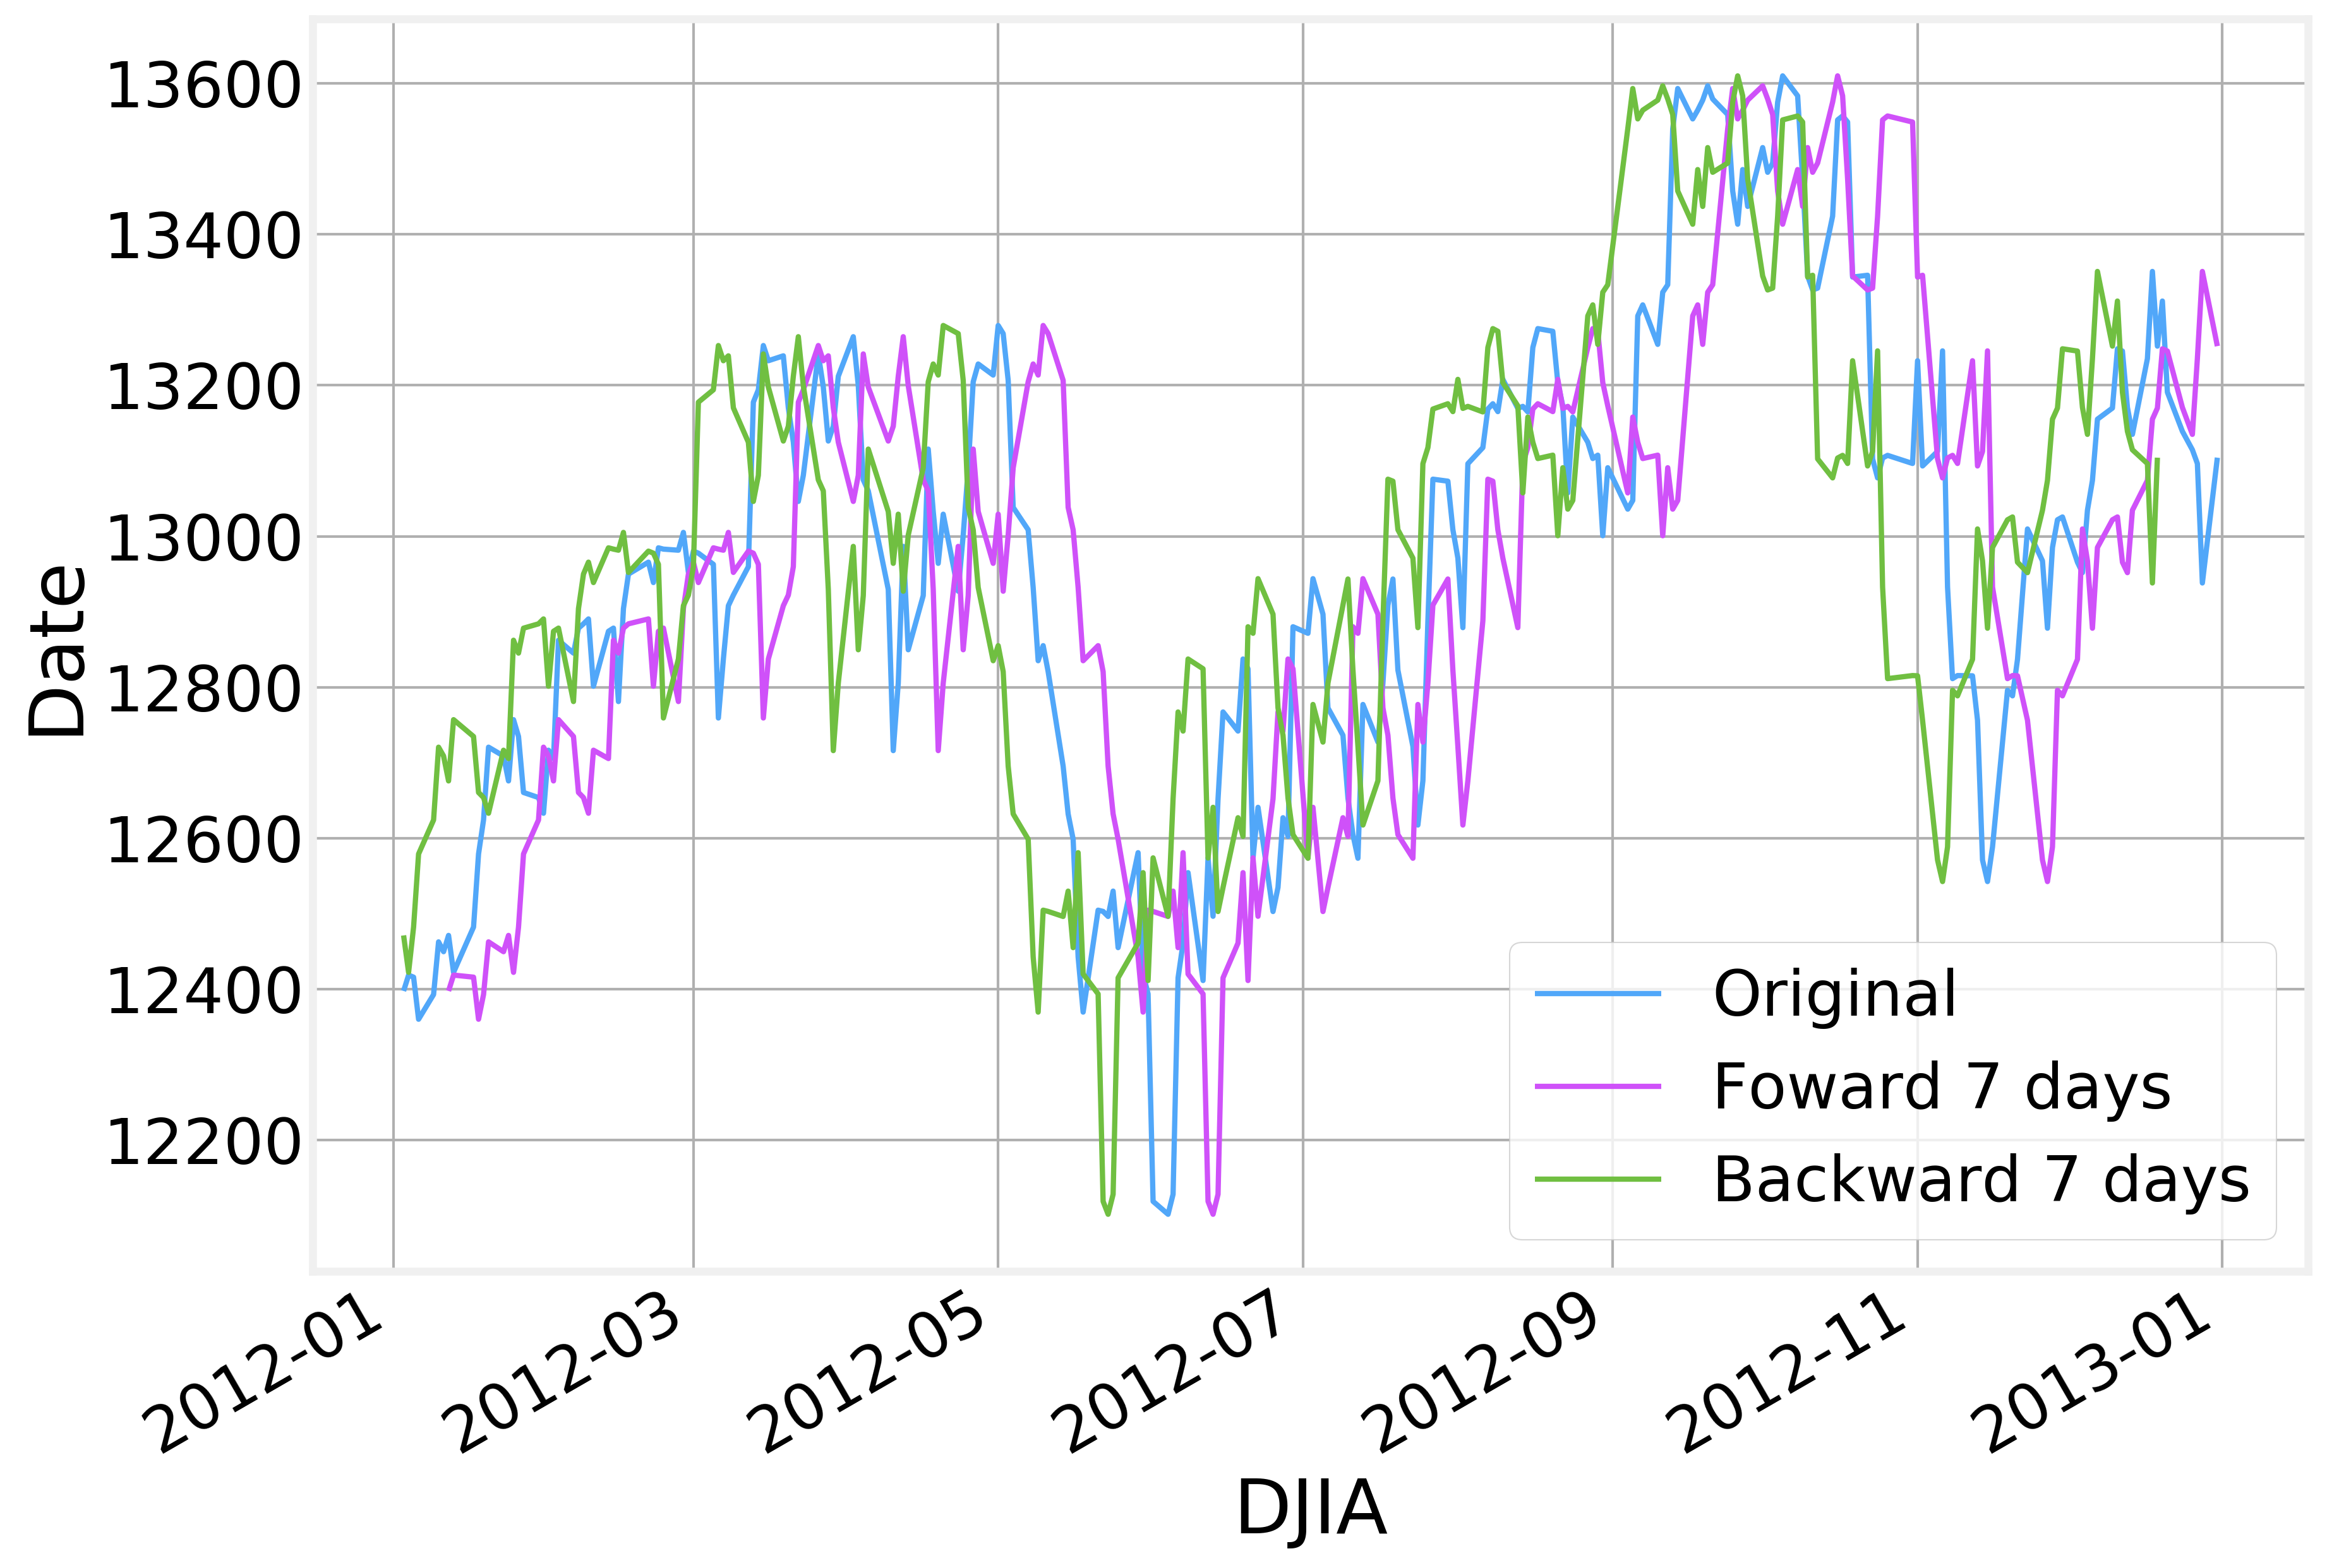
Lagged values

Slide 69
Differences
Perhaps the most common use case for lagged values is for the calculation of differences of the form:
Where $l≥1$ is the value of the lag we are interested in.
Naturally, higher order differences can also be used, in which case, the difference of the difference is calculated:
This can be thought of as a discrete version of the usual derivative of a function.
Differences are also a particularly simple way to detrend a time series
$$x_{t}-x_{t-l}$$
$$y_{t}=x_{t}-x_{t-l}$$
$$z_{t}=y_{t}-y_{t-l}≡x_{t}-2x_{t-l}+x_{t-2l}$$

Slide 70
Differences

Slide 71
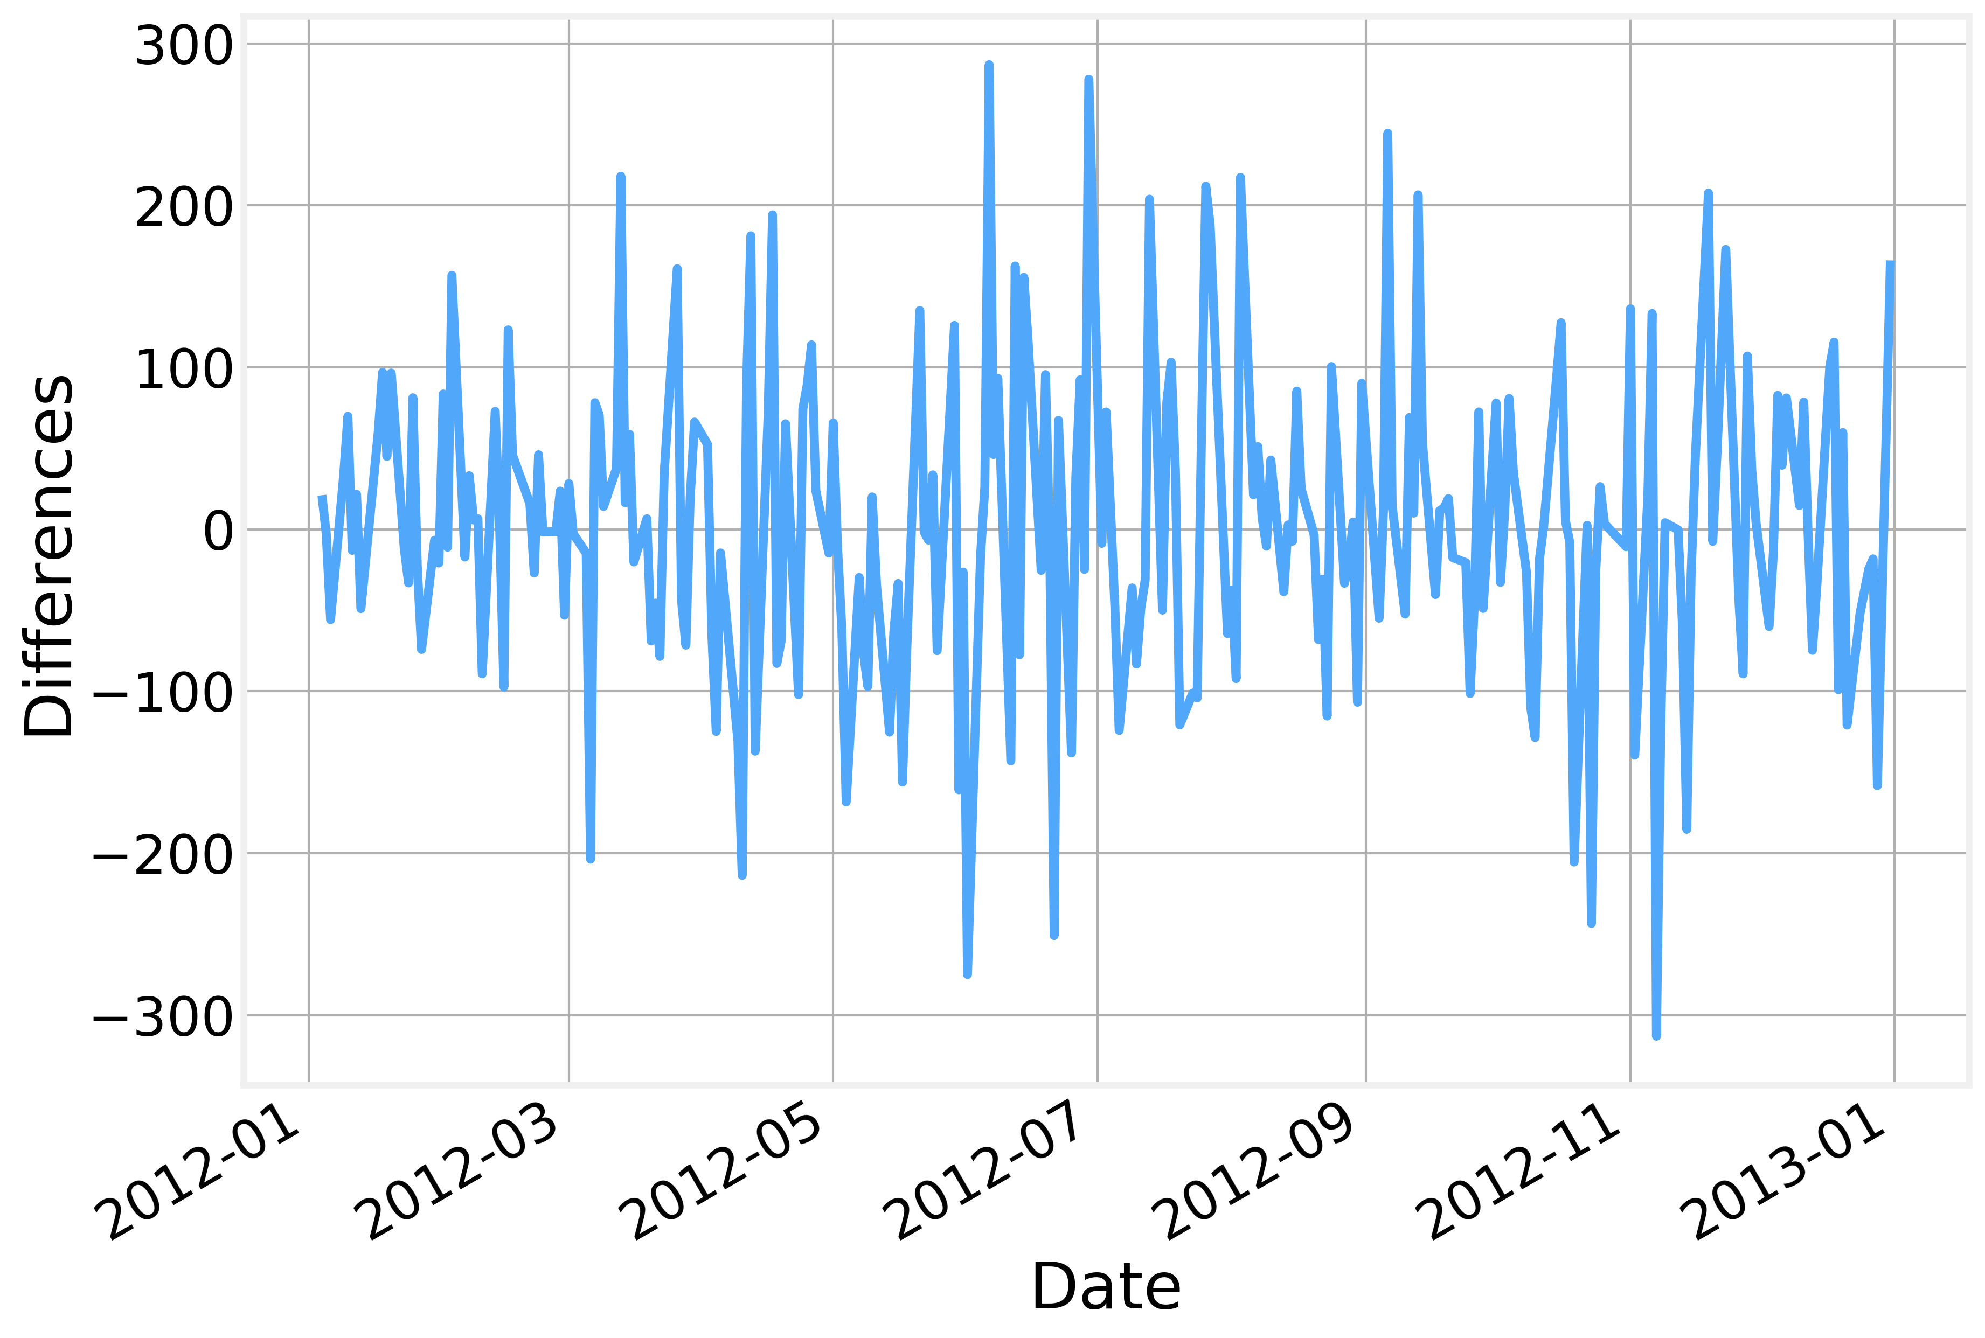
Differences

Slide 72
Windowing
When analyzing the temporal behavior of of a signal, we often need to evaluate if specific quantities are time varying or not
A common approach is to use sliding windows of a given length to evaluate the required values
So a sliding window of width $6$ on a series of length $11$ would look like:
and we would calculate the metric of interest within each window.
By using sliding windows we necessary lose some data points
$$x_{0}$$
$$x_{1}$$
$$x_{2}$$
$$x_{3}$$
$$x_{4}$$
$$x_{5}$$
$$x_{6}$$
$$x_{7}$$
$$x_{8}$$
$$x_{9}$$
$$x_{10}$$
$$x_{0}$$
$$x_{1}$$
$$x_{2}$$
$$x_{3}$$
$$x_{4}$$
$$x_{5}$$
$$x_{1}$$
$$x_{2}$$
$$x_{3}$$
$$x_{4}$$
$$x_{5}$$
$$x_{6}$$
$$x_{2}$$
$$x_{3}$$
$$x_{4}$$
$$x_{5}$$
$$x_{6}$$
$$x_{7}$$
$$=$$
$$x_{3}$$
$$x_{4}$$
$$x_{5}$$
$$x_{6}$$
$$x_{7}$$
$$x_{8}$$
$$x_{4}$$
$$x_{5}$$
$$x_{6}$$
$$x_{7}$$
$$x_{8}$$
$$x_{9}$$
$$x_{5}$$
$$x_{6}$$
$$x_{7}$$
$$x_{8}$$
$$x_{9}$$
$$x_{10}$$

Slide 73
Windowing
One common approach is to place all “lost values” at the beginning as it avoids “future leaking” when splitting the dataset
Lost values

Slide 74
Running Values
In the first part of the lecture, we already used running averages to detrend a time series
Other common metrics are:
Variance
Maximum value
Minimum value
etc…
One important detail to note is that while using windowing to calculate running values we “lose” a number of points equal to the width of the window
Depending on the application we can choose to place the missing values in either or (or even both) extremes of the time interval

Slide 75
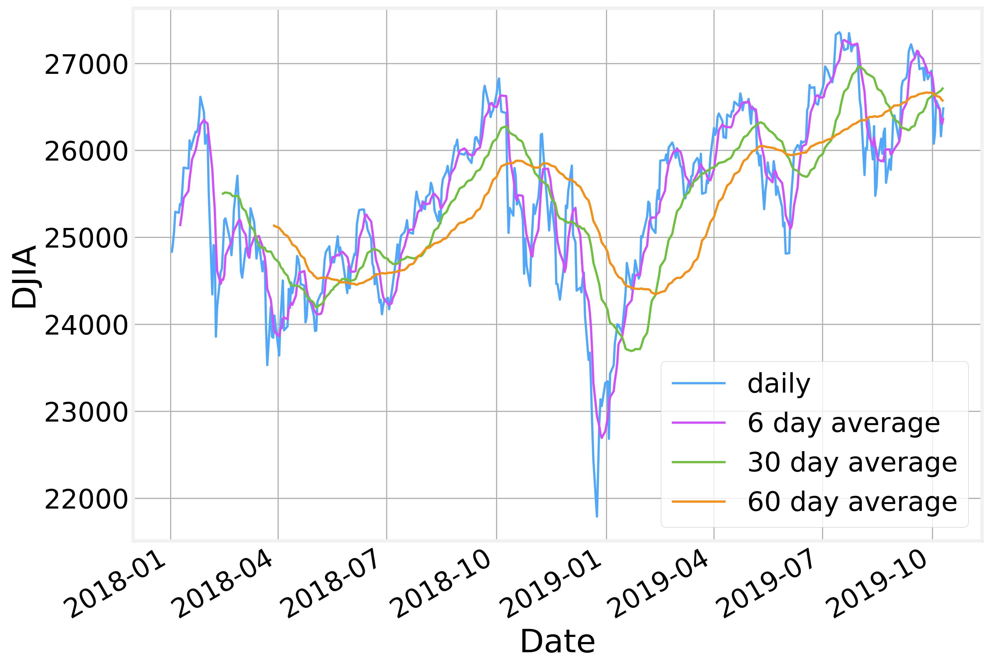
Running Values

Slide 76
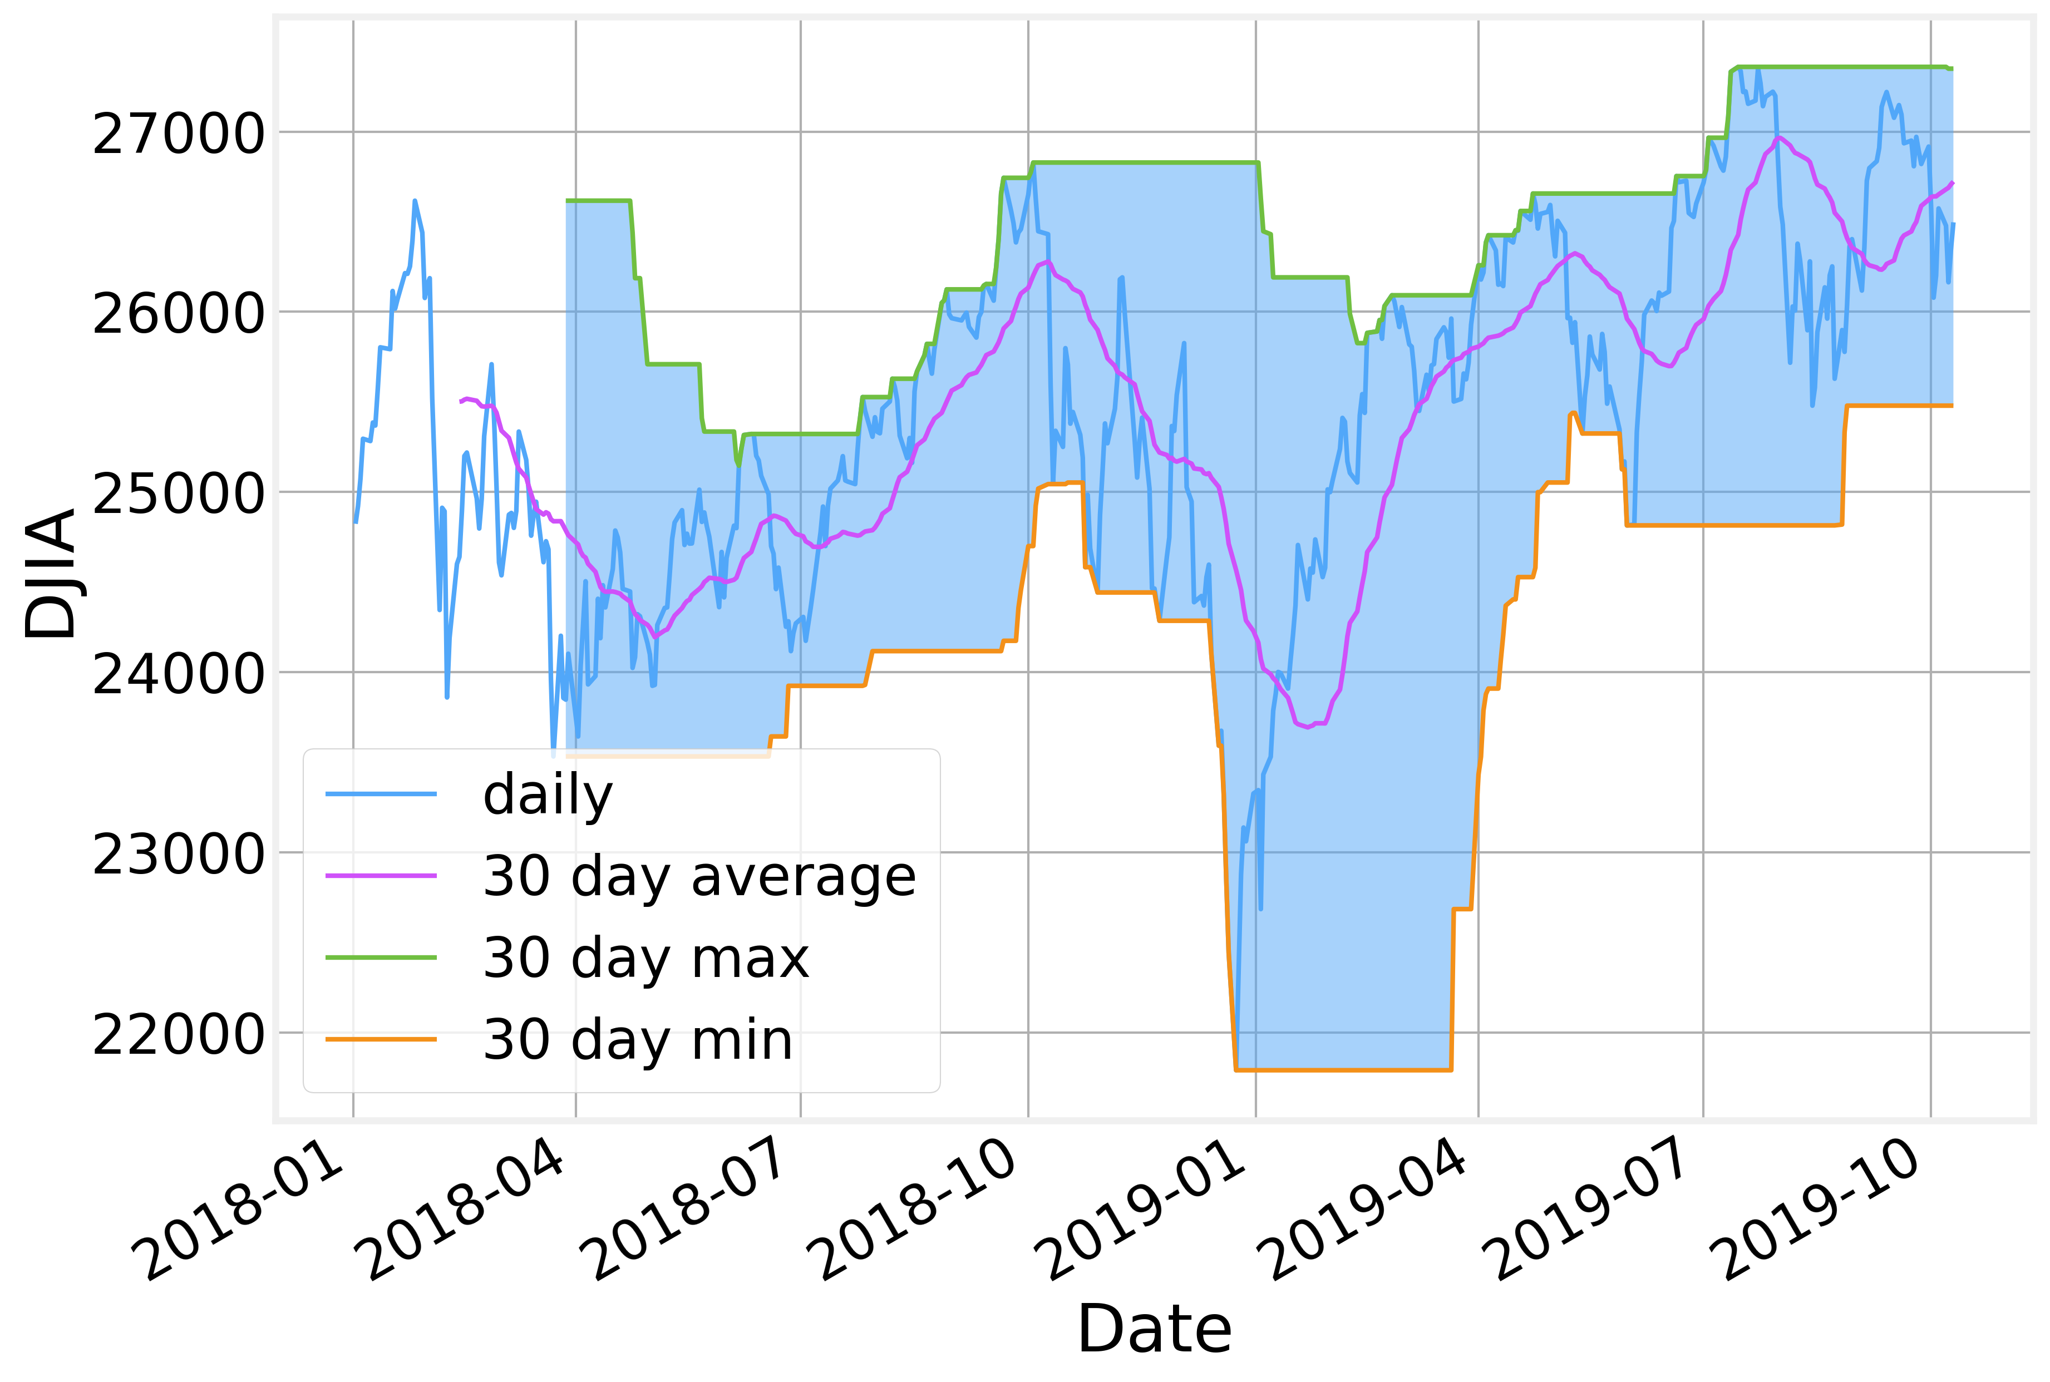
Envelopes
Envelopes help characterize the typical behavior of the series

Slide 77
Bollinger Bands
https://en.wikipedia.org/wiki/Bollinger_Bands
A common use for application for running values is the calculation of Bollinger Bands.
Introduced by John Bollinger in the 1980s as a complement to more traditional time series technical analysis techniques.
Bollinger Bands are defined by two components:
A $N$ period moving average, $μ_{N}$
The area $K$ standard deviations above and below the moving average $μ_{N}±Kσ_{N}$
Both $μ_{N}$ and $σ_{N}$ are computed on a running window of size $N$
The values of $N$ and $K$ are application specific. For stock trading, $N=20$ and $K=2$ are typical values.
Whenever the time series steps out of the Bollinger Band that’s a clear indication of a change in the temporal behavior.

Slide 78
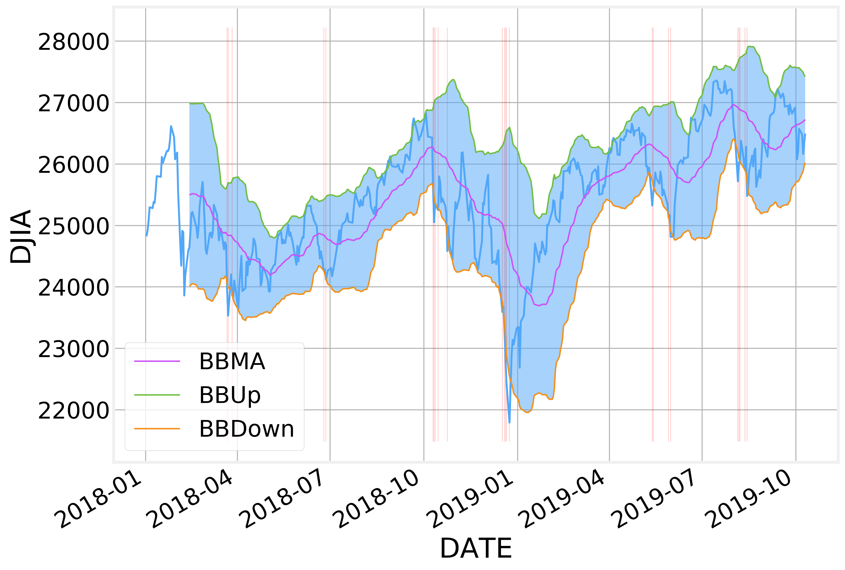
Bollinger Bands

Slide 79
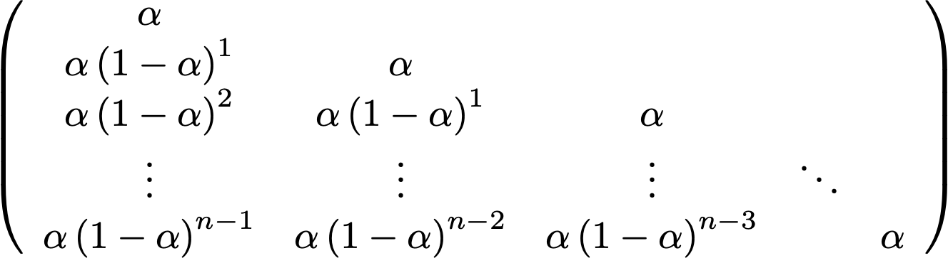
Exponential Running Average
One alternative to a simple running average is Exponential Smoothing
The exponentially“smooth” version of a time series is given by:
The smaller the value of the weight $α$, the less influence each point has on the transformed time series.
Each point depends implicitly on all previous points
$$z_{t}=αx_{t}+\left(1-α\right)z_{t-1}$$
$$x_{0}$$
$$x_{1}$$
$$x_{2}$$
$$x_{3}$$
$$x_{4}$$
$$x_{5}$$
$$x_{6}$$
$$x_{7}$$
$$x_{8}$$
$$x_{9}$$
$$x_{10}$$

Slide 80
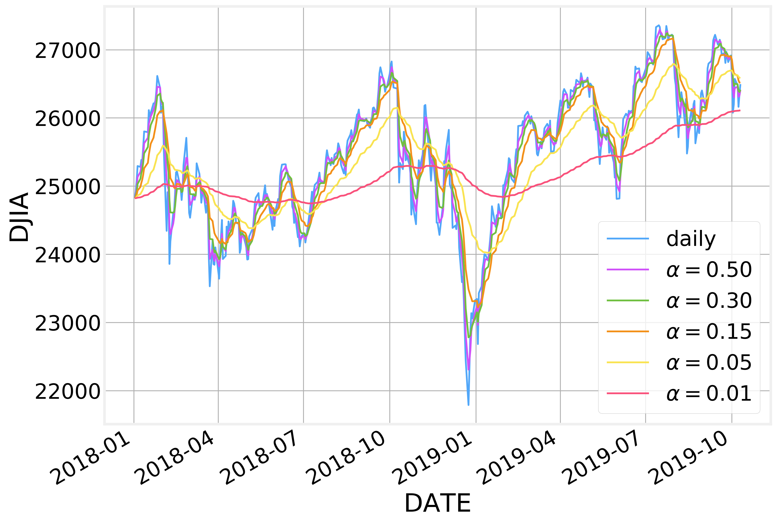
Exponential Running Average
Smaller values of $α$ result in smoother time series

Slide 81
Forecasting
We can also use the Exponential Moving Averages as a simple forecasting tool.
The value at time $t+1$ is given by:
Which we can consider to be a prediction on the value of $x_{t+1}$, based on the current value of $z_{t}$ and some faction of our current error value $x_{t}-z_{t}$:
$$z_{t+1}=αx_{t}+\left(1-α\right)z_{t}$$
$$z_{t+1}=z_{t}+α\left(x_{t}-z_{t}\right)$$

Slide 82
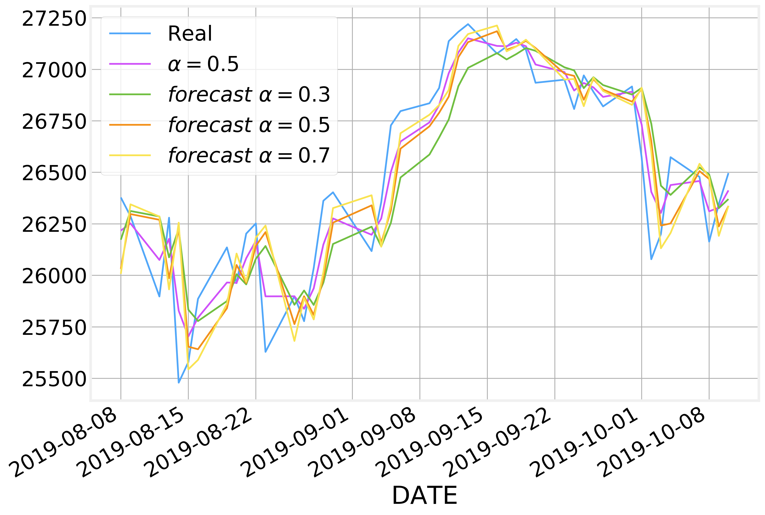
Forecasting

Slide 83
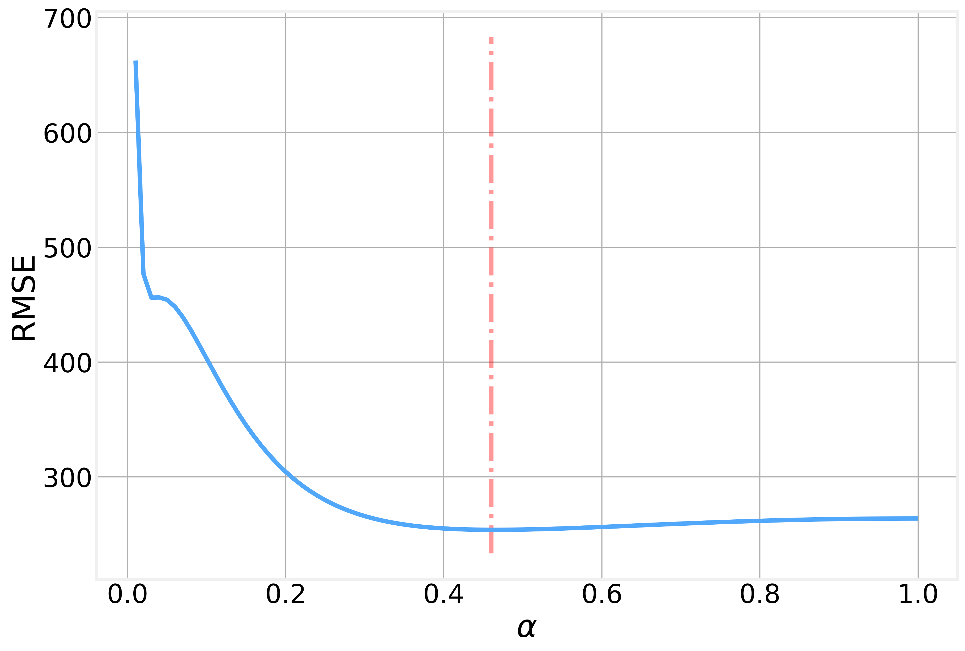
Forecasting
The optimal value of $α$ is that which minimize the prediction error

Slide 84
Data Imputation
Sometimes the time series is incomplete.
Missing data points can be due to data corruption, data collection issues, etc.
Missing values are represented as nan
Several techniques have been developed to handle this case:
back fill - keep the last previous value
forward fill - keep the next value
How can we handle missing data?
interpolate - add values by interpolating between the previous and the next value
imputation - add values based on what we expect the missing values to be

Slide 85
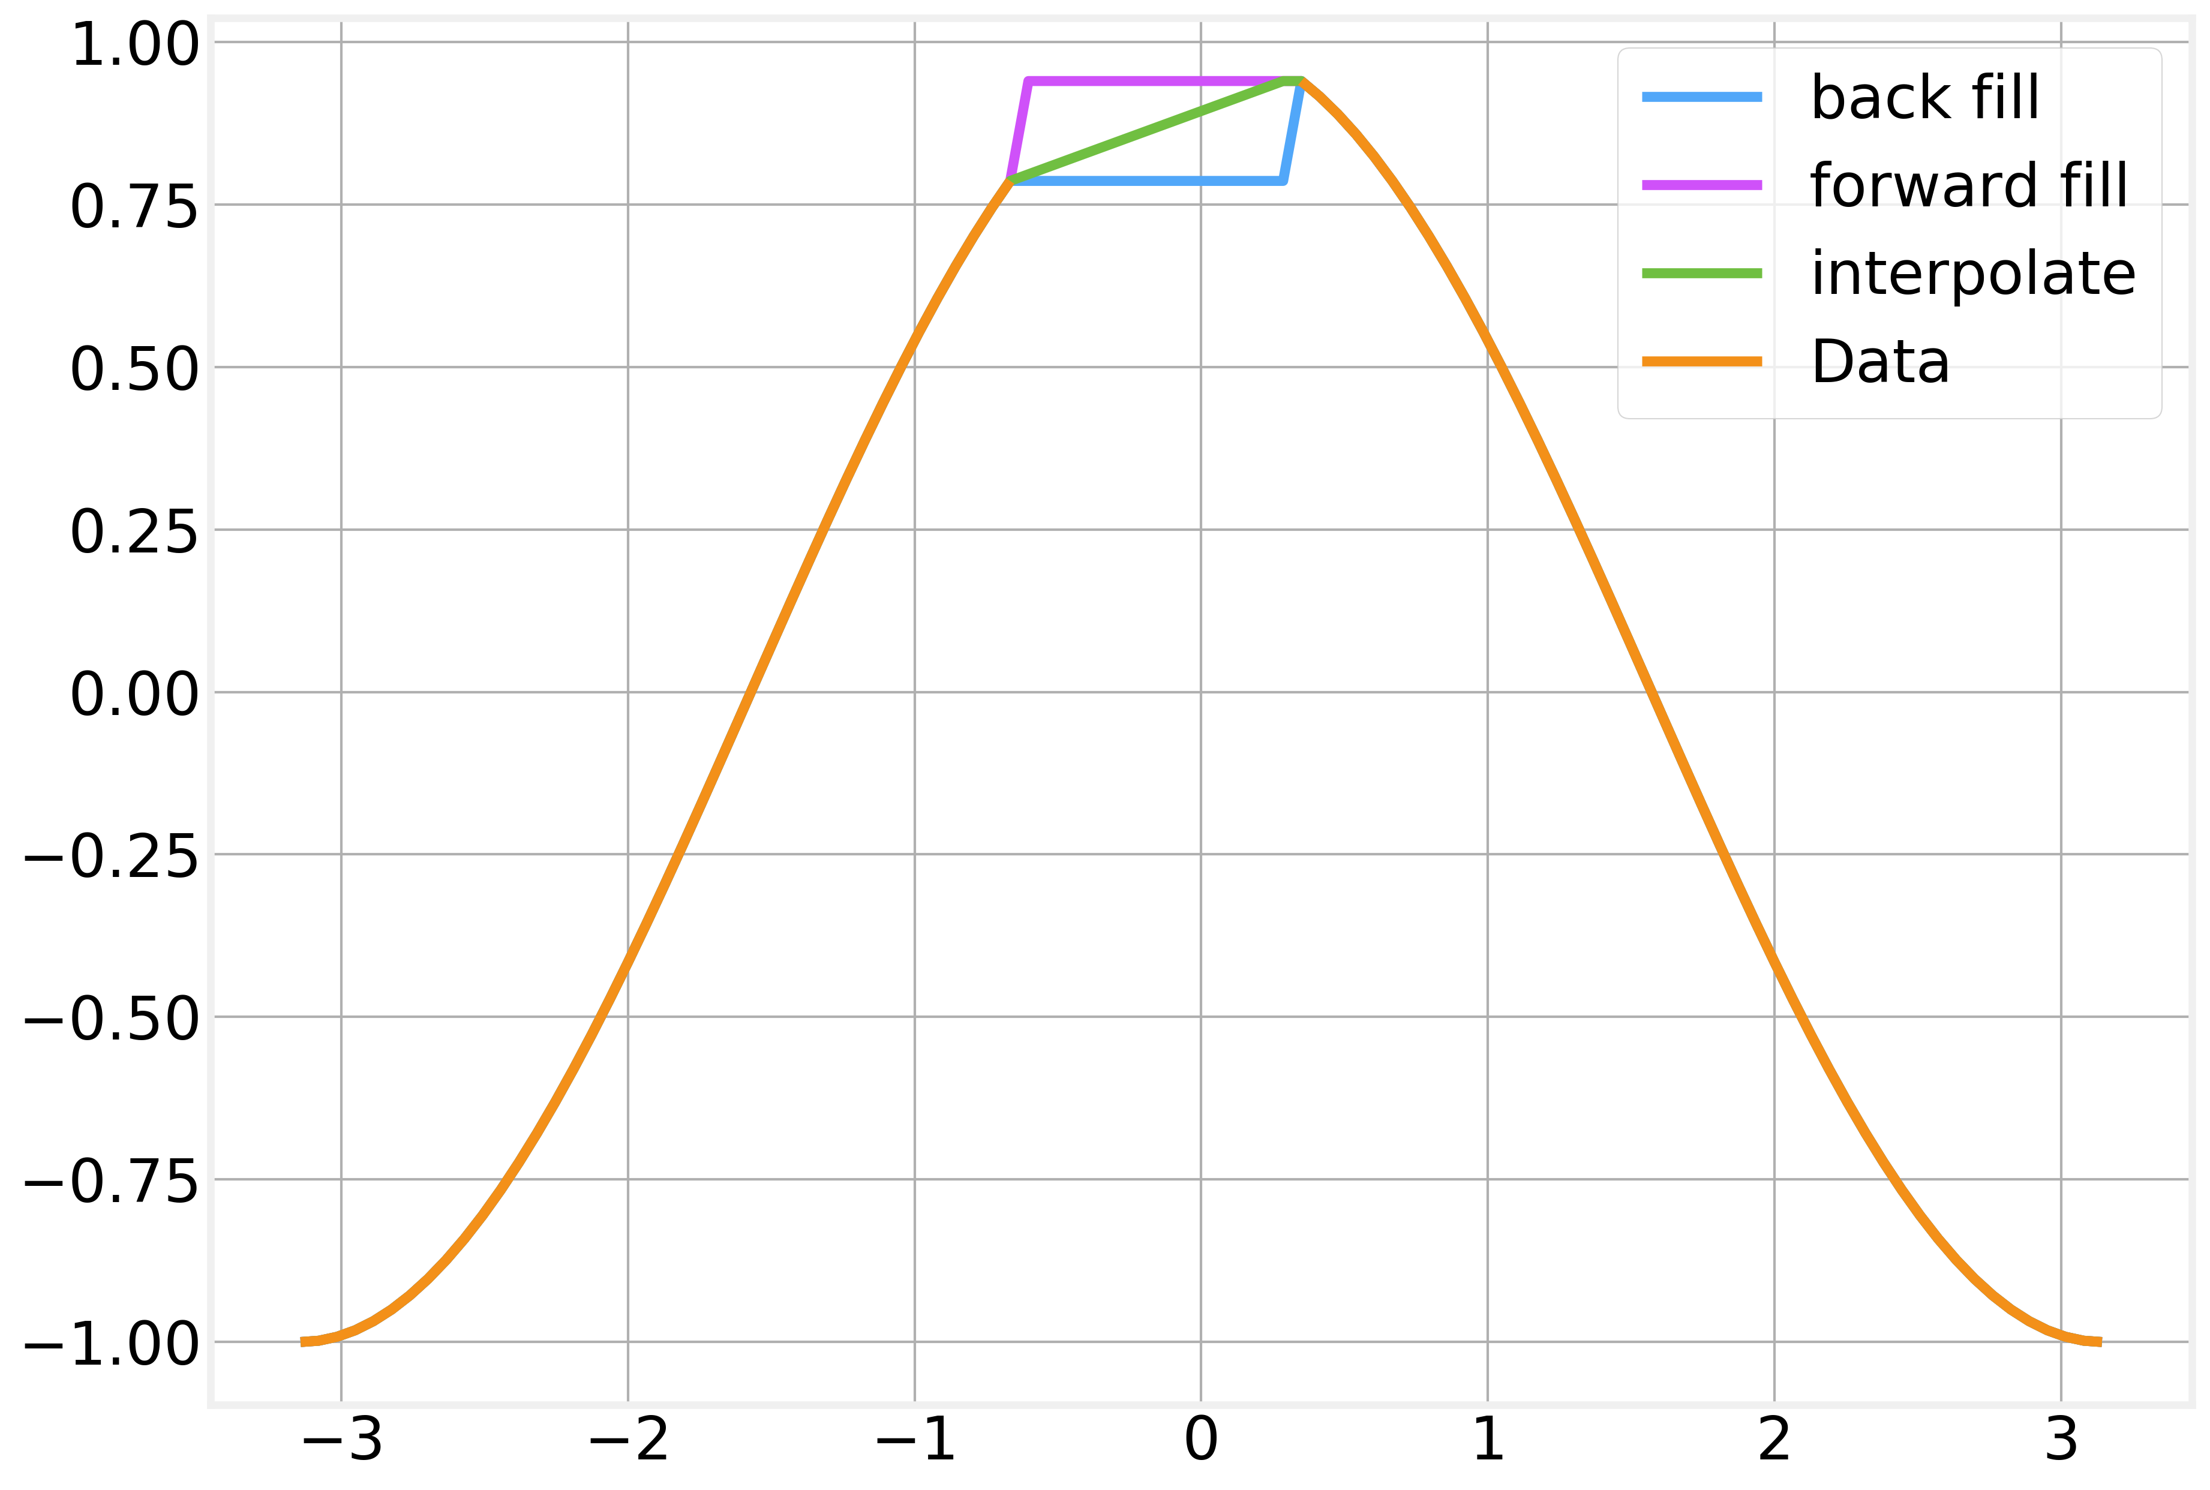
Data Imputation

Slide 86
Resampling
Time series typically have an intrinsic time scale at which the data was collected: ticks, seconds, days, months, etc
In many cases, our analysis requires that we resample the data to a different time scale
Resampling to a longer timescale is relatively simple and similar to aggregation:
Transforming from daily to weekly frequency requires simply aggregating by week
Resampling to shorter timescales requires interpolation or imputation to make up for the missing values
Going from weekly to daily frequency requires specifying how to allocate the values for each day of the week

Slide 87
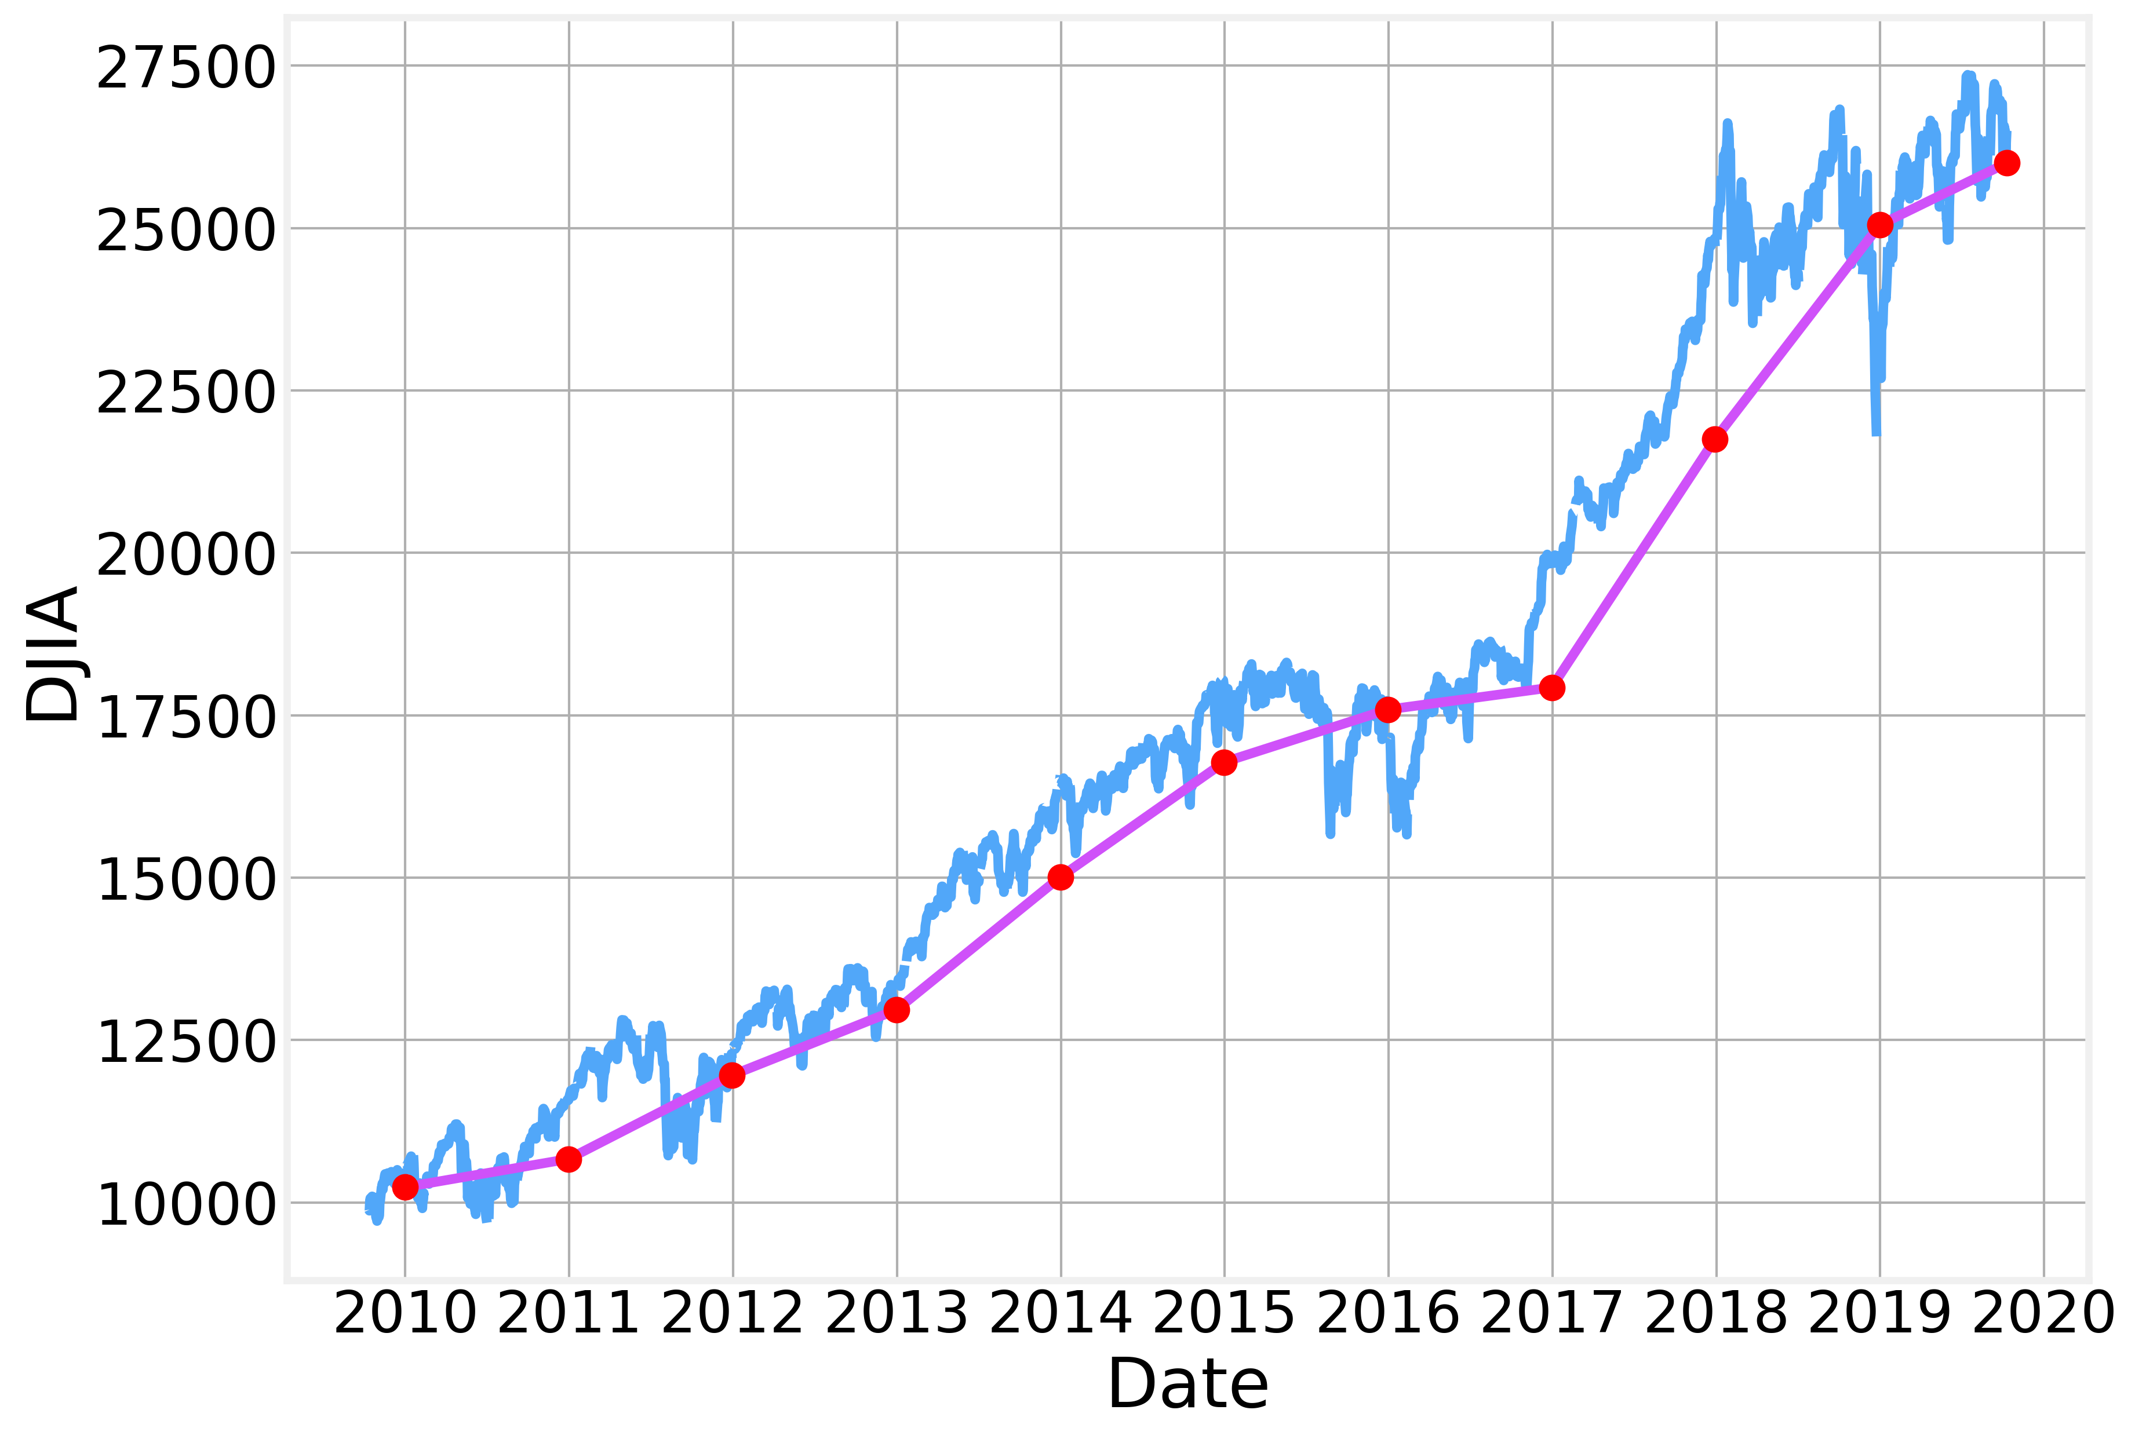
Resampling

Slide 88
Jackknife Estimation
Also known as ‘leave one out’ estimation
Commonly used for mean and variance estimates
The Jackknife estimate of a parameter is the average value of the parameter calculated by omitting each of the values one at a time.
If $μ_{i}$ is the mean calculated by omitting the $i^{th}$ value, then the Jackknife estimate of the mean is given by:
And the variance of the estimate is:
$$\overset{̂}{μ}=\frac{1}{N}\overset{N}{\underset{i=1}{∑}}μ_{i}$$
$$\overset{̂}{σ}\left(\overset{̂}{μ}\right)=\frac{N-1}{N}\overset{N}{\underset{i=1}{∑}}{\left(μ_{i}-\overset{̂}{μ}\right)}^{2}$$

Slide 89
Bootstrapping
Bootstrapping is another alternative to estimate statistical properties such as mean and variance
Bootstrapping measures the desired property in a large number of samples (with replacement), of the observed dataset.
Each sample has equal size to the observed dataset.
From the entire population of samples, the empirical bootstrap distribution of the expected values can be obtained to provide information about the distribution in the total population

Slide 90

Bootstrapping
$$μ-σ$$
$$μ$$
$$μ+σ$$

Slide 91
Code - Transformations
https://github.com/DataForScience/Timeseries_long

Slide 92
Fourier Analysis

Slide 93
Frequency Domain
So far we have focused on the natural (time based) representation of a time series.
An alternative representation is based on frequencies and was first introduced by Jean Fourier in 1807
Fourier showed that periodic functions can be decomposed as a sum of trigonometric functions
Fourier’s original result was later extended to all functions
The Discrete Fourier Transforms provides us with an simple and convenient way to move from the time-domain to the frequency-domain and back.

Slide 94

Adding Frequencies
Complex functions can be constructed by adding simple waves of the right frequencies and amplitudes

Slide 95

3D Visualization
Complex functions can be constructed by adding simple waves of the right frequencies and amplitudes

Slide 96
Spectrogram
https://en.wikipedia.org/wiki/Spectrogram

Slide 97
(Discrete) Fourier Transform
https://en.wikipedia.org/wiki/Discrete-time_Fourier_transform
The DFT maps a sequence of $N$ values $x_{n}$ representing a time series $x\left(t\right)$ into $N$ complex numbers $X_{k}$ defined as:
where:
To recover the original values we use the Inverse DFT, defined as:
The DFT represents the continuous series $x\left(t\right)$ as a sum of discrete frequencies:
$$X_{k}=\overset{N-1}{\underset{n=0}{∑}}x_{n}e^{-i\frac{2πkn}{N}}$$
$$e^{iθ}=cos\left(θ\right)+isin\left(θ\right)$$
$$x_{n}=\frac{1}{N}\overset{N-1}{\underset{k=0}{∑}}x_{k}e^{i\frac{2πkn}{N}}$$
$$ω_{n}=2π\frac{k}{N}$$

Slide 98

(Discrete) Fourier Transform
https://en.wikipedia.org/wiki/Discrete-time_Fourier_transform

Slide 99

numpy
Provides practical implementation of the Fast Fourier Transform an efficient algorithm to compute the DFT and IDFT. See https://en.wikipedia.org/wiki/Fast_Fourier_transform
numpy.fft.fft()/numpy.fft.ifft() - DFT and IFT
numpy.fft.fftfreq() - return the list of frequencies
numpy.fft.fftshift()/numpy.fft.ifftshift() - Shift the zero-frequency component to the center of the spectrum and back.

Slide 100
Filtering
Common applications of Fourier Analysis are:
Seasonality - determine the main frequency underlying a time series
Filtering - remove higher order frequencies to eliminate noise
Processing - Several signal processing operations are simpler to compute in the frequency-space
Extrapolation/Forecasting - We can also extend the reconstructed signal to future values, with a couple of small caveats…

Slide 101
Filtering

Slide 102

Filtering
Seasonality

Slide 103
Filtering

Slide 104

Filtering

Slide 105
Filtering

Slide 106

Filtering

Slide 107
Extrapolation
As we saw above, we can recover the original signal from the FFT values by using:
Where $n$ is our time variable.
There’s nothing stopping us from extending the values of $n$ beyond the original domain of the signal
The resulting extrapolated values correspond to a forecast into the future.
$$x_{n}=\frac{1}{N}\overset{N-1}{\underset{k=0}{∑}}x_{k}e^{i\frac{2πkn}{N}}$$

Slide 108

Extrapolation

Slide 109
Code - Fourier Analysis
https://github.com/DataForScience/Timeseries

Slide 110
Correlations

Slide 111

Correlation
Many correlation measures have been proposed over the years
The most well known one is the Pearson Correlation
Assumes a linear relationship between $x$ and $y$.
$$ρ\left(x,y\right)=\overset{N}{\underset{i=1}{∑}}\frac{\left(x_{i}-μ_{x}\right)\left(y_{i}-μ_{y}\right)}{σ_{x}σ_{y}}$$

Slide 112
Correlations of 2 time series
The correlation of two time series gives you an indication of how similar their behavior is
Two completely unrelated time series (say, two sequences of random numbers) will have a Pearson correlation coefficient of $0$

Slide 113

Correlations of 2 time series
The correlation of two time series gives you an indication of how similar their behavior is
Two completely unrelated time series (say, two sequences of random numbers) will have a Pearson correlation coefficient of $0$
Correlation != Causation

Slide 114
Correlations of 2 time series
The correlation of two time series gives you an indication of how similar their behavior is
Two completely unrelated time series (say, two sequences of random numbers) will have a Pearson correlation coefficient of $0$
Correlation != Causation!
Adding a trend to both series we immediately observe a significant correlation
The Pearson correlation of two trending series is overwhelmed by the trend

Slide 115
Auto-correlation
https://en.wikipedia.org/wiki/Correlogram
It follows from the previous slide that a series will have a perfect correlation with itself, but what about lagged versions of itself?
We define the Auto-correlation function as the Pearson correlation between values of the time series at different lags, as a function of the lag:
By definition, $ACF_{x}\left(0\right)≡1$
And as the lag $l$ increases the value of the $ACF$ tends to decrease.
We can calculate the confidence interval for the $ACF$ using:
where $z_{1-α/2}$ is the quantile of the normal distribution corresponding to significance level $α$ and $r_{l}$ are the values of the $ACF$ for a specific lag $l$
$$ACF_{x}\left(l\right)=ρ\left(x_{t},x_{t-l}\right)$$
$$CI=±z_{1-α/2}\sqrt{\frac{1}{N}\left(1+2\overset{k}{\underset{l=1}{∑}}r_{l}^{2}\right)}$$

Slide 116
Auto-correlation

Slide 117

Auto-correlation

Slide 118

Auto-correlation
https://en.wikipedia.org/wiki/Correlogram

Slide 119
Partial Autocorrelation
https://en.wikipedia.org/wiki/Partial_autocorrelation_function
One of the disadvantages of the Autocorrelation function is that it still considers the intermediate values
The Partial Autocorrelation function calculate the correlation function between $x_{t}$ and $x_{t-l}$ after explaining away all the intermediate values $x_{t-1}⋯x_{t-l+1}$
Intermediate values are "explained away” by fitting a linear model of the form:
And then calculating the Pearson correlation function between the values and their residuals:
Confidence intervals can be computed using the same formula used for the $ACF$
$${\overset{̂}{x}}_{t}=f\left(x_{t-1}⋯x_{t-l+1}\right)$$
$${\overset{̂}{x}}_{t-l}=f\left(x_{t-1}⋯x_{t-l+1}\right)$$
$$PACF_{x}\left(l\right)=ρ\left(x_{t}-\overset{̂}{x_{t}},x_{t-l}-{\overset{̂}{x}}_{t-l}\right)$$

Slide 120

Partial Autocorrelation
https://en.wikipedia.org/wiki/Partial_autocorrelation_function

Slide 121
Code - Correlations
https://github.com/DataForScience/Timeseries_long

Slide 122
Random Walks

Slide 123
Random Walks
Illustration by George Gamow
At each step flip a coin
Heads: Move right
Tails: Move left
If you start at position 0, do you ever reach position L?
On average, we expect the position to be always close to 0.
What if the coin is biased as in the previous example?

Slide 124
Random Walks
Mathematically, we can describe the position of our random walker at time $t$ as:
Where $ϵ_{t}$ is the stochastic value generated by our coin flip ($+1$ or $-1$)
We can further write:
which shows that the current position is just the sum across all coin flips in our walk.
Naturally, we can treat a random walk as a realization of a time series, but is it stationary?
The mean position is:
If the coin is unbiased, $⟨ϵ_{i}⟩=0$ and the mean is constant. On the other hand, the variance is:
which is not constant. So even the simple random walk is not a stationary process.
$$x_{t}=x_{t-1}+ϵ_{t}$$
$$x_{t}=x_{0}+\underset{i}{∑}ϵ_{i}$$
$$μ=⟨x_{t}⟩=⟨x_{0}⟩+\underset{i}{∑}⟨ϵ_{i}⟩$$
$$σ=σ\left(x_{t}\right)=σ\left(x_{0}\right)+\underset{i}{∑}σ\left(ϵ_{i}\right)=σ\left(x_{0}\right)+t⋅σ\left(ϵ\right)$$

Slide 125

Random Walks
Deviations from Zero can be significant because $σ\left(ϵ_{i}\right)≠0$ and $σ\left(x_{t}\right)$ grows linearly in time

Slide 126

Random Walk with a drift
With a biased coin we “drift” in one direction as $⟨ϵ_{i}⟩≠0$

Slide 127

White noise
Let's take a deep look at our stochastic variables (the outcomes of the “coin flips”)

Slide 128
Stationary vs Non-Stationary
We can also describe this process in the same mathematical framework as:
which is clearly a stationary process.
We can combine both expressions into a single one:
Where $ρ$ gives us a “knob” to interpolate between the two extremes, between a stationary and a non-stationary process.
$$x_{t}=ϵ_{i}$$
$$x_{t}=ρx_{t-1}+ϵ_{i}$$

Slide 129

Stationary vs Non-Stationary

Slide 130
Dickey-Fuller Test
The Dickey-Fuller Test is a test of stationarity inspired by a simple: Can we show that
with some degree of certainty?
Numerically, we can express this as a linear regression fit
where $γ=ρ-1$
The slope of the regression is then our expected value for $ρ-1$.
If the process is non-stationary then we expect $γ≠0$.
$$ρ≠1$$
$$x_{t}-x_{t-1}=γx_{t-1}+ϵ_{t}$$

Slide 131

Dickey-Fuller Test
From the residuals of $γ$ we compute the Dickey-Fuller statistic:
The value of this statistic is then compared with a critical values table.
$$DF=\frac{\overset{̂}{γ}}{SE\left(γ\right)}$$
In general, the more negative it is, the more certain we can be that we can reject the null hypothesis
The Dickey-Fuller Test has many variants.
The most common one is the known as the Augmented-Dickey-Fuller test and is able to account for multiple lags, trends, etc.

Slide 132
Hurst Exponent
The Hurst Exponent is another metric that allows us to determine wether or not a time series is stationary.
It measures the “speed of diffusion” defined as:
where $H$ is the Hurst exponent
$H<0.5$ - mean reverting series
$H=0.5$ - geometric random walk
$H>0.5$ - trending series
Smaller values indicate stronger levels of mean reversion, while larger values represent stronger trends
$$Var\left(τ\right)=⟨{\left|z\left(t+τ\right)-z\left(t\right)\right|}^{2}⟩∼τ^{2H}$$

Slide 133
Code - Random Walks
https://github.com/DataForScience/Timeseries

Slide 134
ARIMA Models

Slide 135
Moving Average (MA) Model
We start our exploration of the ARIMA family of models by considering the Moving Average model.
The simplest moving average model can be written as:
Which we already saw in our discussion of random walks.
A more general case can be written as:
where $β$ is a constant offset, $ω_{l}$ are the weights for the values at lag $l$ and $q$ is the moving window size. $ω_{0}≡1$.
The $ϵ_{t}$ values are stochastic variables (often referred to as “errors") rather than the actual observed values $x_{t}$
The generated $x_{t}$ is uncorrelated with itself for any lag $l>q$
$$x_{t}=ϵ_{t}$$
$$x_{t}=β+\overset{q}{\underset{l=0}{∑}}ω_{l}ϵ_{t-l}$$

Slide 136

Moving Average (MA) Model

Slide 137

Moving Average (MA) Model
The number of significant values gives us the value of $q$

Slide 138
Auto-Regressive (AR) Models
Auto-Regressive models rely on the fact that in stationary models any deviation from the mean must be compensated. The series must “revert to the mean”.
AR models can be defined as:
Where the constant $c$ represents the process’ average value and the $x_{t-l}$ are the observed values at a given lag $l$ and $ϕ_{l}$ are the corresponding weights.
$$x_{t}=α+ϵ_{t}\overset{p}{\underset{l=1}{∑}}ϕ_{l}x_{t-l}$$

Slide 139

Auto-Regressive (AR) Models

Slide 140

Auto-Regressive (AR) Models
The number of significant values gives us the value of $p$

Slide 141
Integrative (I) “model”
We already saw that we can take differences to “stationarize" the time series.
To recover the original values, we must then integrate
While not a model by itself, it is often an important first step in modeling time series

Slide 142
ARIMA model
The three classes of models we described above can be integrated into a single model:
Auto Regressive Integrated Moving Average
The complete model can be written as:
where ${\overset{̂}{x}}_{t}$ is the properly differentiated time series
$$x_{t}=c+\overset{p}{\underset{i}{∑}}ϕ_{i}x_{t-i}+ϵ_{t}$$
$$x_{t}=μ+ϵ_{t}+\overset{q}{\underset{i}{∑}}θ_{i}ϵ_{i}$$
$${\overset{̂}{x}}_{t}=c+μ+\overset{p}{\underset{i}{∑}}ϕ_{i}x_{t-i}+\overset{q}{\underset{j}{∑}}θ_{i}ϵ_{t-i}+ϵ_{t}$$

Slide 143
ARIMA model
From this simple definition we can easily recover several interesting special cases:
$ARIMA\left(0,1,0\right)$ - Random Walk (with or without drift)
$$x_{t}-x_{t-1}=c+ϵ_{t}$$
$ARIMA\left(0,0,0\right)$ - White noise (the sequence of stochastic variables)
$$x_{t}=ϵ_{t}$$
$ARIMA\left(0,1,1\right)$ - Exponential Smoothing
$$x_{t}-x_{t-1}=ϵ_{t}+θ_{1}ϵ_{t-1}$$
$ARIMA\left(0,2,2\right)$ - Double exponential Smoothing
$$x_{t}-2x_{t-1}+x_{t-2}=ϵ_{t}+θ_{1}ϵ_{t-1}+θ_{2}ϵ_{t-2}$$

Slide 144

Fitting ARIMA models
https://www.analyticsvidhya.com/blog/2015/12/complete-tutorial-time-series-modeling/
$d$ - degree of differencing
$p$ - number of lag observations included in the model ($PACF$)
$q$ - size of the moving average window ($ACF$)
The general procedure to fit an ARIMA model was originally proposal by Box-Jenkins

Slide 145
Code - ARIMA
https://github.com/DataForScience/Timeseries_long

Slide 146
Machine Learning

Slide 147



3 Types of Machine Learning
https://github.com/DataForScience/DeepLearning
Supervised Learning
Predict output given input
Training set of known inputs and outputs is provided
Unsupervised Learning
Autonomously learn an good representation of the dataset
Find clusters in input
Reinforcement Learning
Learn sequence of actions to maximize payoff
Discount factor for delayed rewards

Slide 148
3 Types of Machine Learning
https://github.com/DataForScience/DeepLearning
Supervised Learning
Predict output given input
Training set of known inputs and outputs is provided
Unsupervised Learning
Autonomously learn an good representation of the dataset
Find clusters in input
Reinforcement Learning
Learn sequence of actions to maximize payoff
Discount factor for delayed rewards

Slide 149
Supervised Learning

Slide 150
Supervised Learning - Regression
Dataset formatted as an NxM matrix of N samples and M features
Each sample corresponds to a specific value of the target variable
The goal of regression is to predict or approximate the value of a function at previously unseen points
Linear Regression
Neural Networks
Feature 1
Feature M
Feature 2
Feature 3
…
value
Sample 1
Sample 2
Sample 3
Sample 4
Sample 5
Sample 6
.
Sample N

Slide 151
Supervised Learning - Regression
Dataset formatted as an NxM matrix of N samples and M features
Each sample corresponds to a specific value of the target variable
The goal of regression is to predict or approximate the value of a function at previously unseen points
Linear Regression
Neural Networks
Feature 1
Feature M
Feature 2
Feature 3
…
value
Sample 1
Sample 2
Sample 3
Sample 4
Sample 5
Sample 6
.
Sample N
Two fundamental types of problems:
Regression (continuous output value)
Classification (discrete output value)

Slide 152
Supervised Learning - Classification
Dataset formatted as an NxM matrix of N samples and M features
Each sample belongs to a specific class or has a specific label.
The goal of classification is to predict to which class a previously unseen sample belongs to by learning defining regularities of each class
Logistic Regression
Neural Networks
Feature 1
Feature M
Feature 2
Feature 3
…
label
Sample 1
Sample 2
Sample 3
Sample 4
Sample 5
Sample 6
.
Sample N
Two fundamental types of problems:
Regression (continuous output value)
Classification (discrete output value)

Slide 153

Regression
In principle we can use simple Linear Regression to predict $x_{t+1}=f\left(x_{t}\right)$

Slide 154

Regression
In principle, we can use simple Linear Regression to predict $x_{t+1}=f\left(x_{t}\right)$

Slide 155
Code - Linear Regression
https://github.com/DataForScience/Timeseries_long

Slide 156
Deep Learning

Slide 157

How the Brain “Works” (Cartoon version)

Slide 158

How the Brain “Works” (Cartoon version)
Each neuron receives input from other neurons
10¹¹ neurons, each with with 10⁴ weights
Weights can be positive or negative
Weights adapt during the learning process
“neurons that fire together wire together” (Hebb)
Different areas perform different functions using same structure (Modularity)

Slide 159



How the Brain “Works” (Cartoon version)
Inputs
f(Inputs)
Output

Slide 160
Optimization Problem
(Machine) Learning can be thought of as an optimization problem.
Optimization Problems have 3 distinct pieces:
The constraints
The function to optimize
The optimization algorithm.
Neural Network
Prediction Error
Gradient Descent

Slide 161













Artificial Neuron
Bias
Activation function
Output
Inputs
Weights

Slide 162


Activation Function - Sigmoid
Non-Linear function
Differentiable
non-decreasing
Compute new sets of features
Each layer builds up a more abstract representation of the data
Perhaps the most common

Slide 163


Activation Function - tanh
Non-Linear function
Differentiable
non-decreasing
Compute new sets of features
Each layer builds up a more abstract representation of the data

Slide 164








Forward Propagation
The output of a perceptron is determined by a sequence of steps:
obtain the inputs
multiply the inputs by the respective weights
calculate output using the activation function
To create a multi-layer perceptron, you can simply use the output of one layer as the input to the next one.
But how can we propagate back the errors and update the weights?

Slide 165
Backward Propagation of Errors (BackProp)
BackProp operates in two phases:
Forward propagate the inputs and calculate the deltas
Update the weights
The error at the output is a weighted average difference between predicted output and the observed one.
For inner layers there is no “real output”!

Slide 166


Loss Functions
For learning to occur, we must quantify how far off we are from the desired output. There are two common ways of doing this:
Quadratic error function:
Cross Entropy
The Cross Entropy is complementary to sigmoid activation in the output layer and improves its stability.

Slide 167



Gradient Descent
Find the gradient for each training batch
Take a step downhill along the direction of the gradient
where is the step size.
Repeat until “convergence”.

Slide 168


Slide 169
Feed Forward Networks
$$h_{t}$$
Output
$$x_{t}$$
Input
$$h_{t}=f\left(x_{t}\right)$$

Slide 170

Feed Forward Networks
$$h_{t}$$
Output
Information Flow
$$x_{t}$$
Input
$$h_{t}=f\left(x_{t}\right)$$

Slide 171


Recurrent Neural Network (RNN)
$$h_{t}$$
Output
$$h_{t}$$
Output
Previous
Output
$$h_{t-1}$$
$$x_{t}$$
Input
$$h_{t}=f\left(x_{t},h_{t-1}\right)$$
$$h_{t}=f\left(x_{t}\right)$$
Information Flow

Slide 172
Recurrent Neural Network (RNN)
Each output depends (implicitly) on all previous outputs.
Input sequences generate output sequences (seq2seq)
$$h_{t-1}$$
$$h_{t}$$
$$h_{t+1}$$
$$h_{t-2}$$
$$h_{t-1}$$
$$h_{t}$$
$$h_{t+1}$$
$$x_{t-1}$$
$$x_{t}$$
$$x_{t+1}$$

Slide 173
Recurrent Neural Network (RNN)
$$h_{t}$$
$$h_{t-1}$$
$$h_{t}$$
$$tanh$$
$$x_{t}$$
$$h_{t}=tanh\left(Wh_{t-1}+Ux_{t}\right)$$
Concatenate both inputs.

Slide 174

Timeseries
Temporal sequence of data points
Consecutive points are strongly correlated
Common in statistics, signal processing, econometrics, mathematical finance, earthquake prediction, etc
Numeric (real or discrete) or symbolic data
Supervised Learning problem:
$$X_{t}=f\left(X_{t-1},⋯,X_{t-n}\right)$$

Slide 175
Code - Simple RNN
https://github.com/DataForScience/Timeseries_long

Slide 176
Long Short-Term Memory

Slide 177
Long-Short Term Memory (LSTM)
What if we want to keep explicit information about previous states (memory)?
How much information is kept, can be controlled through gates.
LSTMs were first introduced in 1997 by Hochreiter and Schmidhuber
$$h_{t-1}$$
$$h_{t}$$
$$h_{t+1}$$
$$c_{t-2}$$
$$c_{t-1}$$
$$c_{t}$$
$$c_{t+1}$$
$$h_{t-2}$$
$$h_{t-1}$$
$$h_{t}$$
$$h_{t+1}$$
$$x_{t-1}$$
$$x_{t}$$
$$x_{t+1}$$

Slide 178
Long-Short Term Memory (LSTM)
$$+$$
Element wise addition
$$×$$
Element wise multiplication
$$1-$$
1 minus the input
$$h_{t}$$
$$c_{t-1}$$
$$×$$
$$+$$
$$c_{t}$$
$$tanh$$
$$f$$
$$i$$
$$×$$
$$o$$
$$×$$
$$g$$
$$σ$$
$$σ$$
$$tanh$$
$$σ$$
$$h_{t-1}$$
$$h_{t}$$
$$x_{t}$$
$$f=σ\left(W_{f}h_{t-1}+U_{f}x_{t}\right)$$
$$g=tanh\left(W_{g}h_{t-1}+U_{g}x_{t}\right)$$
$$i=σ\left(W_{i}h_{t-1}+U_{i}x_{t}\right)$$
$$c_{t}=\left(c_{t-1}⊗f\right)+\left(g⊗i\right)$$
$$o=σ\left(W_{o}h_{t-1}+U_{o}x_{t}\right)$$
$$h_{t}=tanh\left(c_{t}\right)⊗o$$

Slide 179
Long-Short Term Memory (LSTM)
$$+$$
Element wise addition
$$×$$
Element wise multiplication
$$1-$$
1 minus the input
$$h_{t}$$
$$c_{t-1}$$
$$×$$
$$+$$
$$c_{t}$$
Forget gate: How much of the previous state should be kept?
$$tanh$$
$$f$$
$$i$$
$$×$$
$$o$$
$$×$$
$$g$$
$$σ$$
$$σ$$
$$tanh$$
$$σ$$
$$h_{t-1}$$
$$h_{t}$$
$$x_{t}$$
$$f=σ\left(W_{f}h_{t-1}+U_{f}x_{t}\right)$$
$$g=tanh\left(W_{g}h_{t-1}+U_{g}x_{t}\right)$$
$$i=σ\left(W_{i}h_{t-1}+U_{i}x_{t}\right)$$
$$c_{t}=\left(c_{t-1}⊗f\right)+\left(g⊗i\right)$$
$$o=σ\left(W_{o}h_{t-1}+U_{o}x_{t}\right)$$
$$h_{t}=tanh\left(c_{t}\right)⊗o$$

Slide 180
Long-Short Term Memory (LSTM)
$$+$$
Element wise addition
$$×$$
Element wise multiplication
$$1-$$
1 minus the input
$$h_{t}$$
$$c_{t-1}$$
$$×$$
$$+$$
$$c_{t}$$
Input gate: How much of the previous output
should be remembered?
$$tanh$$
$$f$$
$$i$$
$$×$$
$$o$$
$$×$$
$$g$$
$$σ$$
$$σ$$
$$tanh$$
$$σ$$
$$h_{t-1}$$
$$h_{t}$$
$$x_{t}$$
$$f=σ\left(W_{f}h_{t-1}+U_{f}x_{t}\right)$$
$$g=tanh\left(W_{g}h_{t-1}+U_{g}x_{t}\right)$$
$$i=σ\left(W_{i}h_{t-1}+U_{i}x_{t}\right)$$
$$c_{t}=\left(c_{t-1}⊗f\right)+\left(g⊗i\right)$$
$$o=σ\left(W_{o}h_{t-1}+U_{o}x_{t}\right)$$
$$h_{t}=tanh\left(c_{t}\right)⊗o$$

Slide 181
Long-Short Term Memory (LSTM)
$$+$$
Element wise addition
$$×$$
Element wise multiplication
$$1-$$
1 minus the input
$$h_{t}$$
$$c_{t-1}$$
$$×$$
$$+$$
$$c_{t}$$
Output gate: How much of the previous output
should contribute?
$$tanh$$
All gates use the same inputs and activation functions,
but different weights
$$f$$
$$i$$
$$×$$
$$o$$
$$×$$
$$g$$
$$σ$$
$$σ$$
$$tanh$$
$$σ$$
$$h_{t-1}$$
$$h_{t}$$
$$x_{t}$$
$$f=σ\left(W_{f}h_{t-1}+U_{f}x_{t}\right)$$
$$g=tanh\left(W_{g}h_{t-1}+U_{g}x_{t}\right)$$
$$i=σ\left(W_{i}h_{t-1}+U_{i}x_{t}\right)$$
$$c_{t}=\left(c_{t-1}⊗f\right)+\left(g⊗i\right)$$
$$o=σ\left(W_{o}h_{t-1}+U_{o}x_{t}\right)$$
$$h_{t}=tanh\left(c_{t}\right)⊗o$$

Slide 182
Long-Short Term Memory (LSTM)
$$+$$
Element wise addition
$$×$$
Element wise multiplication
$$1-$$
1 minus the input
$$h_{t}$$
$$c_{t-1}$$
$$×$$
$$+$$
$$c_{t}$$
Output gate: How much of the previous output
should contribute?
$$tanh$$
$$f$$
$$i$$
$$×$$
$$o$$
$$×$$
$$g$$
$$σ$$
$$σ$$
$$tanh$$
$$σ$$
$$h_{t-1}$$
$$h_{t}$$
$$x_{t}$$
$$f=σ\left(W_{f}h_{t-1}+U_{f}x_{t}\right)$$
$$g=tanh\left(W_{g}h_{t-1}+U_{g}x_{t}\right)$$
$$i=σ\left(W_{i}h_{t-1}+U_{i}x_{t}\right)$$
$$c_{t}=\left(c_{t-1}⊗f\right)+\left(g⊗i\right)$$
$$o=σ\left(W_{o}h_{t-1}+U_{o}x_{t}\right)$$
$$h_{t}=tanh\left(c_{t}\right)⊗o$$

Slide 183
Long-Short Term Memory (LSTM)
$$+$$
Element wise addition
$$×$$
Element wise multiplication
$$1-$$
1 minus the input
$$h_{t}$$
$$c_{t-1}$$
$$×$$
$$+$$
$$c_{t}$$
State: Update the current state
$$tanh$$
$$f$$
$$i$$
$$×$$
$$o$$
$$×$$
$$g$$
$$σ$$
$$σ$$
$$tanh$$
$$σ$$
$$h_{t-1}$$
$$h_{t}$$
$$x_{t}$$
$$f=σ\left(W_{f}h_{t-1}+U_{f}x_{t}\right)$$
$$g=tanh\left(W_{g}h_{t-1}+U_{g}x_{t}\right)$$
$$i=σ\left(W_{i}h_{t-1}+U_{i}x_{t}\right)$$
$$c_{t}=\left(c_{t-1}⊗f\right)+\left(g⊗i\right)$$
$$o=σ\left(W_{o}h_{t-1}+U_{o}x_{t}\right)$$
$$h_{t}=tanh\left(c_{t}\right)⊗o$$

Slide 184
Long-Short Term Memory (LSTM)
$$+$$
Element wise addition
$$×$$
Element wise multiplication
$$1-$$
1 minus the input
$$h_{t}$$
$$c_{t-1}$$
$$×$$
$$+$$
$$c_{t}$$
Output: Combine all available information.
$$tanh$$
$$f$$
$$i$$
$$×$$
$$o$$
$$×$$
$$g$$
$$σ$$
$$σ$$
$$tanh$$
$$σ$$
$$h_{t-1}$$
$$h_{t}$$
$$x_{t}$$
$$f=σ\left(W_{f}h_{t-1}+U_{f}x_{t}\right)$$
$$g=tanh\left(W_{g}h_{t-1}+U_{g}x_{t}\right)$$
$$i=σ\left(W_{i}h_{t-1}+U_{i}x_{t}\right)$$
$$c_{t}=\left(c_{t-1}⊗f\right)+\left(g⊗i\right)$$
$$o=σ\left(W_{o}h_{t-1}+U_{o}x_{t}\right)$$
$$h_{t}=tanh\left(c_{t}\right)⊗o$$

Slide 185
Using LSTMs
#features
$$inputs$$
$$LSTM$$
$$W_{2}$$
$$inputs$$
$$W_{1}$$
$$Neuron$$
$$inputs$$
$$W_{1}$$
$$LSTM$$
$$inputs$$
$$W_{1}$$
$$LSTM$$
$$inputs$$
$$W_{1}$$
$$LSTM$$
$$inputs$$
$$W_{1}$$
$$LSTM$$
$$inputs$$
$$W_{1}$$
$$LSTM$$
$$inputs$$
$$W_{1}$$
$$LSTM$$
$$W_{1}$$
$$LSTM$$
#LSTM cells
Sequence Length

Slide 186
Code - Simple RNN
https://github.com/DataForScience/Timeseries_long

Slide 187
Applications
Language Modeling and Prediction
Speech Recognition
Machine Translation
Part-of-Speech Tagging
Sentiment Analysis
Summarization
Time series forecasting

Slide 188
Neural Networks?
$$h_{t}$$
$$c_{t-1}$$
$$c_{t}$$
$$h_{t-1}$$
$$h_{t}$$
$$x_{t}$$

Slide 189


Or legos?
https://keras.io

Slide 190
Keras
keras.io
Open Source neural network library written in Python
TensorFlow, Microsoft Cognitive Toolkit or Theano backends
Enables fast experimentation
Created and maintained by François Chollet, a Google engineer.
Implements Layers, Objective/Loss functions, Activation functions, Optimizers, etc…

Slide 191
Keras
keras.io
keras.models.Sequential(layers=None, name=None)- is the workhorse. You use it to build a model layer by layer. Returns the object that we will use to build the model
keras.layers
Dense(units, activation=None, use_bias=True) - None means linear activation. Other options are, ’tanh’, ’sigmoid’, ’softmax’, ’relu’, etc.
Dropout(rate, seed=None)
Activation(activation) - Same as the activation option to Dense, can also be used to pass TensorFlow or Theano operations directly.
SimpleRNN(units, input_shape, activation='tanh', use_bias=True, dropout=0.0, return_sequences=False)
GRU(units, input_shape, activation='tanh', use_bias=True, dropout=0.0, return_sequences=False)
LSTM(units, input_shape, activation='tanh', use_bias=True, dropout=0.0, return_sequences=False)

Slide 192
Keras
keras.io
model = Sequential()
model.add(layer) - Add a layer to the top of the model
model.compile(optimizer, loss) - We have to compile the model before we can use it
optimizer - ‘adam’, ‘sgd’, ‘rmsprop’, etc…
loss - ‘mean_squared_error’, ‘categorical_crossentropy’, ‘kullback_leibler_divergence’, etc…
model.fit(x=None, y=None, batch_size=None, epochs=1, verbose=1, validation_split=0.0, validation_data=None, shuffle=True)
model.predict(x, batch_size=32, verbose=0) - fit/predict interface similar to sklearn.
model.summary() - Output a textual representation of the model

Slide 193
Gated Recurrent Unit (GRU)
Introduced in 2014 by K. Cho
Meant to solve the Vanishing Gradient Problem
Can be considered as a simplification of LSTMs
Similar performance to LSTM in some applications, better performance for smaller datasets.

Slide 194
Gated Recurrent Unit (GRU)
$$+$$
Element wise addition
$$×$$
Element wise multiplication
$$1-$$
1 minus the input
$$h_{t}$$
$$h_{t-1}$$
$$×$$
$$+$$
$$h_{t}$$
$$1-$$
$$r$$
$$×$$
$$×$$
$$z$$
$$c$$
$$σ$$
$$σ$$
$$tanh$$
$$x_{t}$$
$$c=tanh\left(W_{c}\left(h_{t-1}⊗r\right)+U_{c}x_{t}\right)$$
$$z=σ\left(W_{z}h_{t-1}+U_{z}x_{t}\right)$$
$$r=σ\left(W_{r}h_{t-1}+U_{r}x_{t}\right)$$
$$h_{t}=\left(z⊗c\right)+\left(\left(1-z\right)⊗h_{t-1}\right)$$

Slide 195
Gated Recurrent Unit (GRU)
$$+$$
Element wise addition
$$×$$
Element wise multiplication
$$1-$$
1 minus the input
$$h_{t}$$
$$h_{t-1}$$
$$×$$
$$+$$
$$h_{t}$$
Update gate: How much of the previous state should be kept?
$$1-$$
$$r$$
$$×$$
$$×$$
$$z$$
$$c$$
$$σ$$
$$σ$$
$$tanh$$
$$x_{t}$$
$$c=tanh\left(W_{c}\left(h_{t-1}⊗r\right)+U_{c}x_{t}\right)$$
$$z=σ\left(W_{z}h_{t-1}+U_{z}x_{t}\right)$$
$$r=σ\left(W_{r}h_{t-1}+U_{r}x_{t}\right)$$
$$h_{t}=\left(z⊗c\right)+\left(\left(1-z\right)⊗h_{t-1}\right)$$

Slide 196
Gated Recurrent Unit (GRU)
$$+$$
Element wise addition
$$×$$
Element wise multiplication
$$1-$$
1 minus the input
$$h_{t}$$
$$h_{t-1}$$
$$×$$
$$+$$
$$h_{t}$$
Reset gate: How much of the previous output should be removed?
$$1-$$
$$r$$
$$×$$
$$×$$
$$z$$
$$c$$
$$σ$$
$$σ$$
$$tanh$$
$$x_{t}$$
$$c=tanh\left(W_{c}\left(h_{t-1}⊗r\right)+U_{c}x_{t}\right)$$
$$z=σ\left(W_{z}h_{t-1}+U_{z}x_{t}\right)$$
$$r=σ\left(W_{r}h_{t-1}+U_{r}x_{t}\right)$$
$$h_{t}=\left(z⊗c\right)+\left(\left(1-z\right)⊗h_{t-1}\right)$$

Slide 197
Gated Recurrent Unit (GRU)
$$+$$
Element wise addition
$$×$$
Element wise multiplication
$$1-$$
1 minus the input
$$h_{t}$$
$$h_{t-1}$$
$$×$$
$$+$$
$$h_{t}$$
Current memory: What information do we remember right now?
$$1-$$
$$r$$
$$×$$
$$×$$
$$z$$
$$c$$
$$σ$$
$$σ$$
$$tanh$$
$$x_{t}$$
$$c=tanh\left(W_{c}\left(h_{t-1}⊗r\right)+U_{c}x_{t}\right)$$
$$z=σ\left(W_{z}h_{t-1}+U_{z}x_{t}\right)$$
$$r=σ\left(W_{r}h_{t-1}+U_{r}x_{t}\right)$$
$$h_{t}=\left(z⊗c\right)+\left(\left(1-z\right)⊗h_{t-1}\right)$$

Slide 198
Gated Recurrent Unit (GRU)
$$+$$
Element wise addition
$$×$$
Element wise multiplication
$$1-$$
1 minus the input
$$h_{t}$$
$$h_{t-1}$$
$$×$$
$$+$$
$$h_{t}$$
Output: Combine all available information.
$$1-$$
$$r$$
$$×$$
$$×$$
$$z$$
$$c$$
$$σ$$
$$σ$$
$$tanh$$
$$x_{t}$$
$$c=tanh\left(W_{c}\left(h_{t-1}⊗r\right)+U_{c}x_{t}\right)$$
$$z=σ\left(W_{z}h_{t-1}+U_{z}x_{t}\right)$$
$$r=σ\left(W_{r}h_{t-1}+U_{r}x_{t}\right)$$
$$h_{t}=\left(z⊗c\right)+\left(\left(1-z\right)⊗h_{t-1}\right)$$

Slide 199


Events
learning.oreilly.com/
www.data4sci.com/newsletter
Deep Learning For Everyone Mar 27, 2020 - 5am-9am (PST)
Time Series for Everyone
Apr 8, 2020 - 5am-9am (PST)
Applied Probability Theory for Everyone
Apr 19, 2020 - 5am-9am (PST)
Natural Language Processing (NLP) from Scratch
http://bit.ly/LiveLessonNLP - On Demand

